Slide 1
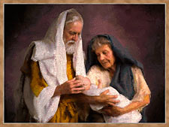

Family Life Lessons in Genesis
Class 2:
Abraham & Sarah & Lot
Trust in the Lord with all your heart, and lean not on your own understanding; In all your ways acknowledge Him, and He shall direct your paths. (Proverbs 3:5-6)

Slide 2
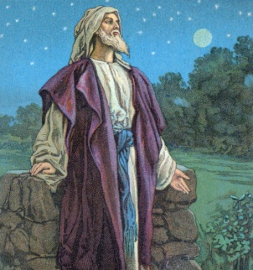
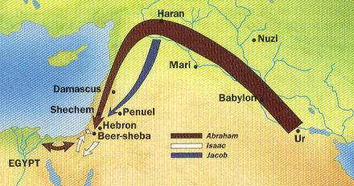
Genesis 12
1 Now the LORD had said to Abram: "Get out of your country, from your family and from your father's house, to a land that I will show you.
Abraham’s faith in action:
He separated from his larger family & only took his immediate family
There are times when we need to separate from some of the people of this world
Requires wisdom, courage, faith and prayer

Slide 3

Genesis 12:10-13
10 Now there was a famine in the land, and Abram went down to Egypt to dwell there, for the famine was severe in the land.
11 And it came to pass, when he was close to entering Egypt, that he said to Sarai his wife, "Indeed I know that you are a woman of beautiful countenance.
12 "Therefore it will happen, when the Egyptians see you, that they will say, 'This is his wife'; and they will kill me, but they will let you live.
13 "Please say you are my sister, that it may be well with me for your sake, and that I may live because of you."
In a challenging time, Abraham was kind

Slide 4
Terah’s Family

Slide 5

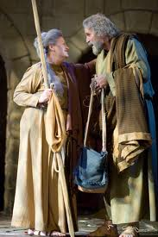
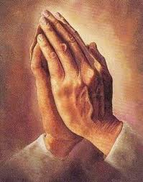
Abram & Sarah work together
Show kindness to each other:
  “please” (NKJV & NASB) [12:13; 16:2]
1 Peter 3:7 (RSV)
7 Likewise you husbands, live considerately with your wives, bestowing honor on the woman as the weaker sex, since you are joint heirs of the grace of life, in order that your prayers may not be hindered.

Slide 6
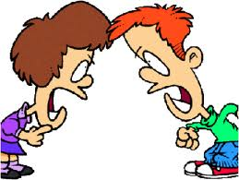
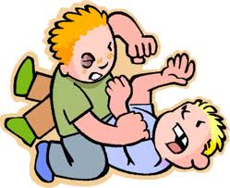
Genesis 13:2-8
Resolving Strife:
2 Abram was very rich in livestock, in silver, and in gold.
5 Lot also, who went with Abram, had flocks and herds and tents.
6 Now the land was not able to support them, that they might dwell together, for their possessions were so great that they could not dwell together.
7 And there was strife between the herdsmen of Abram's livestock and the herdsmen of Lot's livestock. The Canaanites and the Perizzites then dwelt in the land.
8 So Abram said to Lot, "Please let there be no strife between you and me, and between my herdsmen and your herdsmen; for we are brethren.
Blessed are the peacemakers, for they will be called Sons of God (Mat 5:9)

Slide 7

Every family, ecclesia & CYC needs some!

Slide 8
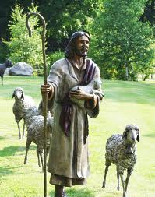
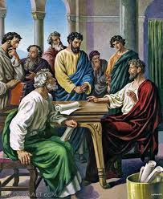
Leadership Responsibilities for
Parents and Ecclesial Leaders
Must discuss big issues and then make decisions that will be best for the family or ecclesia
Pray: Ask for God’s direction and blessing
Commit to finding a solution so the children and sheep will not be lost
Solution doesn’t have to be equal – find a compromise! It’s better to have a peaceful solution, but can’t compromise God’s truth!

Slide 9
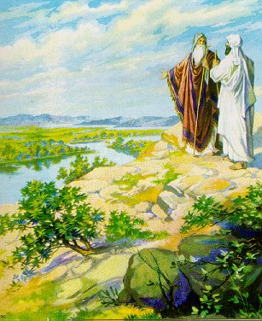
Making Choices
Genesis 13:10-11
10 And Lot lifted his eyes and saw all the plain of Jordan, that it was well watered everywhere (before the LORD destroyed Sodom and Gomorrah) like the garden of the LORD, like the land of Egypt as you go toward Zoar.
11 Then Lot chose for himself all the plain of Jordan, and Lot journeyed east. And they separated from each other.
Lot failed to choose for the long term good of his family!
Choices need to be made in prayer. Keep the spiritual welfare of everyone in mind. Think about the future. Pray for God’s blessing.

Slide 10
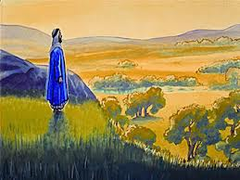
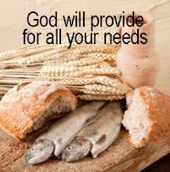
Abraham’s faith
Genesis 13:14-15
14 And the LORD said to Abram, after Lot had separated from him: "Lift your eyes now and look from the place where you are-- northward, southward, eastward, and westward;
15 "for all the land which you see I give to you and your descendants forever.
Abraham knew God would provide. Faith sees beyond the present. God will provide for you too!

Slide 11
Hebrews 11:1-2, 6
The Power of Faith
1 Now faith is the substance of things hoped for, the evidence of things not seen.
2 For by it the elders obtained a good testimony.
6 But without faith it is impossible to please Him, for he who comes to God must believe that He is, and that He is a rewarder of those who diligently seek Him.
Faith allows us to make hard choices for the future & accept what God brings into our lives – because we need it. Let others choose first: at home, at work, in the ecclesia. Faith empowers us to accept what God gives us. Faith believes God gives each of us what we need to be in His family

Slide 12


Genesis 14:1-3
1 And it came to pass in the days of Amraphel king of Shinar, Arioch king of Ellasar, Chedorlaomer king of Elam, and Tidal king of nations,
2 that they made war with Bera king of Sodom, Birsha king of Gomorrah, Shinab king of Admah, Shemeber king of Zeboiim, and the king of Bela (that is, Zoar).
3 All these joined together in the Valley of Siddim (that is, the Salt Sea).
God gave Lot a warning! Get out of Sodom! We need to learn to read the signs of life.
Abraham immediately set out to rescue Lot (at night). No hesitation! No “I warned you” or “I told you so!” or “Lot got what he deserved!”
Your Spiritual Life is in danger!
This was faith and love in action!

Slide 13

1 Corinthians 13:4-7 (RSV)
Abraham was motivated by Love
4 Love is patient and kind; love is not jealous or boastful;
5 it is not arrogant or rude. Love does not insist on its own way; it is not irritable or resentful;
6 it does not rejoice at wrong, but rejoices in the right.
7 Love bears all things, believes all things, hopes all things, endures all things.
Love is not an academic research topic! It is part of God’s character that must be revealed in us. “We know love because He first loved us” (1 Jn 4:19)

Slide 14
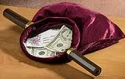

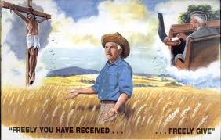
Abraham paid Tithes
Genesis 14:16-24
16 So he brought back all the goods, and also brought back his brother Lot and his goods, as well as the women and the people.
18 Then Melchizedek king of Salem brought out bread and wine; he was the priest of God Most High.
19 And he blessed him and said: "Blessed be Abram of God Most High, Possessor of heaven and earth;
20 And blessed be God Most High, who has delivered your enemies into your hand." And he gave him a tithe of all.
Tithes should not be exacted, because they represent our appreciation to God for all He has done for us. We need to decide in advance, or we might just give very little on the spot.
For God loves a cheerful giver (2 Cor 9:7)

Slide 15
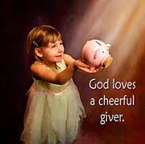
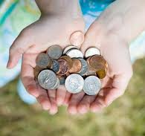
Giving Back to God
God loves a cheerful giver!
Genesis 28:20-22
20 Then Jacob made a vow, saying, "If God will be with me, and keep me in this way that I am going, and give me bread to eat and clothing to put on,
21 "so that I come back to my father's house in peace, then the LORD shall be my God.
22 "And this stone which I have set as a pillar shall be God's house, and of all that You give me I will surely give a tenth to You."
1 Corinthians 16:2
2 On the first day of the week let each one of you lay something aside, storing up as he may prosper, that there be no collections when I come.
Under the Law: 10% off the top + gifts of kindness + voluntary offerings. Opportunity to help the poor.
We can give more than we think. Involves changes to our lifestyle. Best to start when we are young!

Slide 16
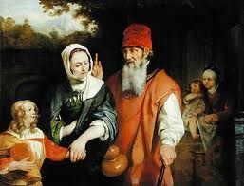
Genesis 16:1-4
Sarah’s Plan
1 Now Sarai, Abram's wife, had borne him no children. And she had an Egyptian maidservant whose name was Hagar.
2 So Sarai said to Abram, "See now, the LORD has restrained me from bearing children. Please, go in to my maid; perhaps I shall obtain children by her." And Abram heeded the voice of Sarai.
3 Then Sarai, Abram's wife, took Hagar her maid, the Egyptian, and gave her to her husband Abram to be his wife, after Abram had dwelt ten years in the land of Canaan.
4 So he went in to Hagar, and she conceived. And when she saw that she had conceived, her mistress became despised in her eyes.
Both Abraham & Sarah agreed on the plan. Sarah had a good motive (offspring to fulfill the promises), but it backfired! Note how Abraham & Sarah worked it out!

Slide 17
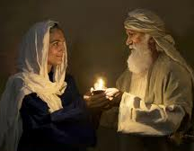
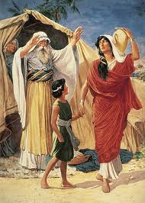
Abraham & Sarah work it out together
Genesis 16:5-6
5 Then Sarai said to Abram, "My wrong be upon you! I gave my maid into your embrace; and when she saw that she had conceived, I became despised in her eyes. The LORD judge between you and me."
6 So Abram said to Sarai, "Indeed your maid is in your hand; do to her as you please." And when Sarai dealt harshly with her, she fled from her presence.
Great opportunity for Abraham to blame Sarah! Abraham doesn’t demand his “right way to handle it”. He allows Sarah to deal with Hagar as she pleases. Lets Sarah work it out and accepts her solution.

Slide 18


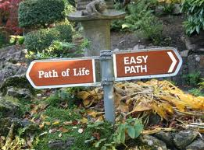
Choices when things go bad:
1) Point our finger and blame.
Criticize: “I told you so”,
refuse to talk, but talk a lot to others
2) Accept mistakes, respond in love, Be supportive in finding a solution
James 3:2 (RSV)
“for we all make many mistakes”
Mistakes are an opportunity for us to extend kindness and compassion. Someone else may have made a mistake, but God is watching to see how we will respond! Don’t sit around and condemn – get involved to help!

Slide 19




Forgiveness isn’t something you do for others, you do it so you can get well and move forward
S

Slide 20
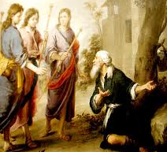
Genesis 18
The Angels visit
1 Then the LORD appeared to him by the terebinth trees of Mamre, as he was sitting in the tent door in the heat of the day.
2 So he lifted his eyes and looked, and behold, three men were standing by him; and when he saw them, he ran from the tent door to meet them, and bowed himself to the ground,
3 and said, "My Lord, if I have now found favor in Your sight, do not pass on by Your servant.
4 "Please let a little water be brought, and wash your feet, and rest yourselves under the tree.
5 "And I will bring a morsel of bread, that you may refresh your hearts. After that you may pass by, inasmuch as you have come to your servant." They said, "Do as you have said."
Continued…

Slide 21
Genesis 18
The Angels visit
6 So Abraham hurried into the tent to Sarah and said, "Quickly, make ready three measures of fine meal; knead it and make cakes."
7 And Abraham ran to the herd, took a tender and good calf, gave it to a young man, and he hastened to prepare it.
8 So he took butter and milk and the calf which he had prepared, and set it before them; and he stood by them under the tree as they ate.
Note the teamwork of Abraham & Sarah. Both support each other
Continued…

Slide 22
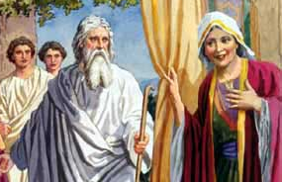
Genesis 18:10-12
The Faith of Abraham & Sarah
10 And He said, "I will certainly return to you according to the time of life, and behold, Sarah your wife shall have a son." (Sarah was listening in the tent door which was behind him.)
11 Now Abraham and Sarah were old, well advanced in age; and Sarah had passed the age of childbearing.
12 Therefore Sarah laughed within herself, saying, "After I have grown old, shall I have pleasure, my lord being old also?"
Abraham took the spiritual lead. He did not weaken in faith, and he was fully convinced that God was able to do what He had promised (Rom 4:19-21)

Slide 23
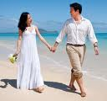
1 Peter 3:1-7
1 Wives, likewise, be submissive to your own husbands, that even if some do not obey the word, they, without a word, may be won by the conduct of their wives,
2 when they observe your chaste conduct accompanied by fear.
3 Do not let your adornment be merely outward-- arranging the hair, wearing gold, or putting on fine apparel--
4 rather let it be the hidden person of the heart, with the incorruptible beauty of a gentle and quiet spirit, which is very precious in the sight of God.
God knows how to make relationships work! Trust Him!
Continued…

Slide 24
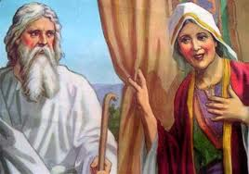
1 Peter 3:1-7
5 For in this manner, in former times, the holy women who trusted in God also adorned themselves, being submissive to their own husbands,
6 as Sarah obeyed Abraham, calling him lord, whose daughters you are if you do good and are not afraid with any terror.
7 Husbands, likewise, dwell with them with understanding, giving honor to the wife, as to the weaker vessel, and as being heirs together of the grace of life, that your prayers may not be hindered.
Sarah’s relationship with Abraham is an example to follow. She thought of him as her “lord” – not just some lip service. Bad relationships hinders our prayers!

Slide 25
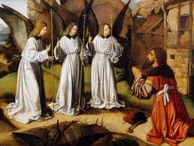
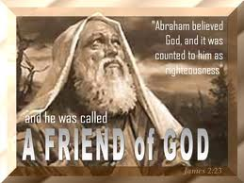
Abraham, the Friend of God
Genesis 18:17-19
17 And the LORD said, "Shall I hide from Abraham what I am doing,
18 "since Abraham shall surely become a great and mighty nation, and all the nations of the earth shall be blessed in him?
19 "For I have known him, in order that he may command his children and his household after him, that they keep the way of the LORD, to do righteousness and justice, that the LORD may bring to Abraham what He has spoken to him."
Abraham was “the friend of God” (Jm 2:23). True friends let each other know what they are doing and don’t hide their plans.
"No longer do I call you servants, for a servant does not know what his master is doing; but I have called you friends, for all things that I heard from My Father I have made known to you. (John 15:15)

Slide 26

Lessons from Abraham & Sarah
Try to work as a team
Live by faith – it will influence all our decisions and attitudes
Do the right thing, regardless of past events
Become a generous financial contributor
God reads our thoughts on how we think about each other
Accept mistakes…learn from them…help each other through them

Slide 27
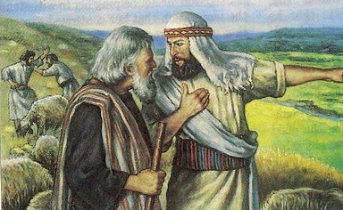
Lot’s bad Choices & God’s Mercy
13:12 Pitched his tent as far as Sodom
14:12 dwelt in Sodom
19:1 sitting in the gate of Sodom
Probably had a large group originally
13:7 herdsmen quarreled with Abraham’s
14:14 Abram had over 318 trained servants born in his house
18:24 Suppose there were 50 righteous
Lot knew the right way to go, but he lacked the foresight to see what his bad choices would cost!

Slide 28
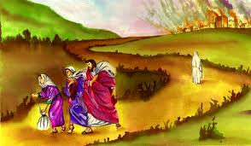

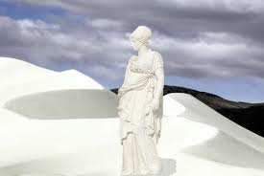
Consequences of Lot’s bad Choices: Genesis 19
All that’s left is:
  Lot & his wife
  2 virgin daughters
  2 Sons-in-law (were to marry)
Too late to influence his family (v.14)
God shows Lot mercy (Vs 15-16)
Lot’s wife looks back (v.26)
Due to poor choices and bad planning, only Lot & his 2 daughters made it out of Sodom!

Slide 29

Genesis 19:29
Pray for your Families!
29 And it came to pass, when God destroyed the cities of the plain, that God remembered Abraham, and sent Lot out of the midst of the overthrow, when He overthrew the cities in which Lot had dwelt.
God does respond to prayers for the families of His saints. Job prayed for his family too (Job 1:5)

Slide 30
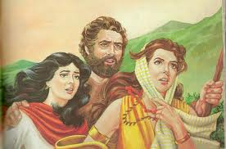
More bad choices for Lot
Genesis 19:30
30 Then Lot went up out of Zoar and dwelt in the mountains, and his two daughters were with him; for he was afraid to dwell in Zoar. And he and his two daughters dwelt in a cave.
Lot should have returned to Abraham
  Hard to admit bad choices to others – but it is very effective! (Naomi when she returned)
  Make it easy for people to return!!!
Lot chooses to hide in a cave – away from all influences – another bad choice
  Ends up fathering 2 children by his daughters

Slide 31
Points worth noting:
About half of high-schoolers drink illegally
How much you drink at one time matters
Binge drinkers more likely to lose inhibitions

Slide 32
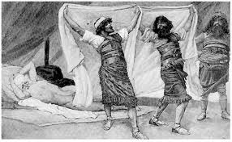
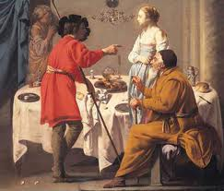
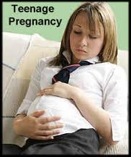
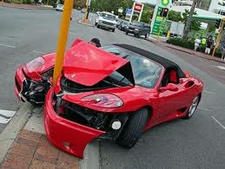
Alcohol in Genesis
It clouds judgment & removes inhibitions
Gen 9:21 Noah became drunk and Ham came in his tent
Gen 19:33 Lot’s daughters got him drunk and he fathered children by them
Gen 29:22 Probably involved in Jacob not realizing that he had gone in to Leah
God can forgive us of our mistakes, but we still live with the consequences of our actions when our judgment is clouded by alcohol

Slide 33


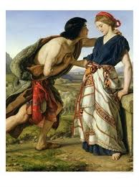
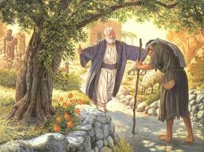
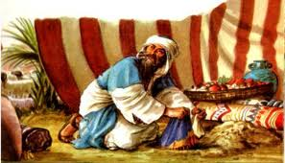
Consequences of Lot’s bad choices
1) Lost his wife, most of his household
2) Lost his home and possessions
3) Lost touch with Abraham (the ecclesia)
4) Became depressed and wanted isolation
5) Impregnated his own two daughters
Dinah & Shechem
Prodigal Son
Achan

Slide 34

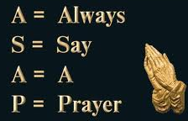
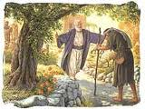
It’s hard to make Good Choices
Must overcome our embarrassment & pride – (like prodigal son)
  Like Naomi returning home (Ruth 1)
May need to pull out of depression, discouragement and despair from other bad choices
Turn to God – pray for His help!
Turn to your ecclesia – Ask for help!
True children in God’s family rejoice when struggling family members return. They are helpful, supportive and understanding. This is their opportunity to show God’s love!

Slide 35

Help your friends make good choices!

Slide 36
Contrast Lot’s Wife & Sarah:
Genesis 19 and 20
Righteous men with totally different wives
Lot’s wife: hanging on to Sodom, dragging the family down with her
Sarah: willing to put her life on the line to save her husband
He who finds a wife finds a good thing,
And obtains favor from the Lord. (Proverbs 18:22)

Slide 37
Family-Life Lessons from Lot
Learn to think long-term - not quick, easy decisions
Watch and learn from the events of our lives. God does talk to us through experiences and warn us.
If things go bad….get back involved in the ecclesia
Spiritual influence on our family must happen now!
God is merciful….but there is a limit
Bad spiritual decisions can cost us our Family!
If we don’t actively seek spiritual friendships… we slowly migrate away from the family of God

Slide 38
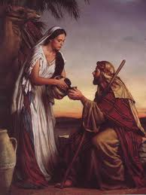
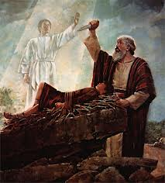
Next Class
We’ll look at lessons from the lives of Isaac & Rebekah

