Slide 1
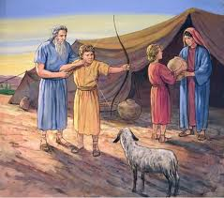

Family Life Lessons in Genesis
Class 3:
Isaac & Rebekah
Trust in the Lord with all your heart, and lean not on your own understanding; In all your ways acknowledge Him, and He shall direct your paths. (Proverbs 3:5-6)

Slide 2

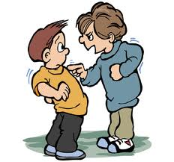

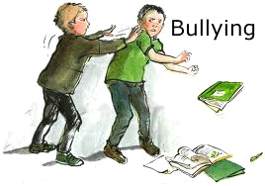
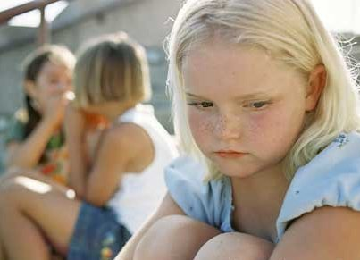
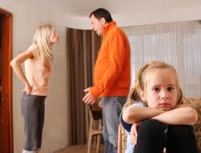
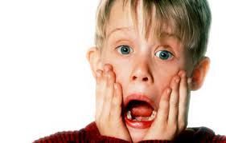
Isaac had a rough beginning!
Maybe you have too!

Slide 3

Genesis 21:8-10
Childhood Persecution
8 So the child grew and was weaned. And Abraham made a great feast on the same day that Isaac was weaned.
9 And Sarah saw the son of Hagar the Egyptian, whom she had borne to Abraham, scoffing.
10 Therefore she said to Abraham, "Cast out this bondwoman and her son; for the son of this bondwoman shall not be heir with my son, namely with Isaac."
Ishmael probably made fun of Isaac all along as son of “old woman & old man”.

Slide 4
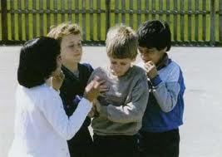
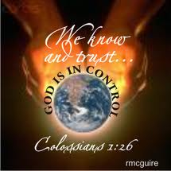
Persecution can have Positive Results:
Depends on our attitude
Reminds us we are not in control
Forces us to consider what really is important
Teaches us to rely on God
Develops faith when we trust God knows what He is doing & will bring good out of bad situations
And we know that God causes all things to work together for good to those who love God, to those who are called according to His purpose.(Rom 8:28 NASB)

Slide 5
Hebrews 12:5-7, 11
5 And you have forgotten the exhortation which speaks to you as to sons: "My son, do not despise the chastening of the Lord, nor be discouraged when you are rebuked by Him;
6 For whom the Lord loves He chastens, and scourges every son whom He receives."
7 If you endure chastening, God deals with you as with sons; for what son is there whom a father does not chasten?
11 Now no chastening seems to be joyful for the present, but painful; nevertheless, afterward it yields the peaceable fruit of righteousness to those who have been trained by it.
God uses chastening like our Parents did, for our good, that we might share His holiness

Slide 6
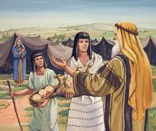
Abraham & Sarah worked together
Sarah wants Hagar & Ishmael out
Abraham is distressed
God assures Abraham
Abraham does what Sarah wants
Galatians 4:28-30
28 Now we, brethren, as Isaac was, are children of promise.
29 But, as he who was born according to the flesh then persecuted him who was born according to the Spirit, even so it is now.
30 Nevertheless what does the Scripture say? "Cast out the bondwoman and her son, for the son of the bondwoman shall not be heir with the son of the freewoman."

Slide 7
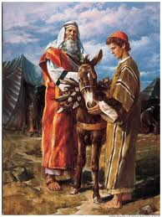
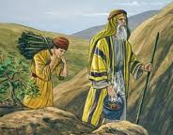
Genesis 22 - Obedience
1 Now it came to pass after these things that God tested Abraham, and said to him, "Abraham!" And he said, "Here I am."
2 And He said, "Take now your son, your only son Isaac, whom you love, and go to the land of Moriah, and offer him there as a burnt offering on one of the mountains of which I shall tell you."
3 So Abraham rose early in the morning and saddled his donkey, and took two of his young men with him, and Isaac his son; and he split the wood for the burnt offering, and arose and went to the place of which God had told him.
Abraham was obedient to his Heavenly Father, and Isaac followed with his obedience to his Father.

Slide 8
Ephesians 6:1-3
1 Children, obey your parents in the Lord, for this is right.
2 "Honor your father and mother," which is the first commandment with promise:
3 "that it may be well with you and you may live long on the earth.”
Obedience to Parents is the basis later for obedience to God
Applies to our parents’ guidance on friendships, school, Bible readings, dating, college, etc.

Slide 9
1 Samuel 15:22-23
Obedience - Parents
22 Then Samuel said: "Has the LORD as great delight in burnt offerings and sacrifices, as in obeying the voice of the LORD? Behold, to obey is better than sacrifice, and to heed than the fat of rams.
23 For rebellion is as the sin of witchcraft, and stubbornness is as iniquity and idolatry. Because you have rejected the word of the LORD, he also has rejected you from being king."
Obedience is the best gift we can offer our heavenly Father

Slide 10


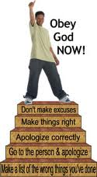
God expects obedience!
Acts 5:29 Obey God rather than men
Rom 6:10 Slaves: of Sin or of God
Heb 5:9 Salvation to all who obey Him
Heb 3:18 those who did not obey
1Pet 1:14 As obedient children
Faith: Obey God even when we don’t understand! Ask for wisdom to understand our trials (James 1:5)

Slide 11
Jeremiah 7:21-24 (NIV)
21 "'This is what the Lord Almighty, the God of Israel, says: Go ahead, add your burnt offerings to your other sacrifices and eat the meat yourselves!
22 For when I brought your forefathers out of Egypt and spoke to them, I did not just give them commands about burnt offerings and sacrifices,
23 but I gave them this command: Obey me, and I will be your God and you will be my people. Walk in all the ways I command you, that it may go well with you.
24 But they did not listen or pay attention; instead, they followed the stubborn inclinations of their evil hearts.
God just wanted obedience!

Slide 12
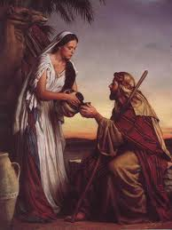
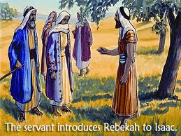
A Wife for Isaac (Genesis 24)
23:2 Sarah is now dead
24:2-3 Abraham has Eliezar swear he won’t let Isaac marry a Canaanite
27:46; 28:1 Rebekah later on reminds Isaac to do same for Jacob
26:34 Esau had already married 2 Hittite women
24:6 Don’t take Isaac back there! (Abraham knew)
Isaac was the only patriarch to not leave the land
24:12 Eliezar prays, Abraham prays, Isaac prays (24:63)
Good choices & Godliness requires effort, planning and lots of prayer by Godly parents – it doesn’t happen by itself!

Slide 13
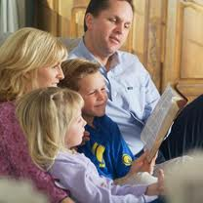

Exhortations to Parents
We must plan for the spiritual health of our children
We must get Bible readings done at home
We must get our kids out to Sunday School, CYC, weekend gatherings
We must invite kids from meeting over to our homes
We must make it clear to our children that doing God’s will is the most important goal of our lives
Work out your own salvation with fear and trembling; for it is God who works in you both to will and to do for His good pleasure. (Phil 2:12-13)

Slide 14
2 Corinthians 6:14-18 (RSV)
Marriages should be “in the Lord”
14 Do not be mismated with unbelievers. For what partnership have righteousness and iniquity? Or what fellowship has light with darkness?
15 What accord has Christ with Be'lial? Or what has a believer in common with an unbeliever?
18 and I will be a father to you, and you shall be my sons and daughters, says the Lord Almighty."
G

Slide 15
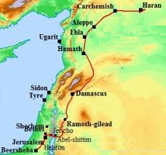
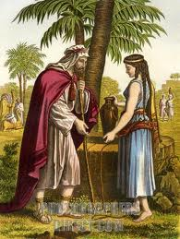
Marriages should be “in the Lord”
Eleazer travelled a long way so Isaac could marry a believer!
600 miles
1 Corinthians 7:39
A wife is bound by law as long as her husband lives; but if her husband dies, she is at liberty to be married to whom she wishes, only in the Lord.
This is the goal for our children to grow up with both Mom and Dad directing them in the ways of the Lord. Remember what God said of Abraham:
"For I have known him, in order that he may command his children and his household after him, that they keep the way of the LORD, to do righteousness and justice, that the LORD may bring to Abraham what He has spoken to him.“ (Gen 18:19)

Slide 16
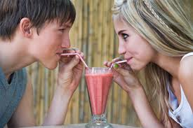
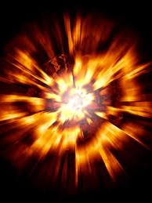
Then what does this mean about Dating?
God wants us to marry a believer
God expects us to date believers
Dating unbelievers is not Biblical.
It is playing with fire and dynamite, and then expecting God to save us out of the resulting explosion!
Dating is not a game! Your spiritual future is at stake. Pray for help & guidance!

Slide 17

To the Unmarried (but considering marriage)
Look and date among Godly believers
Look for a spiritual partner who will love God (and you), no matter what happens
Pray about it constantly
Enter marriage knowing it will require daily work & compromise
Don’t expect a “Cinderella” marriage!
Do not be mismated with unbelievers. For what partnership have righteousness and iniquity? Or what fellowship has light with darkness? (2 Cor 6:14-16 RSV)

Slide 18

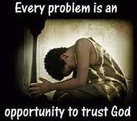
Marriages should be “in the Lord”
The Family Unit is the basis for ecclesial life and life in God’s family
The aim is to get both Mom and Dad striving together for the hope of the gospel
Marriages work best when you are heirs together of the grace of life.
Don’t give up if mistakes are made. Pray for God to bring something good out of the situation and be ready to help.

Slide 19
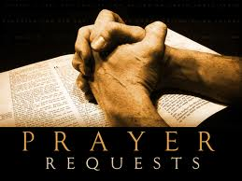
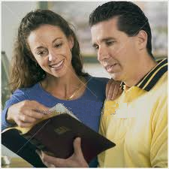


Good Marriages are the result of Daily Prayer and effort!
Pray for God’s help and blessing
Recognize it takes daily effort
Read the Bible together
Work on projects together
Don’t try to change your partner! Change yourself Let God change your partner
Marriage is a work in progress!

Slide 20
Proverbs 19:14
Thank God for success!
Houses and riches are an inheritance from fathers, but a prudent wife is from the LORD.
Thank God daily for success in marriage. One plants, another waters, but it is God who gives the growth!

Slide 21
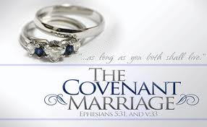
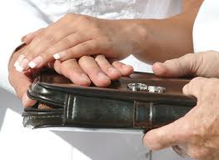
Notice the marriage commitment of both Isaac and Rebekah
Accept unseen & unknown partners
Motivated by faith in the God of Abraham
Completely depended on God to make it work – not their own efforts
Successful marriages don’t come by chance! Both partners are first committed to God, then depend on Him to bring forth fruit in their marriage.

Slide 22

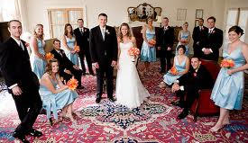
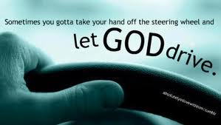
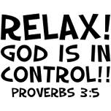
Goals & emphasis today may be in the wrong place
Lot’s of looking and choosing by us
Later leads to 2nd guessing: “I made a mistake” “I married the wrong person”
Too much emphasis put on expensive, elaborate weddings
  The wedding doesn’t make the marriage
  24:67 Isaac simply “brought Rebekah into his mother Sarah’s tent”
Godly partners let God make it work!

Slide 23
Why Couples Don’t Tie the Knot
Detroit News: April 12, 2000

Slide 24
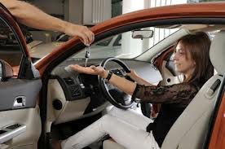
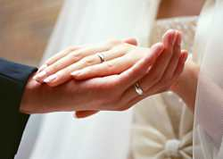

Marriage is not like buying a car!
Trust in the Lord with all your heart, and lean not on your own understanding
In all your ways acknowledge him, and He will direct your paths (Prov 3:5-6)
God’s way requires Faith that He will keep it running!

Slide 25

Genesis 24:56-58
56 And he said to them, "Do not hinder me, since the LORD has prospered my way; send me away so that I may go to my master."
57 So they said, "We will call the young woman and ask her personally."
58 Then they called Rebekah and said to her, "Will you go with this man?" And she said, "I will go."
Rebekah lives “by faith”
She responds to God’s work in her life
  Leaves her family, home and friends
  Accepts her new family & friends
  Accepts her husband from God

Slide 26
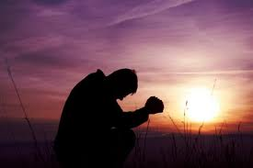
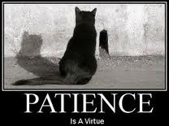
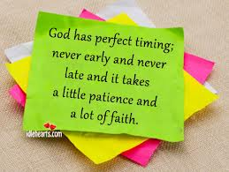
Genesis 25:21
Now Isaac pleaded with the LORD for his wife, because she was barren; and the LORD granted his plea, and Rebekah his wife conceived.
Take it to God in Prayer
Isaac pleads with God for Rebekah
Didn’t mistreat her, get angry at her, didn’t ruin their marriage!
Isaac took the problem direct to God
Patiently waited 20 years for the solution! Godly solutions sometimes take time.
Isaac married Rebekah at 40 & Jacob born at 60

Slide 27
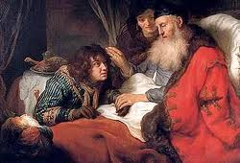

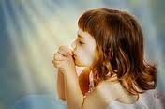
Genesis 25:28
And Isaac loved Esau because he ate of his game, but Rebekah loved Jacob.
Favorite Children
Isaac shows parental weakness
Favors the child who provides him with meat
Some parents favor children who excel in school, work, sports, art, hobbies, etc – rather than Godliness!
Appreciate Godly Children!

Slide 28
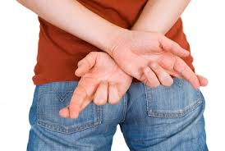

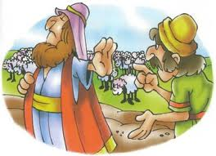
Genesis 26:7
Copying the mistakes of others
And the men of the place asked about his wife. And he said, "She is my sister"; for he was afraid to say, "She is my wife," because he thought, "lest the men of the place kill me for Rebekah, because she is beautiful to behold.”
Isaac & Rebekah try the same tactic Abraham & Sarah used
May have been half-truth for Abraham & Sarah, but not for Isaac & Rebekah
Be careful not to copy poor strategies of others – might not be right for us
Rebekah does risk her life – for Isaac’s sake
David wanted to treat Nabaal the way Saul treated David

Slide 29
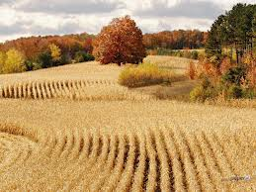

Genesis 26:12
Then Isaac sowed in that land, and reaped in the same year a hundredfold; and the LORD blessed him.
God blessed Isaac
Praise God for His blessings!
God blessed Isaac even during the famine (v.1)
Gave Isaac 100-fold
Philistines envy, angry, hate Isaac & then send him away

Slide 30
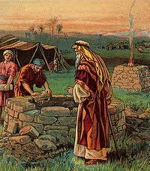
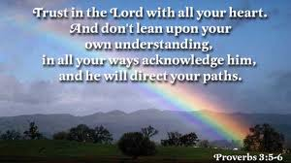
And Isaac dug again the wells of water which they had dug in the days of Abraham his father, for the Philistines had stopped them up after the death of Abraham. He called them by the names which his father had called them.
Isaac trusted God & looked for direction
Genesis 26:18
Isaac re-digs Abraham’s wells
Discovers well of running water – even better! (v.19)
Herdsmen argue….so Isaac moves on!

Slide 31
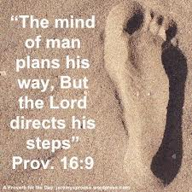

Isaac’s Wells: Reveal his approach to Life
Tries to find a place to locate
Doesn’t demand his “rights”
No fight, no lawyers – just keeps moving on
Turned the other cheek! (Mat 5:39)
Why? Believed God influenced his daily life
Same for us: job, school, ecclesia, family, health, accidents, friendships,
Learn to look for God’s influence in your life. Then, don’t fight it!

Slide 32

Lessons from Isaac & Rebekah
Persecution can have a good impact on us – if we respond in faith
God wants obedience – not sacrifices and promises
Obedience to parents is an opportunity to practice obedience to God
Parents: we need to get our kids out to activities
Look to date and marry “in the Lord”
Take your problems to God, then patiently wait on Him.
Remember Isaac’s wells – Look for God’s direction in the events of our lives

Slide 33
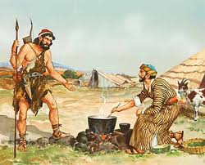
Next Class
We’ll look at family struggles through the life of Jacob

