Slide 1
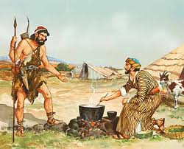

Family Life Lessons in Genesis
Class 4:
Jacob the Schemer
Trust in the Lord with all your heart, and lean not on your own understanding; In all your ways acknowledge Him, and He shall direct your paths. (Proverbs 3:5-6)

Slide 2
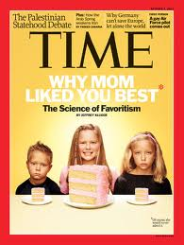
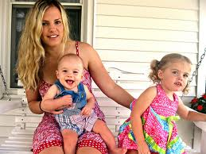
Showing Favoritism among Children
Genesis 25:28
And Isaac loved Esau because he ate of his game, but Rebekah loved Jacob.
Romans 9:12-13
it was said to her, "The older shall serve the younger.“ As it is written, "Jacob I have loved, but Esau I have hated."
Warning to parents: tendency to favor children who excel in things of this world!
  We might enjoy their success
  We might be reaching out to save them
Creates rivalries among children
Emphasizes the wrong goals

Slide 3
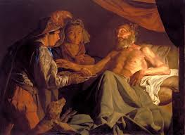
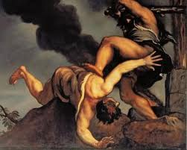
Jacob’s scheming
Gen 25:33 Got Esau to sell his birthright
  Jacob cared, Esau despised (Heb 12:16)
Gen 27 Jacob & Rebekah trick Isaac for the blessing
  V.19 “I am Esau your firstborn”
  V.20 The Lord your God brought it to me
  V.24 Are you really Esau? “I am”
  V.35 your brother came with deceit
Consequences: “So Esau hated Jacob” and wanted to kill him (v.41)

Slide 4
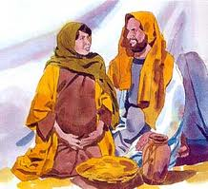
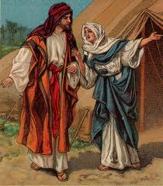
Rebekah reminds Isaac (46)
Genesis 27:46
And Rebekah said to Isaac, "I am weary of my life because of the daughters of Heth (26:34-45); if Jacob takes a wife of the daughters of Heth, like these who are the daughters of the land, what good will my life be to me?"
Last recorded words of Rebekah
She was a spiritual conscience for Isaac
Discussed issue in private with Isaac
Let Isaac handle the issue, but does speak up about the direction to go

Slide 5
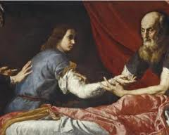
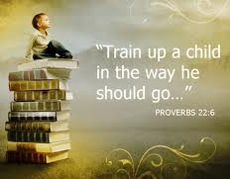
Isaac’s charge to Jacob
Genesis 28:1-4
1 Then Isaac called Jacob and blessed him, and charged him, and said to him: "You shall not take a wife from the daughters of Canaan.
2 "Arise, go to Padan Aram, to the house of Bethuel your mother's father; and take yourself a wife from there of the daughters of Laban your mother's brother.
3 "May God Almighty bless you, and make you fruitful and multiply you, that you may be an assembly of peoples;
4 And give you the blessing of Abraham, to you and your descendants with you, that you may inherit the land in which you are a stranger, which God gave to Abraham.”
Isaac steps up with spiritual counsel
Children need loving direction
Some situations need a geographic change – we may need to move our children to a better location for them
May involve some self-sacrifice. Rebekah never sees Jacob again!

Slide 6
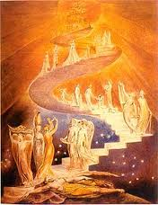
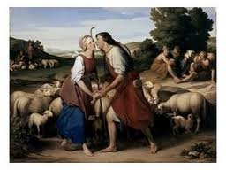
God is working for us!
Gen 28: Jacob was looking for God’s help in his life – he dreamed about the ladder
  V.15 God’s assurance “I am with you”
  V.20 Jacob’s commitment (vow) – If you bring me back in peace, then Yahweh will be my God” [promises to give 10% back]
Gen 29 Jacob stops at a well, and Rachel (Rebekah’s niece) just happens to be coming!
We don’t need to do it all! Commit to God’s service and he will do the impossible – “For it is God who works in you, both to will and to do for His good pleasure” (Philip 2:13)

Slide 7
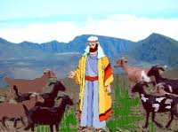

Jacob waited 7 years for Rachel
Genesis 29:18-21
18 Now Jacob loved Rachel; so he said, "I will serve you seven years for Rachel your younger daughter."
19 And Laban said, "It is better that I give her to you than that I should give her to another man. Stay with me."
20 So Jacob served seven years for Rachel, and they seemed only a few days to him because of the love he had for her.
21 Then Jacob said to Laban, "Give me my wife, for my days are fulfilled, that I may go in to her."
Sex should wait! Jacob was engaged for 7 years and waited for marriage. This should be the goal. God knows what’s best!
If young people mess up, we need to show patience, kindness & compassion – God will take care of the rest!

Slide 9
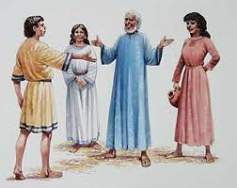
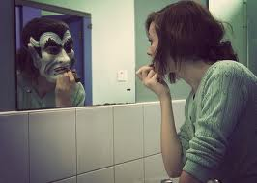
God teaches Jacob about scheming
Genesis 29:25
So it came to pass in the morning, that behold, it was Leah. And he said to Laban, "What is this you have done to me? Was it not for Rachel that I served you? Why then have you deceived me?"
God will make us face our weaknesses
  Don’t react in anger to God or others
  Thank God that He is helping us to change
We don’t need to avenge ourselves on others
We don’t need to change others – we can only change ourselves

Slide 10


Jacob makes a choice!
Genesis 29:26-28
26 And Laban said, "It must not be done so in our country, to give the younger before the firstborn.
27 "Fulfill her week, and we will give you this one also for the service which you will serve with me still another seven years."
28 Then Jacob did so and fulfilled her week. So he gave him his daughter Rachel as wife also.
He could have just accepted Leah as his only wife – tough choice after 7 years!
God’s flexibility – God worked through Jacob’s decision to take Rachel too.
Some choices are not easy or clear – but God can work in a situation either way

Slide 11


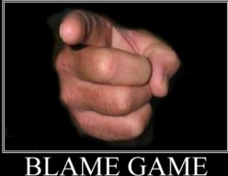
God is at work
Genesis 29:30-31
30 Then Jacob also went in to Rachel, and he also loved Rachel more than Leah. And he served with Laban still another seven years.
31 When the LORD saw that Leah was unloved, He opened her womb; but Rachel was barren.
Jacob may have blamed Leah for going along with Laban’s deceit
God works behind the scenes – don’t fight it, look for his direction, and then go with it
Even during rough situations, be sure to treat everyone with love, kindness and compassion – this is our practice time for eternal life!

Slide 12

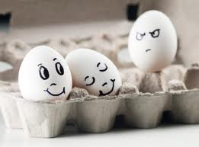
Envy & Jealousy will destroy us
Genesis 30:1
Now when Rachel saw that she bore Jacob no children, Rachel envied her sister, and said to Jacob, "Give me children, or else I die!“
Genesis 37:11
And his brothers envied him, but his father kept the matter in mind.
Envy & jealousy can drive us to hate – and even murder
This IS the devil – and must be fought
Stem from a failure to believe that God has brought the situation on us – or a failure to accept we need it
When it happens, look inside, rather than blaming others
And Jacob's anger was aroused against Rachel, and he said, "Am I in the place of God, who has withheld from you the fruit of the womb?“ (Gen 30:2)

Slide 13
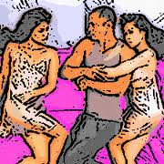
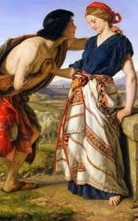

Scheming leads to Anger, Jealousy and Envy
Gen 27:41 Esau hated Jacob
Gen 29:31,33 Leah was hated
(Same Hebrew word in both verses)
Scheming is a short term solution, with bad long term consequences
Scheming stems from a belief that God needs us to work everything out because he can’t or won’t do it himself
Scheming leads to anger & hatred because the other parties know we set out purposely to deceive them

Slide 14
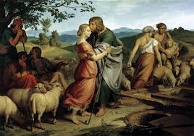
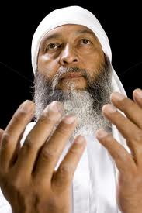

What a mess Jacob’s life is!
He had to leave those who loved him
His brother Esau hates him
He has 2 wives and 2 handmaids
He has 12 children by 4 different women
His family is full of jealousy, envy and anger
He lives with an uncle who sells his daughters for profit and deceives his own family
His children don’t love God
Out of all this, God will grow a family of faithful people who will be included in God’s family forever!

Slide 15
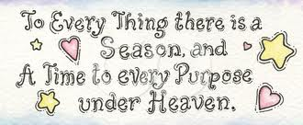
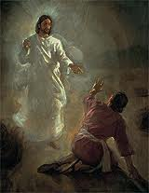
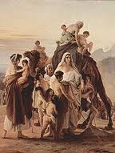
God intervenes
Genesis 31:3-5
3 Then the LORD said to Jacob, "Return to the land of your fathers and to your family, and I will be with you."
4 So Jacob sent and called Rachel and Leah to the field, to his flock,
5 and said to them, "I see your father's countenance, that it is not favorable toward me as before; but the God of my father has been with me.
When family issues were at their worst, God stepped in and told Jacob to go home
Jacob met with both Rachel and Leah
Jacob clearly gave God the credit for prospering him while with Laban (v.42)
God warned Laban not to harm Jacob (v.24)

Slide 16
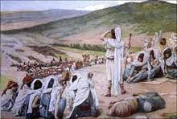

God makes Jacob face his past
Genesis 32:6-8
6 Then the messengers returned to Jacob, saying, "We came to your brother Esau, and he also is coming to meet you, and four hundred men are with him."
7 So Jacob was greatly afraid and distressed; and he divided the people that were with him, and the flocks and herds and camels, into two companies.
8 And he said, "If Esau comes to the one company and attacks it, then the other company which is left will escape."
Angels bring events into our lives that make us face our past mistakes
We must admit our mistakes and pray God will provide a mechanism to move forward
Try to be helpful in moving forward, not arguing about the past

Slide 17
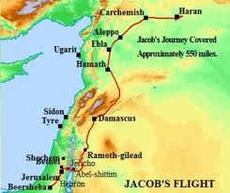
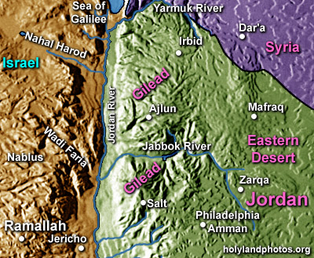
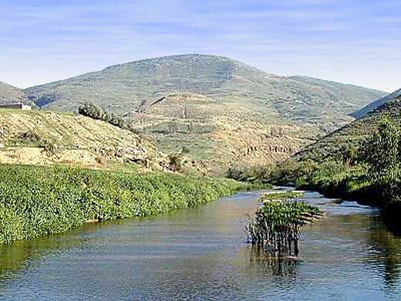
Jacob at the Jabbok River
From Haran to Bethel was about 500 miles!

Slide 18
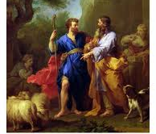
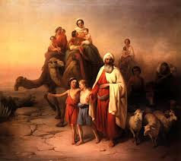
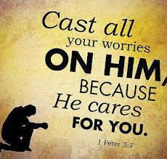
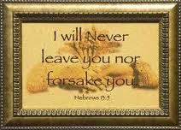
Jacob is in trouble!
Laban is behind him
Esau is in front of him
His family is divided
His children don’t want God
Rachel stole the household gods
He’s moving back home with a big family
When things get bad, we need God the most!

Slide 19
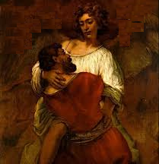
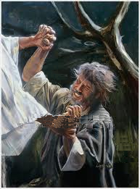
Jacob wrestles with an Angel
Genesis 32:24-26
24 Then Jacob was left alone; and a Man wrestled with him until the breaking of day.
25 Now when He saw that He did not prevail against him, He touched the socket of his hip; and the socket of Jacob's hip was out of joint as He wrestled with him.
26 And He said, "Let Me go, for the day breaks." But he said, "I will not let You go unless You bless me!"
In Gen 28:14-15, God had promised to bring Jacob back and give him the blessing of Abraham
Now Jacob holds the angel all night and refuses to let go until He blesses Jacob’s family

Slide 20
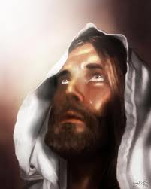
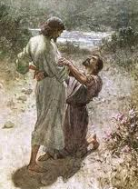
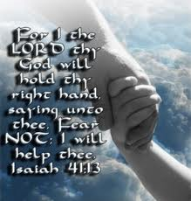
Hosea 12:2-5
2 The LORD also brings a charge against Judah,
and will punish Jacob according to his ways;
according to his deeds He will recompense him.
3 He took his brother by the heel in the womb, and in his strength he struggled with God.
4 Yes, he struggled with the Angel and prevailed; he wept, and sought favor from Him. He found Him in Bethel, and there He spoke to us--
5 That is, the LORD God of hosts. The LORD is His memorable name.
Jacob pleaded with this angel to bless him and would not let go
He prevailed, not by strength, but with tears
This is the pattern for us – pleading with God to bless our families & ecclesias
Same experience Jesus had (Heb 5:7)
  Offered up prayers with loud cries & tears to Him who could save him from death

Slide 21



Don’t forget to give God the credit!
Genesis 33:3-5, 11
3 Then he crossed over before them and bowed himself to the ground seven times, until he came near to his brother.
4 But Esau ran to meet him, and embraced him, and fell on his neck and kissed him, and they wept.
5 And he lifted his eyes and saw the women and children, and said, "Who are these with you?" And he said, "The children whom God has graciously given your servant.“
11 "Please, take my blessing that is brought to you, because God has dealt graciously with me, and because I have enough." And he urged him, and he took it.
God will help us face the issues of our past
We must act in faith, but the victory belongs to God
Be sure to thank God, and give him the praise and honor for helping us through our troubles

Slide 22

Major question to consider….
Why did God allow Abraham to have two sons by two different women (Hagar & Sarah), and then make sure Isaac had twins by Rebekah?
Without Paul’s NT commentary we may never have known!

Slide 23
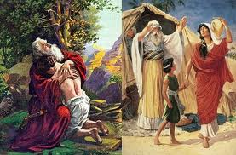
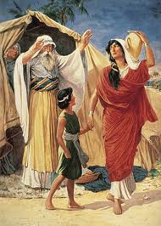
Not all of Abraham’s offspring are children of Abraham by Faith
Romans 9:6-8
6 But it is not that the word of God has taken no effect [God’s plan has not failed!]. For they are not all Israel who are of Israel,
7 nor are they all children because they are the seed of Abraham; but, "In Isaac your seed shall be called."
8 That is, those who are the children of the flesh, these are not the children of God; but the children of the promise are counted as the seed.
So far: Not all of Abraham’s children are God’s children

Slide 24
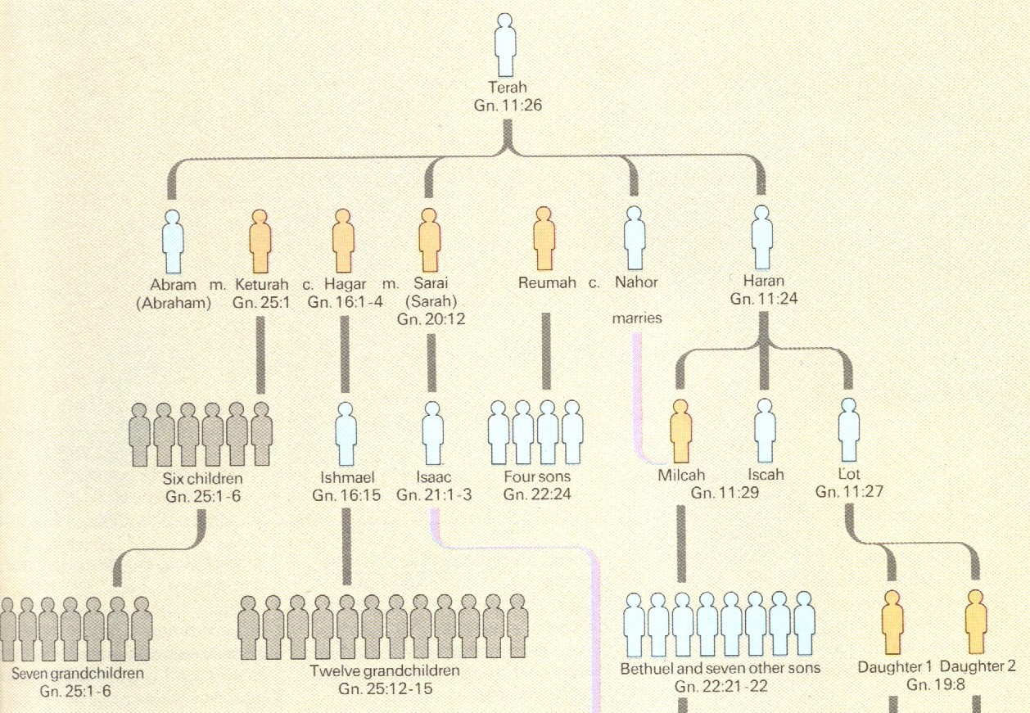
Abraham’s Wives and Children

Slide 25
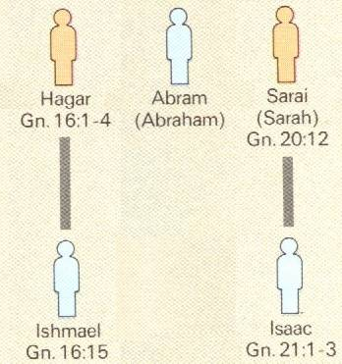
God’s Election
One man, two women, (Hagar was a bondwoman)
In Isaac your seed shall be called (Gen 21:12; Rom 9:7)
God doesn’t call Ishmael Abraham’s son (Gen 21:11-14)
So it’s not about circumcision!
Which one was circumcised?
BOTH!

Slide 26

Romans 9:9
9 For this is the word of promise: "At this time I will come and Sarah shall have a son.”
It’s all of God! It’s His election! Isaac was not selected just because he was Abraham’s son!

Slide 27
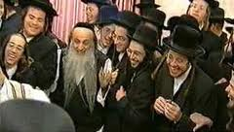
Jewish Reaction: We’re pretty good!
Still feeling pretty good!
Completely agreed that descendants of Hagar through Ishmael were not part of God’s family
But….Paul has got them to acknowledge that not all of Abraham’s children are God’s children! Why???
  Jews thought this was because Ishmael was Abraham’s son through a bondwoman
So, how do you get the Jews to realize that it wasn’t about Abraham’s two different wives & one being a bondwoman?

Slide 28
Romans 9:10-13
10 And not only this, but when Rebecca also had conceived by one man, even by our father Isaac
11 (for the children not yet being born, nor having done any good or evil, that the purpose of God according to election might stand, not of works but of Him who calls),
12 it was said to her, "The older shall serve the younger."
13 As it is written, "Jacob I have loved, but Esau I have hated.”
God made His choice before the kids had done anything good or evil!

Slide 29
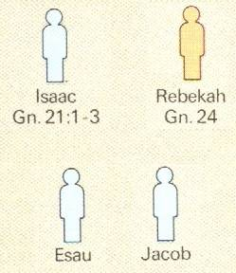
God’s Election
Jacob I have loved,
One man, one wife
but Esau I have hated (Mal 1:2; Rom 9:11)
Two boys born at the same time!
God made his selection before they had done anything!
His selection involved 2 nations! Not just 2 boys! (Malachi 1:2-3)

Slide 30
Lessons from Jacob’s Life
Give up scheming, take up praying for God’s help
Fathers: give good spiritual counsel to your children (Isaac to Jacob)
God is actively working behind the scenes
Make your choices with prayer and faith, asking God to make them work
Give up the envy & jealously – accept what God has given you
Face the issues of the past – with God’s help you will move forward
When progress is made, be sure to give God the credit

Slide 31
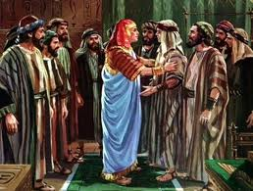
Next: Exhort
We will look at how God caused bad events to work out for good in the life of Joseph & his brothers

