Slide 1




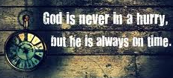





Ecclesiastes: Lasting Happiness can only be found with God
Class 1: What’s the profit of all our work?

Slide 2
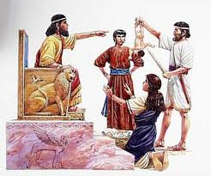
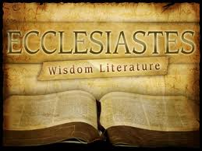
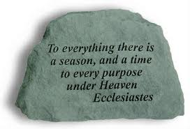
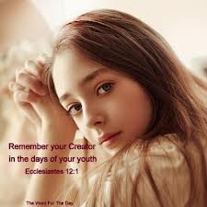

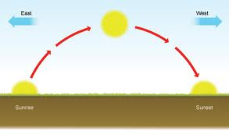
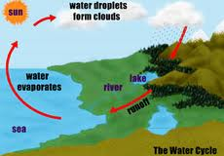
Ecclesiastes
Lasting happiness can only be found with God
Chapter 1: There’s nothing really new – it all just recycles

Slide 3


Got some favorite verses in Ecclesiastes?
  One generation goes & another comes...
  Eye is never satisfied with seeing….
  To everything there is a season, a time…
  For God is in heaven, and you on earth….
  Living know that they will die…..
  God made man upright, but they have….
  A living dog is better than a….
  Remember now your Creator in the days….
  Fear God and keep His commandments….
We will have a look at the context!

Slide 4
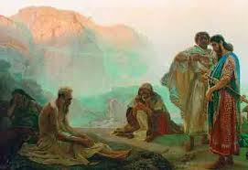
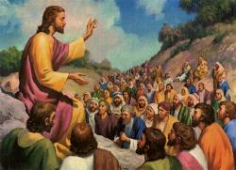
Ecclesiastes serves a purpose like Job: Lessons from a quest!
Job illustrates that God’s way is the right way to live no matter what happens during this life.
  Uses suffering as the means to develop the issue
Ecclesiastes helps us realize that true happiness and satisfaction only come when we fear God & keep his commandments and have the faith to trust whatever God brings into our lives
            Deals with broader issues than Job
Both books were very useful for Jesus

Slide 5
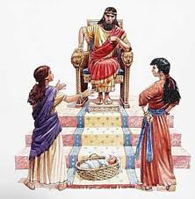
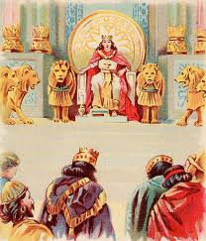
Solomon was the Author
Son of David, King over Israel in Jerusalem (1:1, 12) – before split
Building projects (2:1-11) [2 Chr 9:27]
Gained more wisdom than before him in Jerusalem (1:16) [1 Kings 4:29-34]
1000 wives (7:27) [1 Kgs 11:3]
Set in order many proverbs (12:9) [1Kgs 4:32]
Preacher quotes from Solomon’s prayer at the dedication of the Temple (7:20 and 1 Kings 8:46).
No other King of Israel qualifies

Slide 6
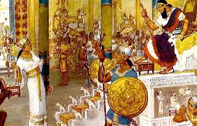
Solomon’s unique qualifications
He had the power and wisdom to experiment and test life
  God gave him a wise & discerning mind, and riches & honor (1Kgs 3:12-13)
  Also offered length of days (1Kgs 3:14) if he is faithful
  God gave him wisdom, very great discernment & breadth of mind like sand on the seashore (1Kgs 4:29-31 NASB)
He had the drive and interest to search things out
He maintained his wisdom – even during the experiments he ran
He didn’t have to worry about defending his kingdom, so he had time to experiment
God let Solomon run the tests!

Slide 7
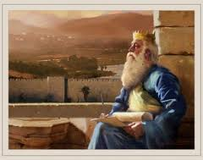
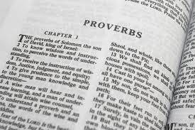
Why not listen to the wise man as he teaches us about life?
Solomon was one of the wisest men to ever live & he was full of the wisdom from God
He spoke 3,000 proverbs & his songs were 1005! (1 Kgs 4:32)

Slide 8
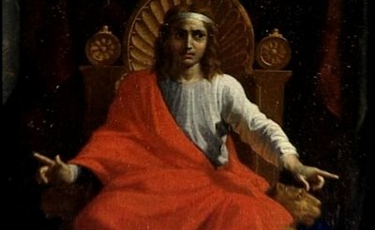
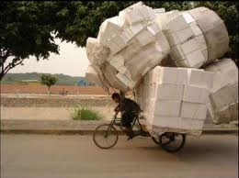
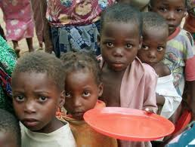


Life Issues that bothered Solomon?
What do you get from all your hard work?
Nothing new, nothing accomplished… just repeating cycles
Life seems unfair:
  some righteous suffer what wicked people should get
  Government & society are full of unfair situations
  Everyone dies: death eliminates the profit of wisdom
  There may not be justice now
Punishment isn’t executed right away so some think they can get away with evil
Some people are workaholics & don’t take the time to enjoy God’s gifts. Others are not allowed to enjoy them
So many people are not content with what God gives them
He tried to analyze life & figure it out

Slide 9

Key Words in the Book
Vanity – life now, without the perspective of how God uses it to train His children
Striving after wind [“vexation of spirit” KJV] – trying to catch the uncatchable! Heb word means “feeding on” wind. Maybe that all we labor for is fed by an illusion we create.
Under the sun: living life now as an end in itself
  never doubts the existence of God
“You” verses “They”, indicates personal exhortations
Wisdom verses foolishness – similar to Proverbs
  Wisdom is the ability to apply perceptions, judgments & actions based on a deep understanding of a situation
Profit (long term): satisfaction, happiness, gain
  Mat 16:26 What profit is it if you gain the whole world but lose your soul
Labor – man’s hard work day after day
“I know”, “I perceived”, “I saw” – Solomon’s personal experience & what he learned
God – clearly indicates Solomon never doubted God was in control of our lives
Solomon was not a skeptic!

Slide 10


References to God
1:13 burdensome task God has given to us
2:24 enjoy good in your labor, for it is from God (also in 3:12)
2:26 God gives wisdom
3:11 God has made everything beautiful in its time
3:14-15 What God does will be forever…that men should fear before Him
3:17-18 God will judge…God tests them
5:2 God is in heaven & you are on earth
5:6-7 Why make God angry at your excuse…fear God
5:18 all the days of life God gives
5:19 God has given riches & wealth
5:20 God keeps him busy with the joy of his heart
6:2 God gives riches, wealth, honor but not power to eat of it
6:10 one cannot contend with God
Solomon never doubted God’s involvement

Slide 11

References to God
7:13 consider the work of God
7:14 God appoints our prosperity & adversity
7:18 he who fears God will escape them all (v.26)
7:29 God made man upright, but…
8:2 Keep King’s commands because of your oath to God
8:12 It will be well with those who fear God
8:15 all the days God gives him
8:17 I saw all the work of God….man can’t find it out
9:1 Righteous & wise are in the hand of God
9:7 Eat with joy & drink….for this is what God wants you to do
11:5 You do not know the works of God
11:9 for all these God will bring you into judgment
12:1,6 Remember your creator
12:7 the spirit returns to God who gave it
12:13 Fear God & keep His commandments
12:14 For God will bring every work into judgment
God is always in control

Slide 12

Passages using “you” or “your”
5:1-9
7:9-10, 16-22
8:2-3
9:7-10
10:4, 20
11:1-6
11:9-10; 12:1-7 “young man”
These sections are personal exhortations appealing to us!

Slide 13
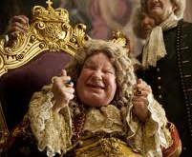
Why was Solomon so Frustrated?
He set out to find the purpose of life in this world
He witnessed that death comes to all & brings everyone to the same point….whether we are good or bad.
  This seemed unfair to Solomon
  This may have been a reaction to some proverbs
He came to realize that from a human perspective this life may be “unfair” because God uses “unfairness” to test us
He also realized that all the wisdom we might have can’t empower us to understand the work of God in our lives.
Solomon had to learn to trust God

Slide 14
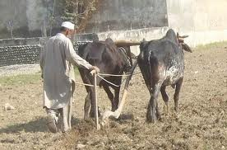
What profit has a man from all his labor? (1:3)
Solomon presents 4 cycles in nature that show life as a series of endless cycles resulting in nothing new – just weariness!
  Generation after generation (1:4)
  Sun rises & sets, then rises again (1:5)
  Wind whirls about continually (1:6)
  Rivers run into the sea, but sea doesn’t get full (1:7)
So much labor that you can’t find the words to express it all, or see it all, nor hear it all (1:8)
  Not quite the way we usually use this verse! Not about desire.
Endless labor for nothing new (1:9-10) – most “new” things are only new because we forget the past! No real progress!
  Politics, Educational methods, Bible study, etc.
Most things we accomplish are forgotten in a few years (1:11) – each generation needs to learn again by experience!
What does all our hard work accomplish?

Slide 15
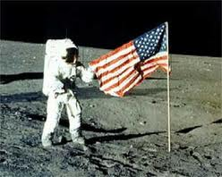
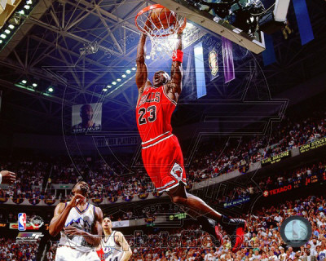
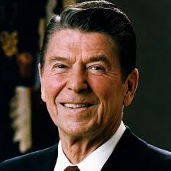
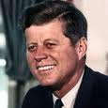
What profit has a man from all his labor? (1:3)
Solomon realizes that for all our efforts in this life, we really don’t accomplish much & it will be forgotten soon!(11)
Solomon laments because it seems to him a waste of time – vanity! (v.2)
Solomon had the enthusiasm & excitement of youth and set out to do a lot and accomplish things that would make him famous.
He found out the rich & famous are soon forgotten!

Slide 16
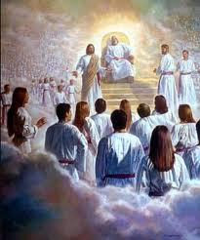
What profit has a man from all his labor? (1:3)
Solomon didn’t realize yet that the goal of this life is to learn to live as children of God
It’s not about what WE get done now, but what GOD is doing in us. God is changing us into His children by the events of our lives.
Paul (in Romans 8) sees the creation God subjected to vanity in hope, groaning in travail, as it will be delivered from the bondage of corruption, into the glorious liberty of the children of God
God is training His children!

Slide 17
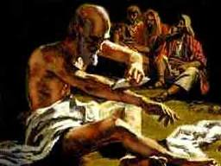
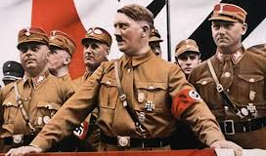
Job had pondered the profit of serving God
Job 9:21-22 (Job Speaking) "Although I am blameless, I have no concern for myself; I despise my own life. 22 It is all the same; that is why I say, 'He destroys both the blameless and the wicked.' (NIV)
Job 34:5-9 (Elihu speaking) "Job says, 'I am innocent, but God denies me justice. 6 Although I am right, I am considered a liar; although I am guiltless, his arrow inflicts an incurable wound.' 7 What man is like Job, who drinks scorn like water? 8 He keeps company with evildoers; he associates with wicked men. 9 For he says, 'It profits a man nothing when he tries to please God.'
Job saw no profit in serving God, if the righteous & wicked were treated the same in this life

Slide 18

Matthew 16:24-27
Jesus had it figured out!
24 Then Jesus said to His disciples, "If anyone desires to come after Me, let him deny himself, and take up his cross, and follow Me. 25 For whoever desires to save his life will lose it, but whoever loses his life for My sake will find it. 26 For what profit is it to a man if he gains the whole world, and loses his own soul? Or what will a man give in exchange for his soul? 27 For the Son of Man will come in the glory of His Father with His angels, and then He will reward each according to his works. [Solomon finally came to this conclusion! Ecc 12:13-14]
Jesus learned from the experiences of others

Slide 19
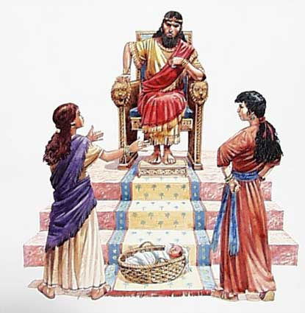
Test 1: Does Wisdom bring profit? (1:12-18)
Solomon’s first gift was wisdom
He tried to use his wisdom to understand and analyze life
  He sees all the work that God has given us to do as a grievous task by which we may be “exercised” (NKJV) or “humbled” (YLT & Strongs)
He becomes frustrated that he can’t make the crooked straight (1:15) - but then learns it is because God makes it that way! (7:13) [verses next]

Slide 20
Ecclesiastes 1:15
What is crooked cannot be made straight, and what is lacking cannot be numbered. [you can’t fix everything!]
Ecclesiastes 7:13
Consider the work of God; For who can make straight what He has made crooked
Solomon is learning as he goes along!

Slide 21
Test 1: Does Wisdom bring profit? (1:12-18)
Solomon’s first gift was wisdom
He tried to use his wisdom to understand and analyze life
He becomes frustrated that he can’t make the crooked straight (1:15) - but then learns it is because God makes it that way! (7:13)
He attempted to analyze with wisdom as opposed to madness & folly (using contrasts), but only found that more knowledge brought more sorrow (1:17-18) The more you know, the more you don’t know, but you are more aware!
Solomon “perceived” (1:17) – he came to know by experience

Slide 22
Next Class
We’ll look at how God knows the right time for everything, but that He uses events of this life to test us!

Slide 24


Slide 25
2
M
G

Slide 26
2
M
G

Slide 27
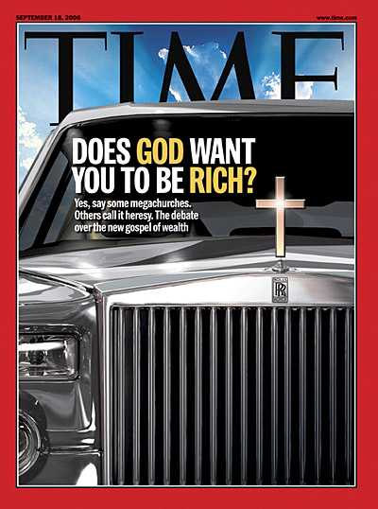

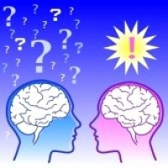
2
S
G

