Slide 1




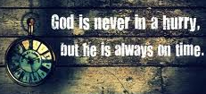

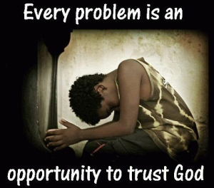

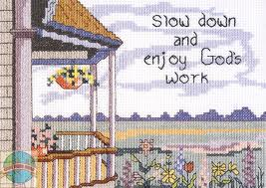

Ecclesiastes: Lasting Happiness can only be found with God
Class 2: God does His work at the right time!

Slide 2
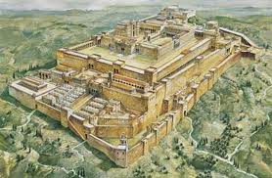
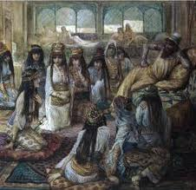
Test 2: Is Pleasure Profitable [hard work & great possessions] (v.4-11)
Solomon built houses, planted vineyards, gardens & orchards with irrigation
He got male & female servants
He bred huge herds & flocks
He gathered silver & gold and king’s treasures
He acquired male & female singers, and many concubines (NASB, NIV, RSV)
He became great and excelled beyond all kings in Jerusalem before him – He tried everything!
It was all vanity & grasping for wind, & didn’t bring the satisfaction he looked for

Slide 3
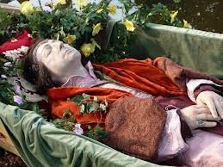
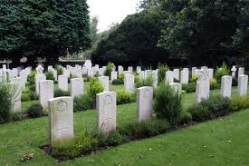
Death eliminates the profit of Wisdom
Next king can only do what previous king did too (v.12) [there’s really nothing new]
Wisdom is more profitable than folly now in this life as a guide (v.13)
Yet both wise and fool die! (v.14-15)
Wise man won’t be remembered any longer than the fool (v.16) [again in 9:15]
Solomon hated life… he found this very distressing (v.17) – life is not just & or fair!
Death levels the playing field! All go to one place (3:20)

Slide 4


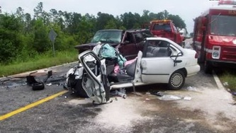
Maybe Solomon misunderstood his own Proverbs!
Prov 2:18 For her house leads down to death, and her paths to the dead;
5:5 Her feet go down to death, her steps lay hold of hell.
7:27 Her house is the way to hell, descending to the chambers of death.
11:19 As righteousness leads to life, so he who pursues evil pursues it to his own death.
14:12 There is a way that seems right to a man, but its end is the way of death.
14:27 The fear of the Lord is a fountain of life, to turn one away from the snares of death.
16:25 There is a way that seems right to a man, but its end is the way of death.
18:21 Death and life are in the power of the tongue, and those who love it will eat its fruit.
He may concluded that the righteous should never suffer the death of the wicked

Slide 5
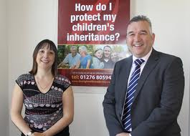
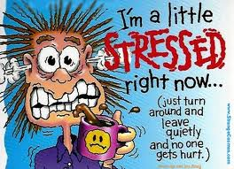
Profits of your hard work pass to others
All you accomplish is given away to others
  They may be a fool (v.19)
  They may not work at all (v.21)
Why work so hard now and stress out? (v.22-23)
  Days become sorrowful
  Work is burdensome
  Can’t sleep at night
Life doesn’t seem fair!

Slide 6
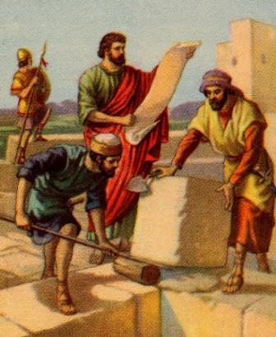
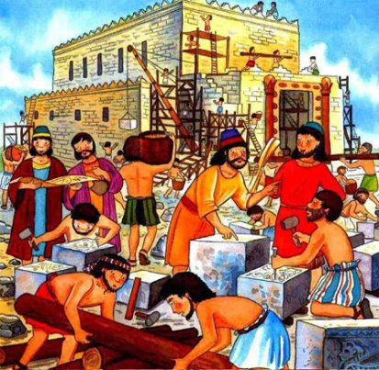
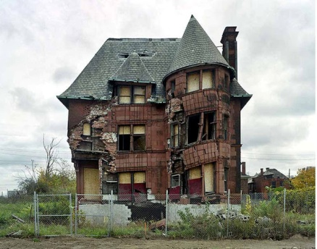
Solomon was a busy man!
1Kgs 5:13 180,000 man labor force for his building projects [30,000 Jews & 150,000 Gentiles]
1Kgs 9:15-19 [read it!] Spent much of his time in building projects:
  7 years building the temple
  13 years building his house
  Built a house for Pharaoh’s daughter
  Repaired the Millo (tower), wall of Jerusalem, etc
Solomon had hoped these projects would last 100’s of years

Slide 7



Take Time to Enjoy the results of your Work & Thank God
Eat & drink – enjoy life while you work (v.24)
Acknowledge that our enjoyment is from God’s hand (v.25)
Solomon had the power & ability to seek out much more, but he realized we should be content with what God gives us (v.26)
God gives wisdom, knowledge & joy to those who are good in his sight (v.27)
God can give the results of sinners’ hard work to those who are good (v.28)
God is in Control: Be content with what He gives us

Slide 8

Philippians 4:11-13
Not that I speak in regard to need, for I have learned in whatever state I am, to be content: 12 I know how to be abased, and I know how to abound. Everywhere and in all things I have learned both to be full and to be hungry, both to abound and to suffer need. 13 I can do all things through Christ who strengthens me.
Godliness with contentment is great gain

Slide 9
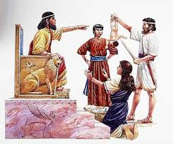

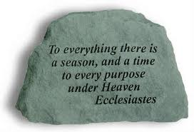
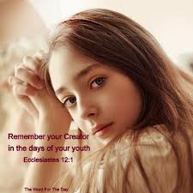

Ecclesiastes
Lasting happiness can only be found with God
Chapter 3: God knows the right time for everything – Trust Him

Slide 10

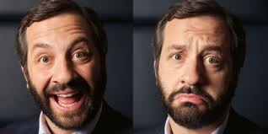
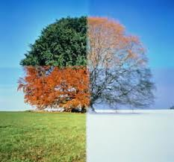
There is a right time for everything
There is a season [set time – Neh 2:6] for every purpose under heaven (under the sun)
To be born & to die, to plant & to harvest
To kill & to heal, to demolish & to build
To weep & to laugh, to mourn & to dance
To scatter stones & to remove them, to hug & to not hug
To search & to give up, to keep & to throw away
To tear & to sew, to be silent & to speak
To love & to hate, to war & to make peace
We don’t have the wisdom to always do things at the right time

Slide 11
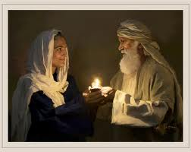
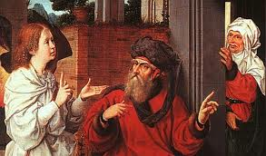
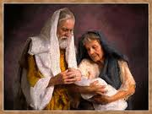
Abraham & Sarah didn’t know the right time!
They decided to take things into their own hands
God visited Sarah at the right time, and the child of promise was born

Slide 12
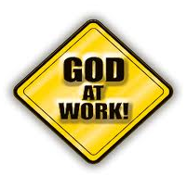
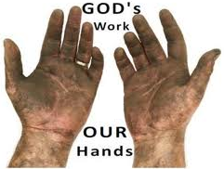
God does things at the right time (3:9-15)
What profit does a worker get from all his work? (3:9)
Men are occupied with work because God intended it that way – to “humble” [1:13 YLT] us (v.10)
  not “grievous” (1:13) now. Solomon is beginning to see God’s purpose!
God made everything beautiful in its time – in harmony with all God’s work (v.11)
He has put eternity: “but though He has permitted man to consider time in its fullness” [Jer Bible], no one can figure out the work God does from beginning to end!
Solomon says: Unless the Lord does it, they labor in vain who work (Ps 127:1-2)

Slide 13
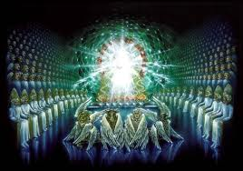
God does things at the right time (3:9-15)
Appreciate what God does for you and has given you – allow it to let you rejoice & do good (3:12)
  “I know” (v.12 & 14) - Solomon’s confidence
Eat, drink and enjoy the results of your labor – it is God’s gift to you (v.13)
Whatever God does is forever – He’s working for our eternal good, not temporary – this should cause us to fear Him (v.14) & learn to live by faith in God.
God knows the end from the beginning, but He requires an account of our past (v.15)
  There will be a judgment day
  There must be something beyond the time of reward
We must trust God’s pathway for us – He knows what He is doing!

Slide 14

Waiting for God’s timetable
Abraham & Sarah had to wait till it was humanly impossible for them to have a child
Isaac & Rebekah waited 20 years for God to cause Isaac to be born
Job waited for God to finally send Elihu and speak to Job himself
David ran from Saul for years as he waited for God to make him king
Jacob waited years for God to change his children into spiritual sons of God
Joseph waited for over 20 years for God to reunite him with his family and his dreams to be fulfilled
Moses, Caleb & Joshua waited 40 years for God to lead Israel into the promised land
Abigail patiently waited years for God to remove Nabal and grant her a Godly husband
God does things at the right time, according to His purpose. He waited 4,000 years to send His son!

Slide 15
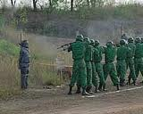
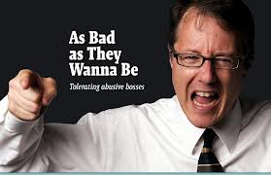
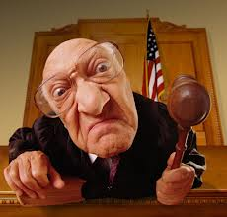
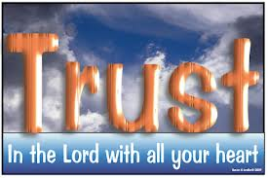
God uses “unfairness” now to test us (16-22)
For now, there are sometimes wicked judgments made (v.16)
God has set a time to eventually judge (17)
God uses the delay to test us:
  It appears now that we have lives like animals (18)
  We live for a while, then die (19)
  Both man & animals are of the dust, & return (20)
  No one knows for sure if man’s spirit goes up (21) – takes faith!
So rejoice & be thankful for God’s gifts now
You can’t know for sure what will happen after death (22) [again in 6:12; 7:14; 10:14; 2:19]
God is testing us now to see if we really want to live like Him & if we will trust Him forever

Slide 16
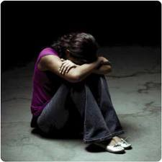
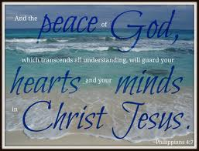
The unfair situations of our life could be in our Ecclesia!
Decisions on Bible principles
  Fellowship, divorce, career, past mistakes
Decisions which prevent us from participating
  Can’t be on AB board, can’t lead CYC or SS
Oppression or mistreatment
  Past mistakes, marriage partner, beard
God uses “unfairness” to test our Faith in Him

Slide 17
The unfair situations of our life could be in our Family!
Maybe not the “favored” child
  Mom and/or Dad treat other kids better
Might have difficult children or none at all
  Seems other families have it so much better
Spouse may mistreat us and/or our kids
  Why should we have to endure the bad spouse?
God gives us what we need to train us to be His children

Slide 18
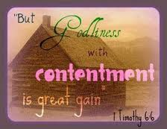

Ecclesiastes
Learning to trust God’s work in our lives!
Chapter 4: Learn to be Content & Enjoy what God gives you

Slide 19
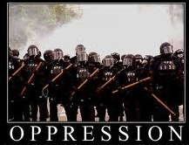
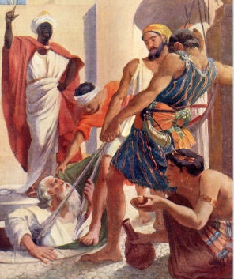
There is “unfairness” in Government & Society (v.1-3)
Many people are oppressed by people who have power
These oppressed people have no comforters – no one to help them
Some oppressed people may be better off dead (2)
Better is he who never existed – didn’t have to see & experience this evil work (3) [Stillborn again in 6:3. This is similar to Job 3:10; 10:18; Jer 20:14; Mat 26:24)
God uses these situations to test His people: Trust Him!

Slide 20
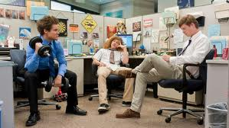
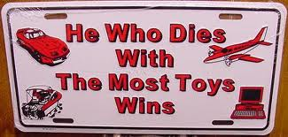
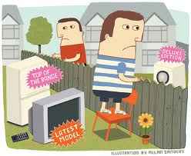
Some people oppress themselves (4-8)
Some people are so fixed on out-doing their neighbor that they oppress themselves to be the best (4)
Other extreme: the fool doesn’t work at all & ruins himself (5) [Prov 6:10; 24:33)
Much better to have a little with peace, than lots with too much stress (6) [Prov 23:4-5]
Some people work endlessly, but are never satisfied, & don’t take the time to enjoy what God gives us (7)
Godliness with contentment is great gain (1 Tim 6:6) [“you gain a lot when you lead a Godly life, but you must be happy with what you have”]

Slide 21
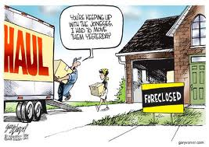
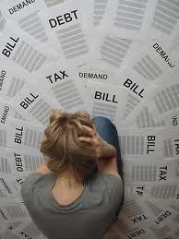
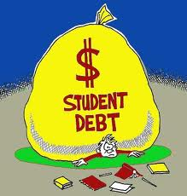
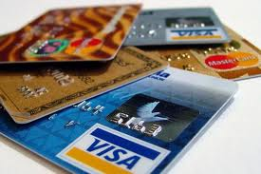

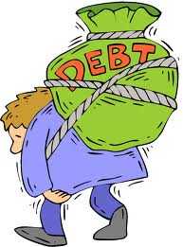
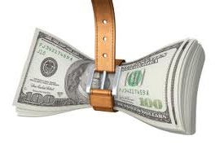
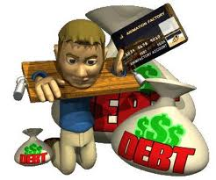
Keeping us up with the Joneses might bury us in debt!
Live within your means!

Slide 22

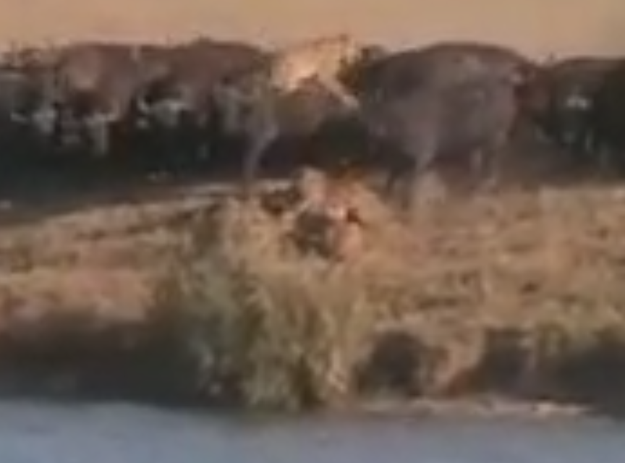
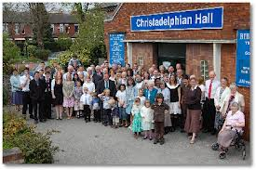
Teamwork is better than trying to be the best (4:9-12)
Two are better than one: they help each other when troubles arise
They keep each other warm (11)
Help defend each other from those who would harm us (12)
    Three is even better than two
Those who go it alone, have no one to help when they need it
Families & Ecclesias are all about teamwork

Slide 23

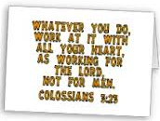
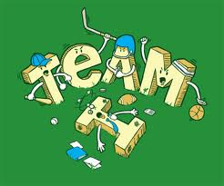
Get involved in your Ecclesia!
Show up to Bible classes & seminars
Volunteer to help with activities
Assist in Sunday School and CYC
  Create a project for Sunday School class teacher
  Help out at CYC activities and weekend trips
Don’t worry about prominent positions, do whatever needs to get done
Don’t take someone’s job, do something that isn’t getting done now
There’s no “I” in “team”

Slide 24

Next Class
We will look at how we can learn to be content with God’s plans & the benefit of God’s wisdom when we plan for the future

