Slide 1




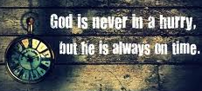

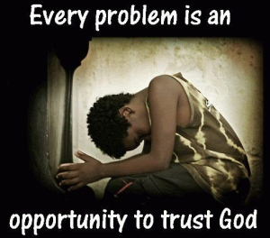



Ecclesiastes: Lasting Happiness can only be found with God
Class 3: God knows what He’s doing: Be patient!

Slide 2
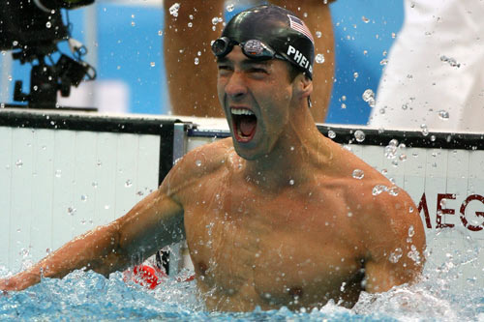
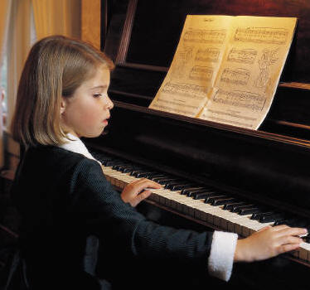
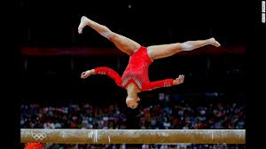
You don’t need to be the best!
Might involve too much practice time or work
Might pull you away from ecclesial & family life so you can’t help others
Might be motivated by pride - to be famous!
Striving to be the best may take a lot of the fun out of it
Solomon knows it won’t last!

Slide 3
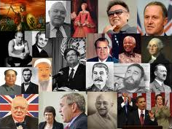
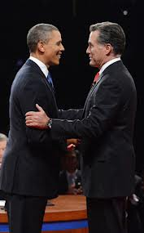
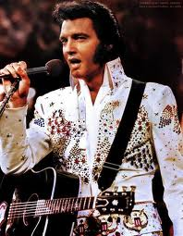
Individual Fame & Power have no lasting Profit (4:13-16)
Old & foolish king can easily be replaced by a poor boy from prison who responds to the people (13-15)
But then the next generation will not appreciate this new young king (16)
Don’t waste your time striving for fame & power. They are fleeting & easily lost, & in the end will not profit

Slide 4
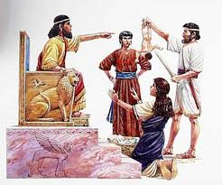
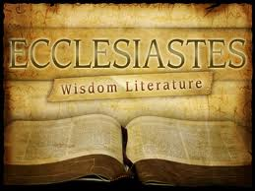
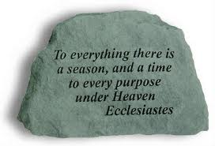
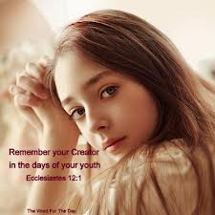

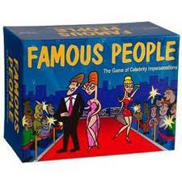

Ecclesiastes
Learning to trust God’s work in our lives!
Chapter 5: Don’t aim for Personal Fame

Slide 5
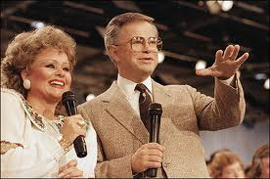
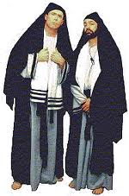
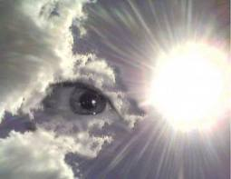
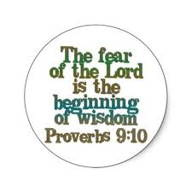
Don’t aim for Religious Fame (5:1-7)
When you go to God’s house, go to hear (1) – s.w. as “obey” (1Sam 15:22)
Watch what you say & think: God is in heaven. Don’t put on a show for others to see! (v.2)
Dream comes through much activity: as too much stress can cause us to dream, so too many words can cause one to speak foolishly [3]
God expects vows to be paid… so don’t utter hasty vows in God’s house to gain fame (4)
  Prov 20:25 It is a snare for a man to devote rashly something as holy, and afterward to reconsider his vows.
God & His angels will hold you accountable for what you say (6)
Rather than striving for fame through religion, fear God!

Slide 6
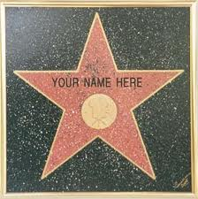


Aiming for Fame in Ecclesial Life
Speaking & Presiding brothers
Arranging brother or wives (re-arranging sisters!)
Recording brother, Finance brother
Head organist or piano player
CYC leaders
Sunday School teachers
Singing class leaders
Thermostat control bro.
The higher you rise, the harder you fall!

Slide 7

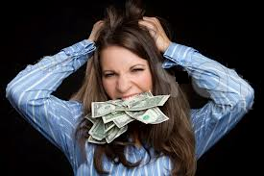
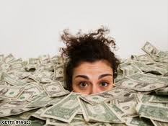

Don’t aim for Riches (5:8-17)
Poor people will be oppressed, their justice perverted, so higher officials (including the king) can profit from them (8-9)
People’s whose focus is riches, are not satisfied with any increase in riches….there is never enough (10)
When you become richer… there are simply more people to share your riches with (11)
When our focus is on riches, we worry and fret to the point we lose sleep over it (12)
Some people who hoard their riches end up losing them anyways through some misfortune (13-16)
So what was the profit of all the riches he worked for? (16-17)
For men will be lovers of themselves, lovers of money, boasters, proud, blasphemers, disobedient to parents, unthankful, unholy (2 Tim 3:2)

Slide 8


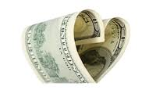
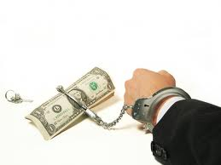
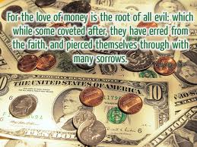

The Love of money…..
Don’t aim for finance brother job so you can control the money
Don’t be influenced to tell the congregation what they want to hear (instead of declaring God’s truth) so you will be popular and benefit financially (1 Tim 6:10)

Slide 9
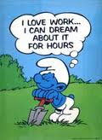

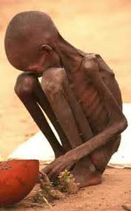
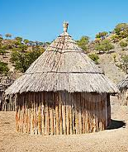
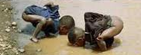
Enjoy your work now & be content (5:18-20
Enjoy the good of your labor that God gives you – it is your heritage (18)
If God gives you riches & power to enjoy them, rejoice! It is God’s gift (19)
Happiness & contentment now, keeps us from getting depressed about the past (20)
Everyone doesn’t get the blessings we enjoy each day

Slide 10

Hebrews 13:5-6
5 Let your conduct be without covetousness; be content with such things as you have. For He Himself has said, "I will never leave you nor forsake you."
6 So we may boldly say: "The Lord is my helper; I will not fear. What can man do to me?"
You gain a lot when you lead a Godly life, but you must be happy with what you have 1 Timothy 6:6

Slide 11
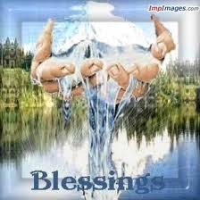
Ecclesiastes
Learning to trust God’s work in our lives!
Chapter 6: Be Content with God’s Good Gifts

Slide 12

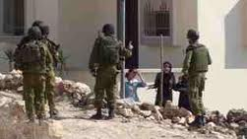
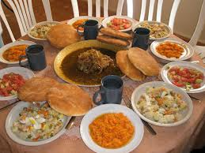


Be content with God’s good gifts (6:1-9)
There are many people to whom God has given riches, but God allows a stranger to enjoy their riches (1-2)
Even if you have lots of kids & live 2,000 years, but don’t experience God’s goodness, a stillborn child is better (3-6)
Be thankful for God’s blessings

Slide 13



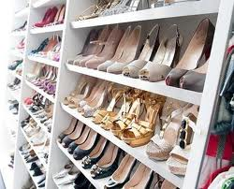
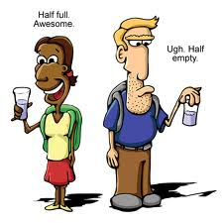

Be content with God’s good gifts (6:1-9)
Some people work hard just to have the food they want, but never seem to get all they desire (7)
Even the wise never have enough & poor people who are wise will still desire more (8)
Enjoy what you have rather than desiring what you don’t have – be content!(9)

Slide 14
Philippians 4:10-13 (RSV)
10 I rejoice in the Lord greatly that now at length you have revived your concern for me; you were indeed concerned for me, but you had no opportunity. 11 Not that I complain of want; for I have learned, in whatever state I am, to be content. 12 I know how to be abased, and I know how to abound; in any and all circumstances I have learned the secret of facing plenty and hunger, abundance and want. 13 I can do all things in him who strengthens me.
Paul figured out the secret of happiness!

Slide 15
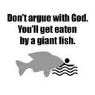

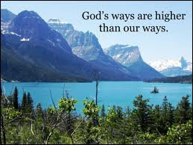
Don’t Challenge God’s plan (6:10-12)
God planned everything long ago, don’t argue with God! [1:9; 3:15] (v.10)
  God determined events & purpose of man
  We can’t understand all God does (8:16-17)
The more we argue, the less we really say (11)
Only God knows what is good for us in this life & God knows the future too! (12)
  “after him” is in this life, not immortality (2:19; 3:22; 7:14)
Oh, the depth of the riches both of the wisdom and knowledge of God! How unsearchable are His judgments and His ways past finding out! (Rom 11:33)

Slide 16
Ephesians 1:9-11 (NIV)
9 And he made known to us the mystery of his will according to his good pleasure, which he purposed in Christ, 10 to be put into effect when the times will have reached their fulfillment — to bring all things in heaven and on earth together under one head, even Christ.
11 In him we were also chosen, having been predestined according to the plan of him who works out everything in conformity with the purpose of his will.
God has a plan & He’s in control!

Slide 17
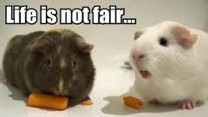
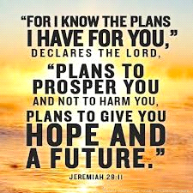
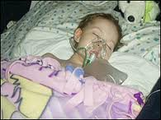

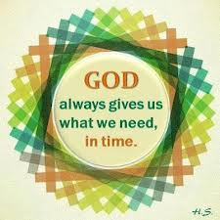

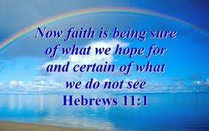
Arguing with God’s Plan
We tend to do it in difficult times
  Struck with a terrible disease
  Someone we love dies
  Lose our job or home
  Marriage troubles, children troubles
Our natural reaction is: “that’s not fair!”
Faith motivates us to reflect on the past and trust God in our future – He is in control!

Slide 18
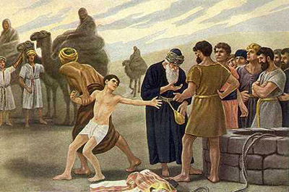
And we know that God causes all things to work together for good to those who love God, to those who are called according to His purpose. (Rom 8:28)
Joseph

Slide 19
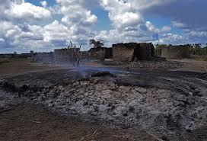
2
David & his men return to Ziklag (1Sam 30:1)
His men want to stone him
S
God rescues all his people!
David strengthens himself in the Lord
One week later David is king of Judah!
Trust in the Lord with all your heart, and don’t lean on your own understanding. In all your ways acknowledge Him and He will direct your paths (Prov 3:5-6)

Slide 20

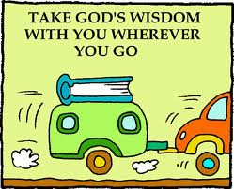
Ecclesiastes
Learning to trust God’s work in our lives!
Chapter 7: Godly wisdom will help you plan for your future

Slide 21

2 Divisions in Ecclesiastes
Chapters 1-6 deal with the vanities of human life
Chapter 7-12 deal with using wisdom to live in these conditions

Slide 22

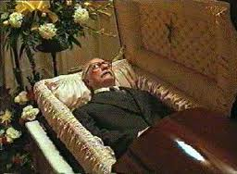


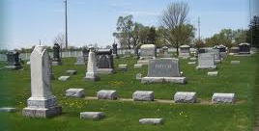
It’s wise to consider your end (7:1-10)
Think about where you are headed!
A good name is better than precious ointment, especially if you keep it to the day you die (1)
  A good name is to be chosen rather than great riches (Prov 22:1)
  “day of death” is better because at that point your life is finished and your good name & way of life secure.
It’s good to be serious about life because everyone’s destiny is death (2)
Sorrow is better than laughter, because sorrow can have a good influence on your mind(3)
Wise people think about funerals [knowing we’ll all end up there], but fools only think about feasting (4)
It’s better to listen to wise people who reprimand you than fools who praise you (5)
  Song of fools can lead to moral corruption (v.7)

Slide 23
Next Class
We will look at how we should learn to trust whatever God brings into our lives – He is in control!

