Slide 1
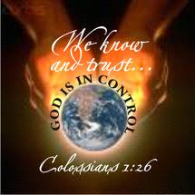
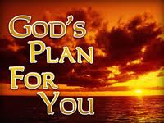


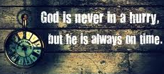
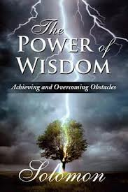
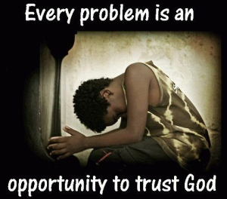
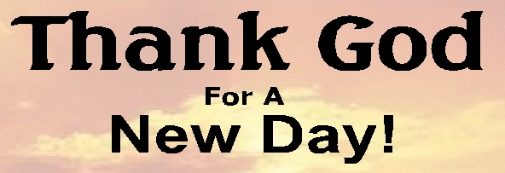


Ecclesiastes: Lasting Happiness can only be found with God
Class 4: God’s wisdom helps you prepare for the future

Slide 2


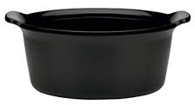
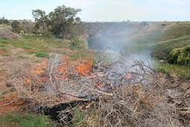
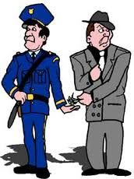
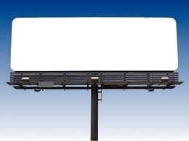

It’s wise to consider your end (7:1-10)
Like the crackling of thorns under a pot, so is the laughter of fools (v.6)
  Thorns burn fast with lots of noise, but very little useful production
For oppression (of your mind - extortion) makes a wise man mad, and a bribe destroys the heart (v.7)
The end of a thing (attain something) is better than its beginning; the patient in spirit is better than the proud in spirit (v.8)
God cares about how we got there!
The ends does not justify the means!

Slide 3
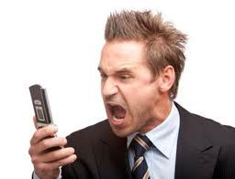


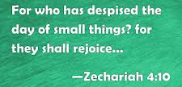
It’s wise to consider your end (7:1-10)
Do not hasten your spirit to be angry, for anger (Heb word means “grief from anger”) rests in the bosom of fools (v.9)
  Like Cain’s anger consumed him till he murdered Abel (Gen 4:5)
  Or Saul’s anger at David’s popularity (1Sam 18:8-9)
Do not say, “Why were the former days better than these?” For you do not inquire wisely concerning this. (v.10) [Hag 2:3; Zech 4:10] – leads to bitterness & impatience!

Slide 4

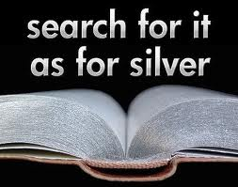
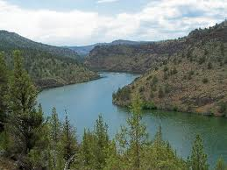

Wisdom gives life to Believers (7:11-14)
Wisdom is as good as an inheritance & profitable for those who see the sun (v.11)
  Those looking for life beyond this life
Wisdom is a defense as money, but the excellence [“profit” s.w. in 6:11] of knowledge is that wisdom preserves life in those who have it [NASB] (v.12)
  Wisdom is a tree of life (Prov 3:18)
Consider the work of God: for who can make straight what He has made crooked? (v.13)
  “work of God” = divine providence (3:11)
  Answers a problem from 1:15 – many of the “crooked” events of our lives are being used by God to help us!
Enjoy days of prosperity, but remember when adversity comes that God brings both – so that man can find out nothing that will come after him [after his death (9:3)] (v.14)
  God uses both so that we cannot judge ourselves or another person based on what God brings into our lives
  Natural tendency to think that if things are going well, God is blessing me because I am righteous – Wisdom helps us to examine deeper!

Slide 5
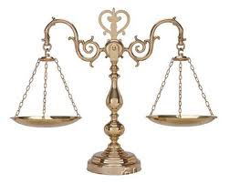
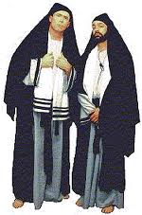
Don’t aim for good or bad extremes
God’s Wisdom brings balance to life (7:15-22)
Solomon witnessed: a just man who perishes in spite of his righteousness & a wicked man who prolongs his life in spite of his wickedness (v.15) – these are God’s “crooked” ways – His providence!
YOU: Don’t be overly righteous [with respect to the Law] or wise – why should you destroy yourself?
  Don’t become an extremist! May cause death! Like Elijah!
  Disguised egotism that competes in piety
Don’t be overly wicked nor foolish – why should you die before your time?
  Poor choices in morality or risks can lead to an early death!
Good that you grasp this [self-righteousness], and also not remove your hand from the other [foolishness] – for he that fears God will escape (as in v.26) them all (the extremes)
But Martha was distracted by all the preparations that had to be made. She came to him and asked, "Lord, don't you care that my sister has left me to do the work by myself? Tell her to help me!” "Martha, Martha," the Lord answered, "you are worried and upset about many things, but only one thing is needed. Mary has chosen what is better, and it will not be taken away from her.“ (Luke 10:40-42 NIV)

Slide 6
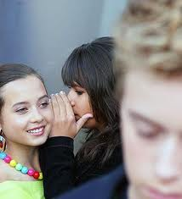

Don’t aim for good or bad extremes
God’s Wisdom brings balance to life (7:15-22)
Wisdom strengthens the wise more than 10 rulers of the city – God’s wisdom has power to save.
For there is not a just man on earth who does good and does not sin (v.20)
  Solomon said “no man who does not sin” (1Kgs 8:46)
  Wisdom motivates us to appeal to God’s mercy
Do not take to heart everything people say, lest you hear your servant cursing (or speaking evil of) you (v.21)
  We need the wisdom to balance what people say about us or it will destroy us
  And you know that you have said bad things about others (v.22)
God’s wisdom will help balance us in our daily activities!
Get Wisdom

Slide 7
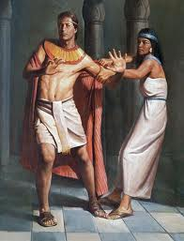
Wisdom will help Godly men escape Harlots (7:23-26)
All this I have proved by wisdom – Solomon set out to use his Godly wisdom to find the “profit” of life now – but it was far from him (v.23)
  Even with Solomon’s great wisdom, he still could not understand God’s work completely
What has been is remote and mysterious [NASB] – who can find it out? (v.24)
  It’s difficult to completely explain Divine providence of the past.
I applied my heart to know…. (v.25) [done back in 1:17]
I find more bitter than death the woman whose heart is snares & nets, whose hands are fetters. He who pleases God shall escape from her (like Joseph), but sinners will be trapped (v.26)
  Many of the words & phrases here are similar to Prov 5:3-6; 7:5-27
  Godly wisdom helps us look beyond satisfying the present, and living for the future – it teaches us to please our Father in heaven
  “how can I do this great evil and sin against God?” (Gen 39:9)
God’s wisdom puts good moral constraints on how we live, giving us a better life

Slide 8

Proverbs 6:23-29
23 For the commandment is a lamp, and the law a light; Reproofs of instruction are the way of life, [and the correction that comes from them will help you have life]
24 To keep you from the evil woman, from the flattering tongue of a seductress.
25 Do not lust after her beauty in your heart, nor let her allure you with her eyelids.
26 For by means of a harlot a man is reduced to a crust of bread; and an adulteress will prey upon his precious life.
27 Can a man take fire to his bosom, and his clothes not be burned?
28 Can one walk on hot coals, and his feet not be seared?
29 So is he who goes in to his neighbor's wife; whoever touches her shall not be innocent.
Solomon probably wrote this earlier in his life

Slide 9
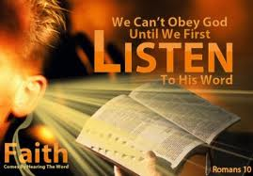
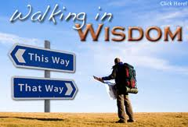
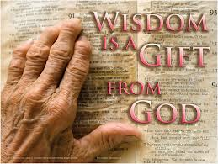
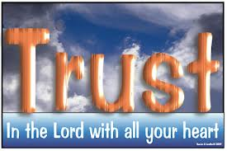
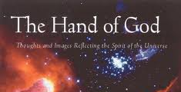
Very few people have Godly wisdom! (7:27-29)
Here is what I have found → indicates one of Solomon’s conclusions is coming (v.27)
1 man among 1,000 indicates Solomon didn’t encounter many men with God’s wisdom
  Solomon didn’t find much Godly wisdom among his 1,000 wives & concubines (1Kg 11:3) [some were political marriages]
God made man upright (before vanity brought in), but they sought out many schemes (v.29)
  It’s not God’s fault there are so few people with Godly wisdom – people scheme through life rather than appreciate & trust God’s divine providence

Slide 10
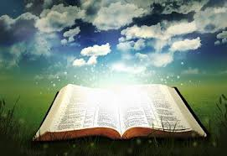
God’s wisdom improves your life! Thank God for His help!
Benefits from Daily Bible Readings!

Slide 11
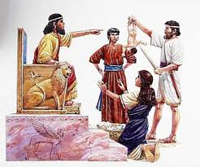
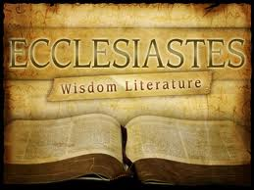
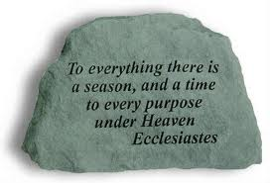
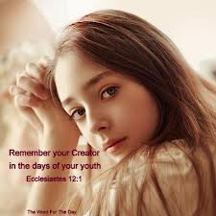
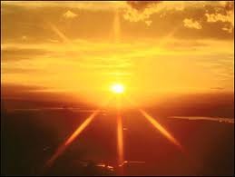
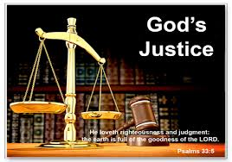
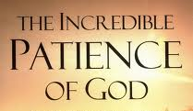
Ecclesiastes
Learning to trust God’s work in our lives!
Chapter 8: God’s justice will eventually prevail – but may not right now

Slide 12

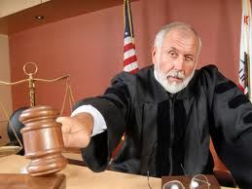
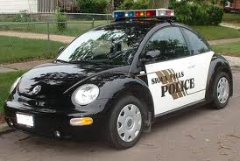
God’s wisdom will cause us to obey Authorities (8:1-8)
Who is a wise man? Wisdom will change how you respond & treat people – makes your face shine! (v.1)
Keep the king’s commandment for sake of your oath to God –
  Oath of allegiance (1 Chr 29:22-24) Wisdom helps us learn to submit
  Don’t rebel, fear the Lord & the king (Prov 24:21)
Don’t be hasty to go from his presence – in disagreement (v.3)
Don’t take your stand for an evil thing [don’t rebel against him] for he does what he pleases – He has the power to punish
King’s word has power – most people can’t question him (v.4)
God expects us to obey the authorities of the land – unless they conflict with God’s ways

Slide 13
Romans 13:1-7
Let every soul be subject to the governing authorities. For there is no authority except from God, and the authorities that exist are appointed by God. 2 Therefore whoever resists the authority resists the ordinance of God, and those who resist will bring judgment on themselves. 3 For rulers are not a terror to good works, but to evil. Do you want to be unafraid of the authority? Do what is good, and you will have praise from the same. 4 For he is God's minister to you for good. But if you do evil, be afraid; for he does not bear the sword in vain; for he is God's minister, an avenger to execute wrath on him who practices evil. 5 Therefore you must be subject, not only because of wrath but also for conscience' sake. 6 For because of this you also pay taxes, for they are God's ministers attending continually to this very thing. 7 Render therefore to all their due: taxes to whom taxes are due, customs to whom customs, fear to whom fear, honor to whom honor.
God wants us to learn submission!

Slide 14
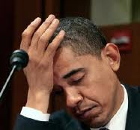
God’s wisdom will cause us to Obey Authorities (8:1-8)
He who obeys the king will not be harmed & a wise man discerns both time & judgment (v.5)
  If the king is wrong, God knows & will fix it eventually – in His time
For every matter there is a time & judgment [there is a right time & right way for everything], though man’s misery increases because he does not know what will happen (v.6-7)
  God knows the right time and way (3:9-15)
  We don’t, so we worry & fret about our future
We can’t control the wind to stop it, and can’t control the day of our death (v.8)
  There is no release in war – Soldiers aren’t released during battle
  Evil can’t release those that do evil – God’s justice will prevail
Kings & authorities make mistakes, but God is in control and His justice will prevail

Slide 15
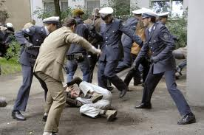
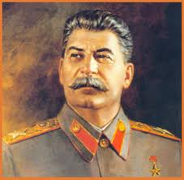
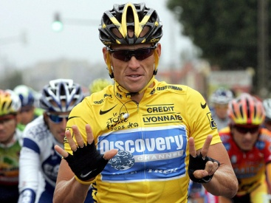
Trust God! His justice will eventually prevail, but may not in this life (8:9-15)
In the mean time, this causes stress, anxiety, etc.
“All this I have seen” – Solomon’s experience
Sometimes men will harm those they control (v.9)
Some wicked men are buried (treated honorably in death, not punished), while those who come from the place of holiness (righteous) are forgotten (10) [tough passage to translate!]
When evil people are not punished right away, it makes others want to do evil, too. (11 NCV)
Stalin
Armstrong
Our faith will help us endure!

Slide 16
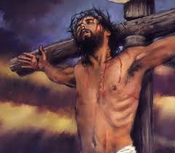
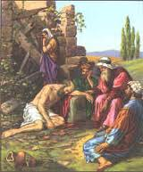
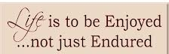
God’s Justice will eventually prevail (8:12-15)
Job
Even if sinners do evil 100 times & live long, Solomon knows it will be better for those who fear God (v.12)
The wicked will only get the days of this life – they can’t prolong their lives – their days are like a passing shadow [compared to eternal life in God’s family!] – we must be patient! (v.13)
Sometimes it seems just people suffer like the wicked, and wicked people get the lives of the just – “good things happen to bad people & bad things happen to good people” (v.14)
  In this life now we don’t get rewards or punishments according to our works
  Seems like vanity because we don’t know what God is doing in every situation
So eat, drink & enjoy the good days of life God gives you – for however long they last! (v.15) – same counsel as 2:24; 3:12,13,22; 5:18; 9:7
  Don’t over analyze events of life – enjoy the good days God gives you
Enjoy life now if you can

Slide 17

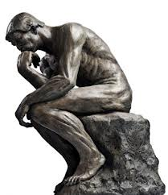
Solomon’s logic in chapter 8 demands:
There must be a future judgment
People will be resurrected from the dead
The days of the wicked will be a shadow (they cannot be immortal)
The righteous will live very long compared to the wicked, but may not in this life
He must have believed in a resurrectional judgment with future rewards

Slide 18
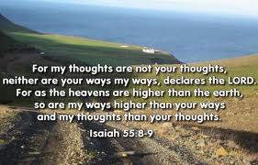

We cannot understand all God is doing
Solomon tried to use wisdom to understand all the work men do – especially busy people who hardly ever sleep (v.16)
He also tried to understand all the work God is doing & concluded that no one can really understand what God is doing (v.17)
  If someone says they do, they can’t
  Even if a wise man says he does, he can’t
Have you not known? Have you not heard? The
everlasting God, the Lord, the Creator of the ends
of the earth, neither faints nor is weary. His
understanding is unsearchable. Isa 40:28

Slide 19
Isaiah 55:7-9
7 Let the wicked forsake his way, and the unrighteous man his thoughts; Let him return to the Lord, and He will have mercy on him; and to our God, for He will abundantly pardon.
8 "For My thoughts are not your thoughts, nor are your ways My ways," says the Lord.
9 "For as the heavens are higher than the earth, so are My ways higher than your ways, and My thoughts than your thoughts.
God’s mercy is beyond us!

Slide 20
Romans 11:33-36
33 Oh, the depth of the riches both of the wisdom and knowledge of God! How unsearchable are His judgments and His ways past finding out!
34 "For who has known the mind of the Lord? Or who has become His counselor?"
35 'Or who has first given to Him and it shall be repaid to him?"
36 For of Him and through Him and to Him are all things, to whom be glory forever.
Paul’s comment after considering God’s election in Romans 9-11

Slide 21
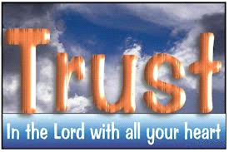
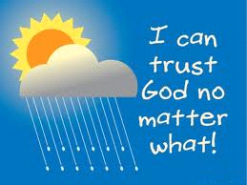
Ecclesiastes
Learning to trust God’s work in our lives!
Chapter 9: Trust all that God does now

Slide 22
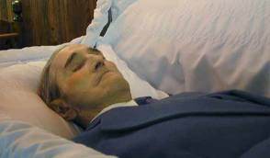
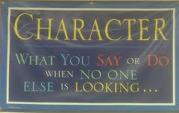
God causes both wicked & righteous to die (1-6)
Considered all this in my heart – Solomon carefully thought this over (v.1) – so he could declare it! [important issues!]
  The righteous & wise & their works are in the hand of God – God knows how they live
  No one knows whether they will experience love or hate by what they see now – can’t tell our status before God by the events of this life
  God is finding out if we really want to live His way, His kind of life – eternal life (1 Jn 5:11,13)
  We must learn to live by faith, believing in a future reward
One event happens to everyone – we all end up the same (v.2)
Since all die, many people think they can lead evil lives and all that will happen is that they will die like everyone else (v.3)
  Since God makes no consistent distinction in this life, people lose restraint and turn to evil – this is God’s test!
  People are not motivated to do good, because they have no hope!
Faith helps us live by God’s character no matter what happens!

Slide 23
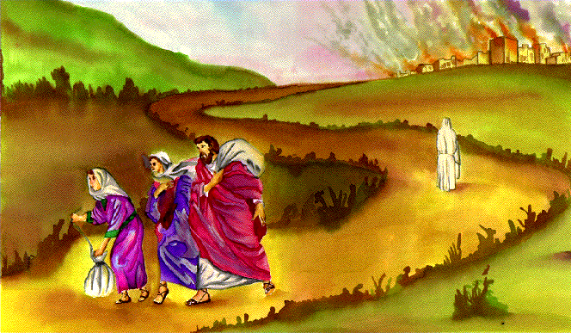

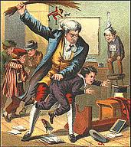
Why doesn’t God deal with us in this life according to how we live?
He’s trying to find out who really wants to live like Him
  Not because we will be punished if we don’t, but because we love God and really desire His way of life
This was one of the major issues in Job: no matter how bad things got for Job, he still held fast to his belief that God’s way of life was right (he did however think God has misjudged him)
God will grant the righteous eternal life! There can be no mistakes. He has to find out who really desires to live as a member of God’s family
If God punished us for each mistake every day, He could train us to be more like Him, but out of fear, not love!
What would happen when we get eternal life and the threat of punishment was over?

Slide 24
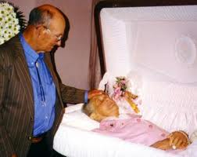

God causes both wicked & righteous to die
But there is hope for those who are still alive (v.4) – they can still respond to God
  Even a living dog (poor man) is better than a dead lion (upper class)
The living know they will die (v.5) – so they can make decisions about their future!
  But the dead know nothing – all their busy concerns are over
  No more reward (in this life), memory is forgotten (2:16)
  Their love, hatred, & envy (their passions that motivated them) have perished (v.6)
  They have no more future under the sun
So make the most of your life while you live! This is God’s gift to you!

Slide 25


Get involved in serving the Lord
S
What can you do to help?

Slide 26

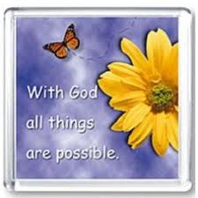

So, make the most of your life now!
Don’t brood about what is coming, go enjoy your life now (v.7) – it’s God’s gift! (3:13; 5:19)
  Eat & drink with joy & a merry heart
  For God has already approved your works [For this is what God wants you to do]
Garments white & head with oil – indicate living by practicing righteousness and doing it with the oil of gladness – positive attitude!
Live joyfully with the wife whom you love – part of God’s gift (“which He has given you”)
  Solomon messed this up and took 700 wives & 300 concubines (1Kgs 11:3)
Do it with all your might: Give your activities your best shot (v.10)
  No work or reason or knowledge or wisdom in Sheol where you are going! (this is the only use of Sheol in Ecc.)
  Giving it all your might doesn’t guarantee you will accomplish what you desire [wisdom can’t guarantee success!]
Therefore, my beloved brethren, be steadfast, immovable, always abounding in the work of the Lord, knowing that your labor is not in vain in the Lord (1Cor 15:58)

Slide 27
Colossians 3:22-25
22 Bondservants, obey in all things your masters according to the flesh, not with eyeservice, as men-pleasers, but in sincerity of heart, fearing God. 23 And whatever you do, do it heartily, as to the Lord and not to men, 24 knowing that from the Lord you will receive the reward of the inheritance; for you serve the Lord Christ. 25 But he who does wrong will be repaid for what he has done, and there is no partiality.
Work happily & sincerely, as serving Christ

Slide 28




Live joyfully with the wife whom you love all the days of your vain life which He has given you under the sun, all your days of vanity; for that is your portion in life, and in the labor which you perform under the sun.
S

Slide 29

It’s not about human effort, God is in control! (11-12)
“I returned and saw” – a new issue, usually after a conclusion
It’s not about the best human effort: no matter how hard we strive for some goal, God may get involved and alter the events!
God controls the timing of events in our lives! (v.11)
“Time and chance happen to them all”
  For everything there is a set time (3:1)
  For man does not know his time (9:12), but God does!
  “chance”: Heb word means “an occurrence or a happening”. Only other time used is 1Kings 5:4 where God is clearly in control of the events!
  This is “time and chance” from man’s perspective – not God’s
God brings bad events upon us that we couldn’t foresee or avoid (12)
  Like fish and birds that are trapped, there are times when God suddenly stops us in our tracks – not to destroy us – but to help us develop. Faith helps us see beyond the devastating event (like Paul’s blindness in Acts 9)
Behold, God works all these things, twice, in fact, three times with a man, to bring back his soul from the Pit, that he may be enlightened with the light of life. (Job 33:29-30)

Slide 30
2
S
G

Slide 31
Matthew 6:26-34
26 Look at the birds of the air, for they neither sow nor reap nor gather into barns; yet your heavenly Father feeds them. Are you not of more value than they? 27 Which of you by worrying can add one cubit to his stature?
28 "So why do you worry about clothing? Consider the lilies of the field, how they grow: they neither toil nor spin; 29 and yet I say to you that even Solomon in all his glory was not arrayed like one of these. 30 Now if God so clothes the grass of the field, which today is, and tomorrow is thrown into the oven, will He not much more clothe you, O you of little faith?
31 "Therefore do not worry, saying, 'What shall we eat?' or 'What shall we drink?' or 'What shall we wear?' 32 For after all these things the Gentiles seek. For your heavenly Father knows that you need all these things. 33 But seek first the kingdom of God and His righteousness, and all these things shall be added to you. 34 Therefore do not worry about tomorrow, for tomorrow will worry about its own things. Sufficient for the day is its own trouble.
God is in control. Our Faith will motivate us to trust Him in all the events of life, no matter what!

Slide 32


Wisdom is superior to strength, but not appreciated (13-18)
“Seemed great to me”(13) – this was important to Solomon
A great king besieged a little city with few men (14)
A poor wise man delivered the city by his wisdom, but no one remembered the man! (15)
  Similar to the event of the wise woman of Abel of Beth Maachah in 2 Sam. 20:15–22
  Wisdom will help save us too – teaches us to trust God – He’s in control
Wisdom is better than strength, but not appreciated [due to failure of humans] (16)
Quiet words of wisdom should be rated higher than loud words of a ruler of fools (17)
Wisdom is better than weapons of war – much better to solve the problem than fight (18)
  One sinner destroys much good: all it takes is one unkind, badly timed word to destroy all that wisdom has patiently worked towards
A fool vents all his feelings, but a wise man holds them back. (Prov 29:11)

Slide 33

Wisdom is better than weapons of war

Slide 34


Ecclesiastes
Learning to trust God’s work in our lives!
Chapter 1o: Wisdom plans for the Future

Slide 35



Wisdom brings discretion because it plans for the future!
Dead flies make perfume stink, a little folly can spoil wisdom – only takes a little to overcome much good!
  All you had to do is cover the perfume!
Wisdom affects our heart (mind) and influences us to do right (v.2)
I have taught you in the way of wisdom; I have led you in right paths. 12 When you walk, your steps will not be hindered, And when you run, you will not stumble. 13 Take firm hold of instruction, do not let go; Keep her, for she is your life. (Prov 4:11-13)

Slide 36




God’s Wisdom in our Minds
If affects choices we make

Slide 37

Wisdom brings discretion because it plans for the future!
Dead flies make perfume stink, a little folly can spoil wisdom – only takes a little to overcome much good!
  All you had to do is cover the perfume!
Wisdom affects our heart (mind) and influences us to do right (v.2)
I have taught you in the way of wisdom; I have led you in right paths. 12 When you walk, your steps will not be hindered, And when you run, you will not stumble. 13 Take firm hold of instruction, do not let go; Keep her, for she is your life. (Prov 4:11-13)
Fools give themselves away even by the way they walk along the road (v.3) – maybe can’t find trodden pathway
  May not have planned the direction of their trip
If the ruler gets mad at you, don’t quit your job. Remaining calm solves great problems (v4)
  Wisdom teaches us to patiently continue on

Slide 38
Proverbs 3:21-26
21 My son, let them not depart from your eyes — Keep sound wisdom and discretion;
22 So they will be life to your soul, and grace to your neck.
23 Then you will walk safely in your way, and your foot will not stumble.
24 When you lie down, you will not be afraid; Yes, you will lie down and your sleep will be sweet.
25 Do not be afraid of sudden terror, nor of trouble from the wicked when it comes;
26 For the Lord will be your confidence, and will keep your foot from being caught.
Wisdom brings life, safety, peace, security

Slide 39





Wisdom helps us prepare now for a better future! (10:5-11)
Rulers make appointment mistakes that will cost them (5):
  Fools are given high positions, while noble people are given low jobs (v.6)
  Servants ride horses, while princes walk (v.7)
Wisdom helps you take precautions:
  If you dig a hole, you may fall into it (v.8)
  If you knock down a stone wall, you may be bitten by a snake
  If you quarry stones, you may be hurt by them (v.9)
  If you split wood, you may be injured (v.10)

Slide 40







Wisdom plans to prevent problems!
G

Slide 41


Wisdom helps us prepare now for a better future! (10:5-11)
Wisdom teaches you to act in time!
  If you use a dull axe, you will have to work harder (v.10) so sharpen the axe before you start chopping!
  If the serpent bites before being charmed, what good is the tamer? [NASB] (v.11)
Wisdom makes a difference in your life!

Slide 42


Fools lack discretion in speech because they live for the moment (12-15)
Words of wise are gracious, but the lips of fools will swallow him up! (v.12)
  Fools don’t plan ahead on what they say
A fool's mouth is his destruction, and his lips are the snare of his soul. (Prov 18:7)
The fool begins with words of folly, and ends with wicked madness! (v.13)
The fool has lots to say about the future, but he doesn’t really know what will happen after him (14)
  Prov 17:27 “He who has knowledge spares his words”
Fools get so tired by a little work, that they don’t even know how to get home (can’t find the trodden pathway back to the city!)
David & Nabal

Slide 43


Fools make poor decisions & in the end it will cost them! (16-20)
It’s sad when the king is an immature child & princes already are feasting in the morning (16) [maybe Rehoboam!]
Land is bless when the king is a son of nobles & princes feast for strength – not drunkenness (17)
Laziness will allow a building to decay & idleness will allow a house to leak (18)
  What is true of a literal house is true of the government house too!
Examples of reckless extravagance of fools: feast is for laughter, wines makes merry, money answers everything (v.19)
YOU: Don’t curse the king or nobles (even in your thoughts or bedroom, for a bird might carry your voice & tell the matter!(20)
Wisdom leads to a better way to live!

Slide 44



Wisdom teaches us to….
Use our time wisely
Make good, thought out choices
Prepare now for the future
Take precautions to prevent accidents
Stay calm & don’t make hasty decisions
Be careful what we say

Slide 45


If Wisdom can help us have a better life now, it also can help our spiritual life too!
Chapters 10 & 11 deal with the practical benefits of wisdom, then lead into the spiritual benefits of wisdom as Solomon’s final thought
Remember now your Creator in the days of your youth….

Slide 46


Solomon’s Discoveries so far
You will have lower frustration and depression in life if you realize that:
1) life is not fair (equal) – Don’t expect it to be!
God custom designs what we need
2) Don’t bother trying to over-excel…….
To be the best in this life at job, skill, etc.
Get the most out of this life - $$$, pleasure
3) Appreciate the simple things of life & believe (faith comes in here) that in all things now, God is preparing you for a better life to come
4) Don’t think you can judge anyone by the events of their life now. God is testing us to see if we really love his ways
He had to learn by experience!

Slide 47

Next: Exhort
We’ll look at how faith lets us trust God’s future plans for us & the importance of choosing to serve God while we are young

