Slide 1
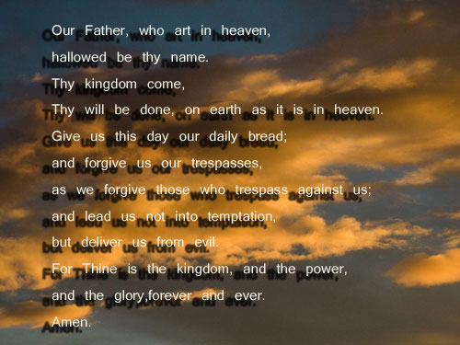
Notes:
And when thou prayest, thou shalt not be as the hypocrites are: for they love to pray standing in the synagogues and in the corners of the streets, that they may be seen of men. Verily I say unto you, They have their reward.
⁶ But thou, when thou prayest, enter into thy closet, and when thou hast shut thy door, pray to thy Father which is in secret; and thy Father which seeth in secret shall reward thee openly.
⁷ But when ye pray, use not vain repetitions, as the heathen do: for they think that they shall be heard for their much speaking.
⁸ Be not ye therefore like unto them: for your Father knoweth what things ye have need of, before ye ask him.
⁹ After this manner therefore pray ye: Our Father which art in heaven, Hallowed be thy name.
¹⁰ Thy kingdom come, Thy will be done in earth, as it is in heaven.
¹¹ Give us this day our daily bread.
¹² And forgive us our debts, as we forgive our debtors.
¹³ And lead us not into temptation, but deliver us from evil: For thine is the kingdom, and the power, and the glory, for ever. Amen.

Slide 2
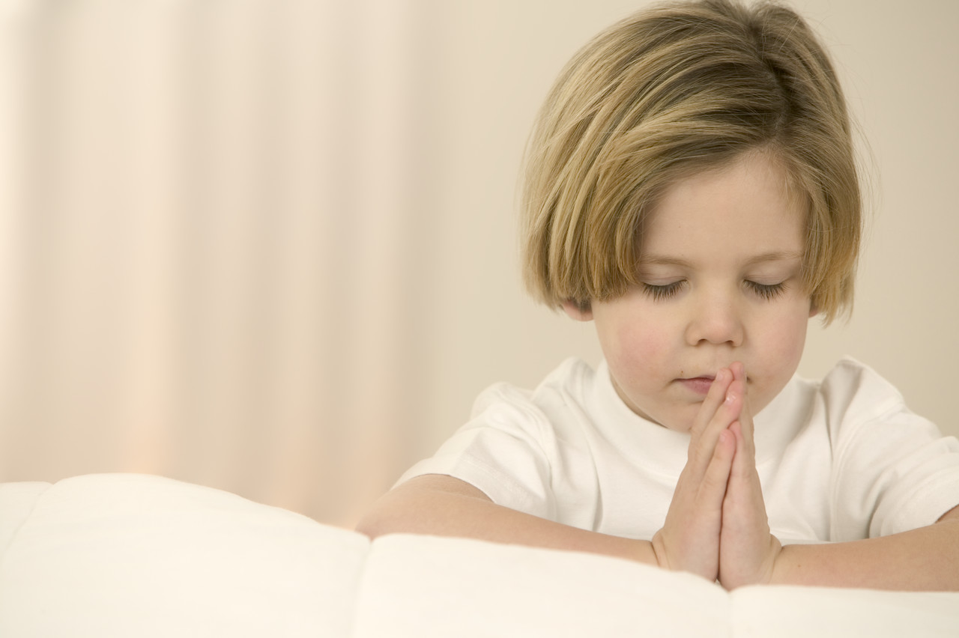
Is Prayer Relevant in the 21 Century?
Notes:
is prayer relevant in the 21st century?
What causes Christians around the world, pray to an entity that they cannot see (PHISICALLY) and that they only know exists through the reading of the Holy Scriptures.
Not debate if a God, or who worships true God.
Use King James authorised version,
It is undeniable that for any religious denomination prayer plays a fundamental part of the individuals worship.
Prayer-sensitive subject, personal.
Even those no religious conviction at all, when faced with crisis, or stark reality of death, resort to prayer as comfort.
many of the world’s great leaders some of the most powerful men in history have been men of prayer
With that in mind then, let’s set out what we aim to achieve of this evening.

Slide 3
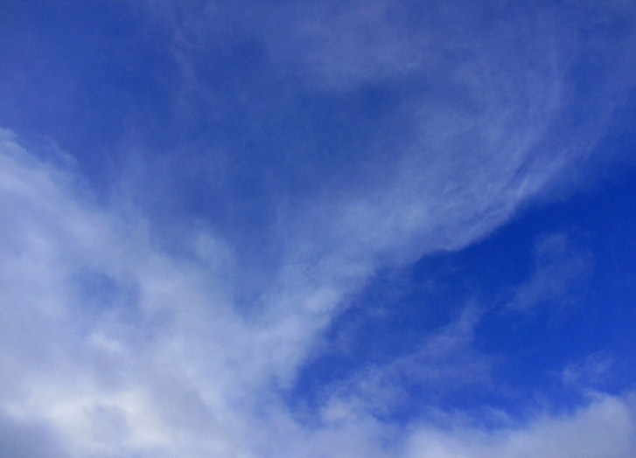
What is Prayer – how should it be performed?
Examine prayers – to see if answered?
Summary:
What reasons if any, for not being prayerful?
Notes:
Firstly, we will aim to establish what prayer is, and how to perform it. We will look at examples of the prayers of faithful believers and the importance they placed upon it.
Secondly, we will examine some of these prayers in more detail to establish whether the prayer was answered and try to establish from their examples a template for our own prayer.
Thirdly, and to summarise, we will try to establish whether there is any good reason not to put our trust and faith in prayer in this-the 21st century.
>:@~?

Slide 4
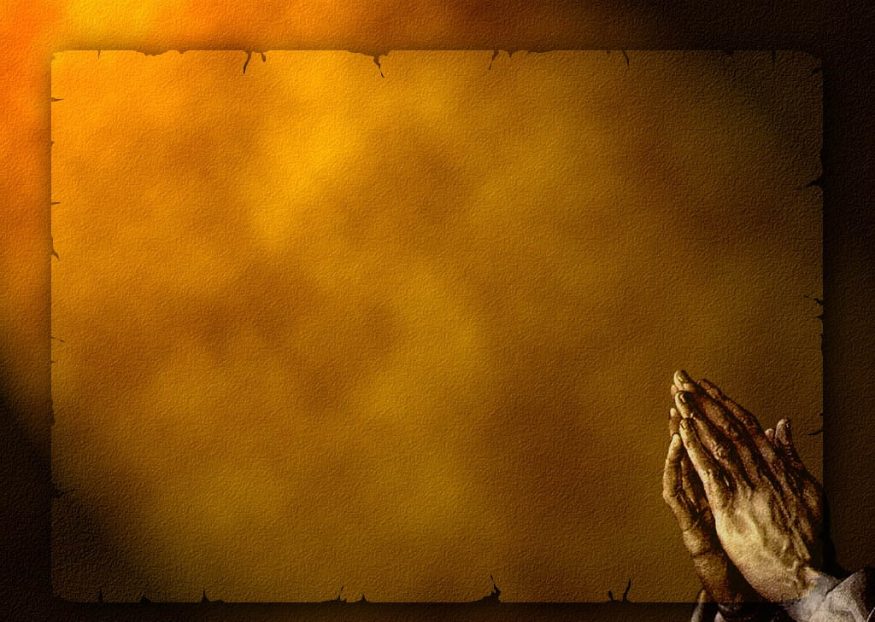
What is Prayer?
Prayer is an invocation or act that seeks to activate a rapport with a deity or object of worship through deliberate communication.
From Wikipedia, the free encyclopedia
Notes:
Button 1: our first question is ….So what then is prayer?
Button 2: read… definition
>:@~?

Slide 5
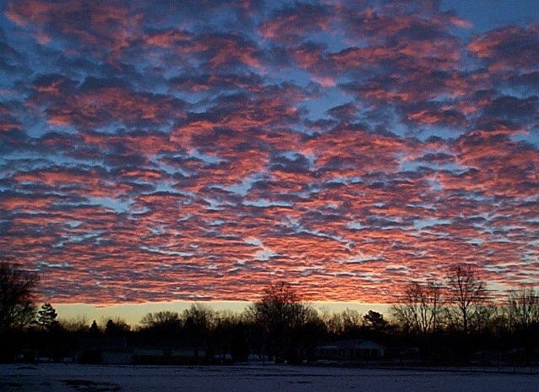
Gen 4:26
And to Seth, to him also there was born a son; and he called his name Enos: then began men to call upon the name of the LORD.
Notes:
first instance prayer in scripture, found genesis 4:26.
Button 1: how did they call on his name…pray?
Is there a correct way to pray?
Let’s spend a few mins to try establish correct, acceptable way to pray according to the examples in scripture…
>:@~?

Slide 6
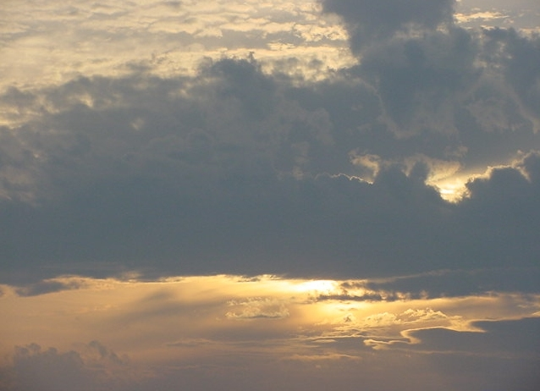
Gen 20:7
Now therefore restore the man his wife; for he is a prophet, and he shall pray for thee, and thou shalt live: and if thou restore her not, know thou that thou shalt surely die, thou, and all that are thine.
Notes:
Read…
Look between lines……
Interesting, 1st instance intercessor…… took prayer of another to spare pharaoh,
Not able to pray for himself!
Perhaps did not know how to approach God.
2 points
1: pray for others
2: Not all are Prayers acceptable!!
For God to hear the prayer, must come from someone who is in tune with God.
What ever that was, Abraham had it! first important thing we note.
So prudent to look at life of Abraham as example.
What about posture? Is there a exact posture for prayer?
No indication of posture only that Abraham new the correct way…
There seems no hard and fast Rules, although it’s very clear from the following verses that certain criteria must be met.
>:@~?

Slide 7
1 Kings 8:54
And it was so, that when Solomon had made an end of praying all this prayer and supplication unto the LORD, he arose from before the altar of the LORD, from kneeling on his knees with his hands spread up to heaven.
Notes:
What do we notice from this account..
well….
>:@~?

Slide 8
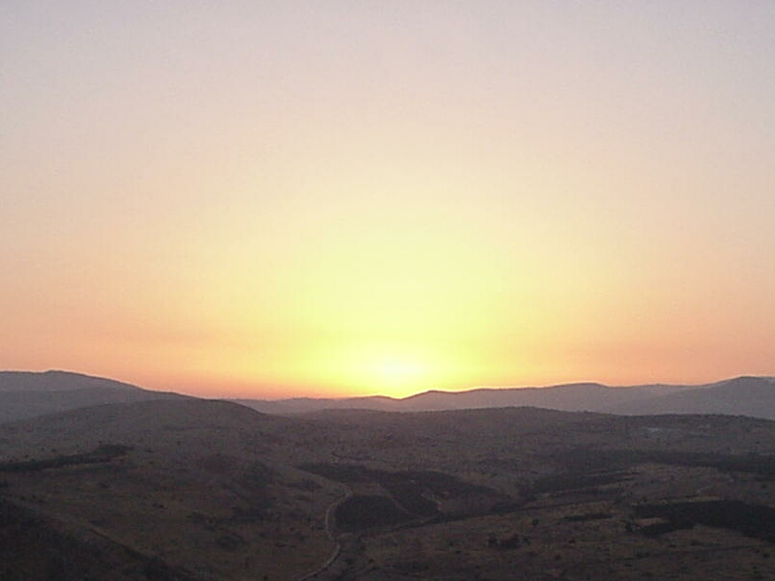
And it was so, that when Solomon had made an end of praying all this prayer and supplication unto the LORD, he arose from before the altar of the LORD, from kneeling on his knees with his hands spread up to heaven.
Notes:
@Arose from kneeling
And again…..
>:@~?

Slide 9
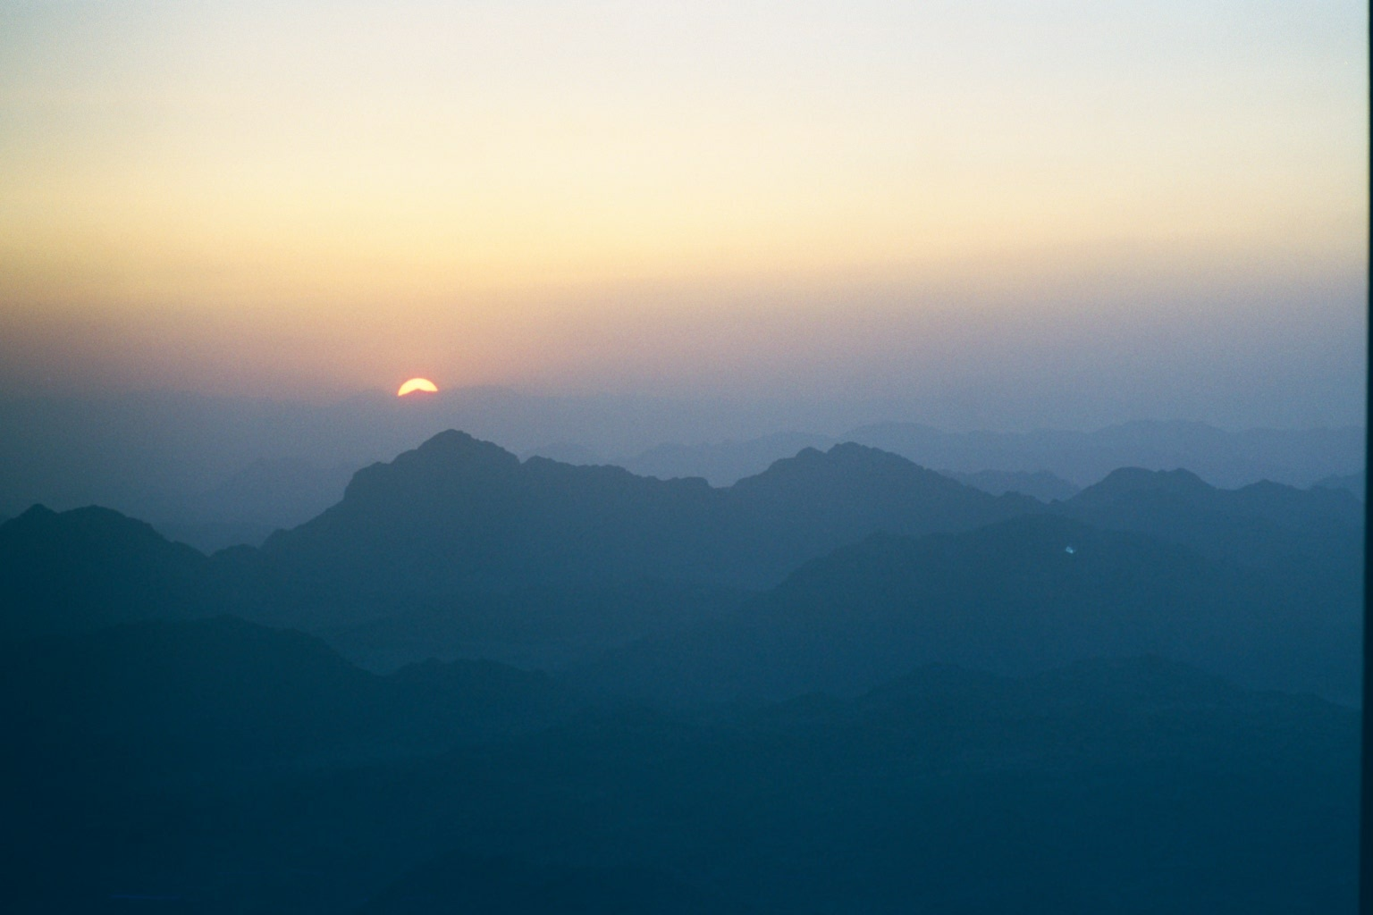
Exodus 4:31
31 And the people believed: and when they heard that the Lord had visited the children of Israel, and that he had looked upon their affliction, then they bowed their heads and worshipped
Notes:
Next:
>:@~?

Slide 10
Exodus 4:31
31 And the people believed: and when they heard that the Lord had visited the children of Israel, and that he had looked upon their affliction, then they bowed their heads and worshipped
Notes:
We are not told if they were standing or kneeling only that there heads were bowed.
Principle established….almost all accounts have heads bowed.!!
So, they bowed there heads.
A sign of humbleness….
and again…..
>:@~?

Slide 11
2 Chronicles 20:18
18 And Jehoshaphat bowed his head with his face to the ground: and all Judah and the inhabitants of Jerusalem fell before the Lord, worshipping the Lord.
Notes:
Next:

Slide 12
2 Chronicles 20:18
18 And Jehoshaphat bowed his head with his face to the ground: and all Judah and the inhabitants of Jerusalem fell before the Lord, worshipping the Lord.
.
Notes:
Again, bowing the head
Acknowledgement of Gods greatness and the worshipers unworthiness.
Think getting general idea….
But continue….
What about the new testament – time of Jesus…
>:@~?

Slide 13
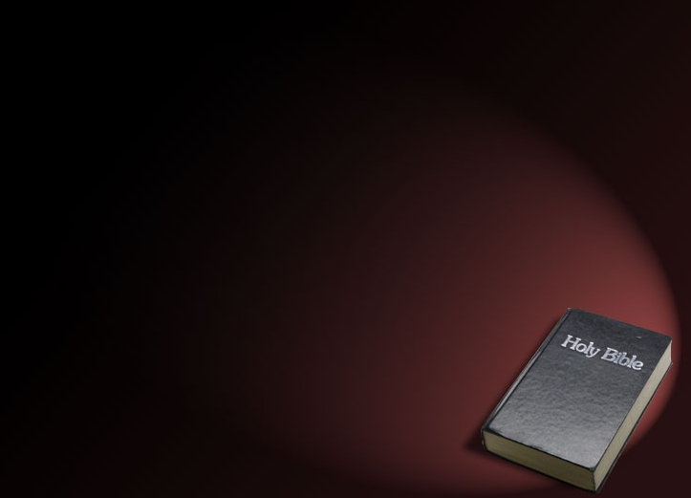
Our Father which art in heaven, Hallowed be thy name.
Thy kingdom come, Thy will be done in earth, as it is in heaven.
Give us this day our daily bread.
And forgive us our debts, as we forgive our debtors.
And lead us not into temptation, but deliver us from evil: For thine is the kingdom, and the power, and the glory, for ever. Amen.
Notes:
Button 1 :The most obvious place to start is mat 6 – the model prayer. Vs:5-13 [READ]
The first thing we note vs. 5, is Jesus comments are to the individual – not a group or a leader of a church – the individual - YOU.
Vs:6 Not to be showy. It’s a state of mind….
vs: 7 Think about what say – not just repeat phrases that you find easy. Develop real relationship.
Vs: 8 don’t be intimidated by others prayers, you will be heard if sincere – God not interested in ability. Flowery words.
Vs: 9 then we have the order, priority
>:@~?

Slide 14
Our Father which art in heaven, Hallowed be thy name.
Thy kingdom come, Thy will be done in earth, as it is in heaven.
Give us this day our daily bread.
And forgive us our debts, as we forgive our debtors.
And lead us not into temptation, but deliver us from evil: For thine is the kingdom, and the power, and the glory, for ever. Amen.
Notes:
the first is …
praise,
will,
provision,
forgiveness,
help,
>:@~?

Slide 15
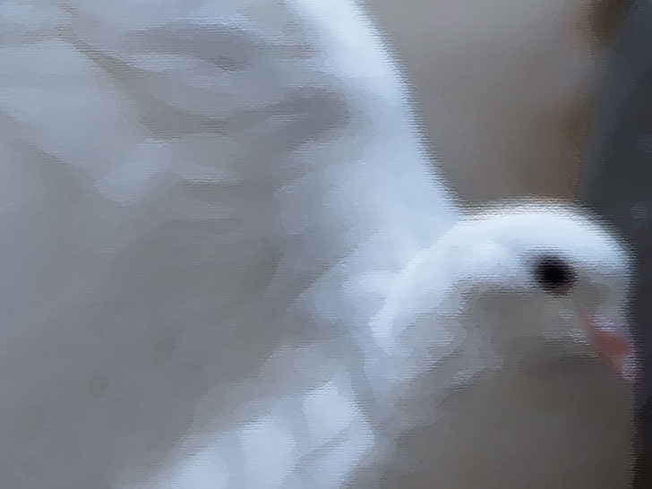
1: God is greater than us.
2: We need to understand what Gods will is.
3: Conditions apply.
Notes:
What can we glean from this example … 3 fundamental points….
1: God is greater than us and able to hear us and answer our request. – requires us to be humble.
2: God’s will- that requires effort and understanding on our part – so need to read his word, What were doing tonight.
3: Conditions – cannot ask for forgiveness if we not prepared to forgive others.
This is template, a basis for our own, and we should structure our own to reflect individual ongoing circumstances.
Not sufficient to repeat this prayer – our petitions must come from the heart.
Ecclesiastes offers further advise….
>:@~?

Slide 16
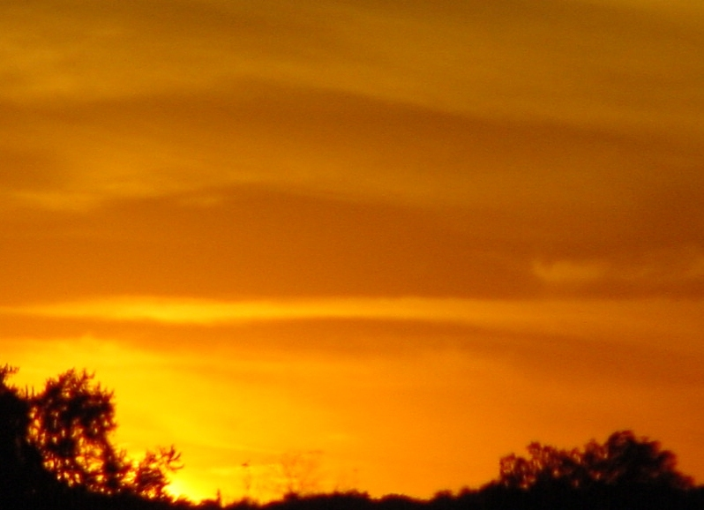
Ecclesiastes 5:2
Be not rash with thy mouth, and let not thine heart be hasty to utter any thing before God:
for God is in heaven, and thou upon earth: therefore let thy words be few.
Notes:
Button 1: Read:
Not abuse this privilege we have of prayer – reminded that should not be flippant.
That we should perhaps meditate and consider how and what we will ask for before prayer.
Lets consider example of prayer from both view points…
Unacceptable and Acceptable to God
>:@~?

Slide 17
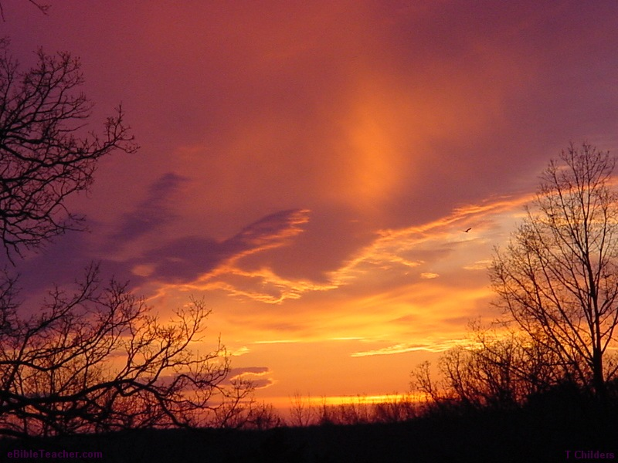
Luke 18 vs: 9-14
The Pharisee and the Publican
The Problem: The attitude: self-righteousness
He approached God with familiarity (he was standing when it would seem more appropriate to kneel.
Luke 18 vs: 9-14
Notes:
Button 1,2
then Read: 9-12 stop
Background….
What The Problem:
Button 3: The attitude: self-righteousness, Self-importance
He prayed vs:11…. “to himself.” – didn’t need God for anything didn’t feel he needed any help just for show
He compared himself to others and was very condemning of others. No empathy, or compassion.
not what God wants from us
Posture…
Button :4 His Stance
He approached God with familiarity (he was standing when it would seem more appropriate to kneel
So this really just confirmed what seen so far.
attitude / approach/ posture.
what about the other prayer recorder here……
~@:>

Slide 18
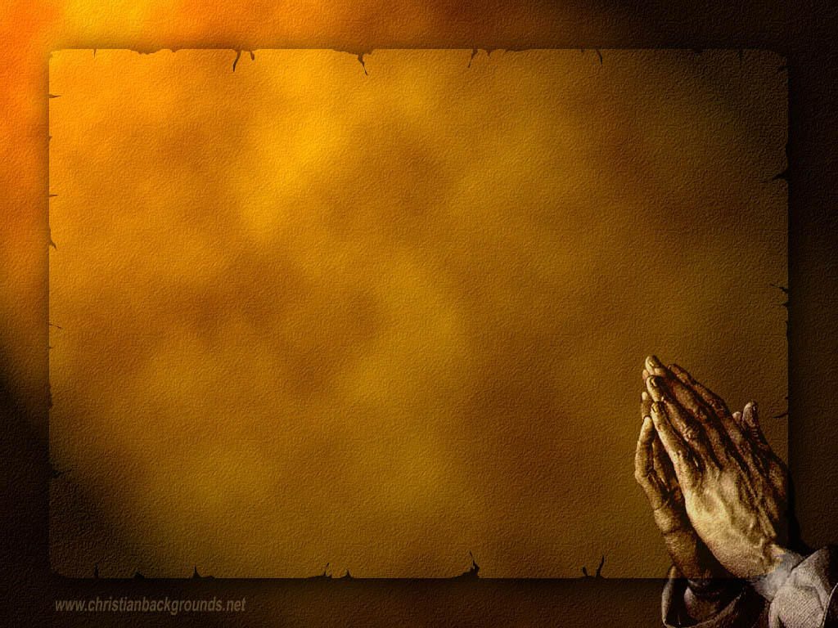
His posture?
He was unwilling to lift his eyes.
This showed his humility.
He was beating his breast
Notes:
Read vs 13
Button 1: In accordance with what seen so far…..
Button 2: Opposite to Pharisee.
Humble, in need of help.
Acknowledged his own sin.
Button 3: Which in that culture was the outward sign of an inward pain in one’s soul usually only seen at funerals
What about his prayer?
~@:>

Slide 19
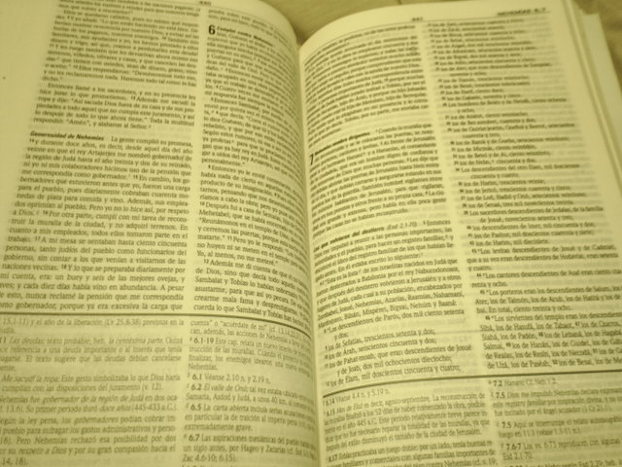
His plea!
Is Prayer relevant in the 21st century?
Depends on God!
He understands and accepts his position!
His asks for Mercy!
A Sinner!
Notes:
Button 1: was a Plea not Boast
Button 2 : read…
Button 3: cant save himself.
Button 4: acknowledge sin
Button 5: been suggested, the sentiment shown here is make this prayer complete. – wonderful template for our own.
Principle - therefore the self-condemned, and not the self-righteous, are justified before God.
Justification of God, = whereby He extends mercy to the repentant sinner who comes to Him in faith.
The one who exalts himself will be humbled and the one who humbles himself will be exalted. v14
Again…Important principle re: prayer – must understand our position before God
The 7 words of that mans prayer perfectly summarise the correct approach to God.
It starts with God and ends with “me a sinner”
>:@~?

Slide 20
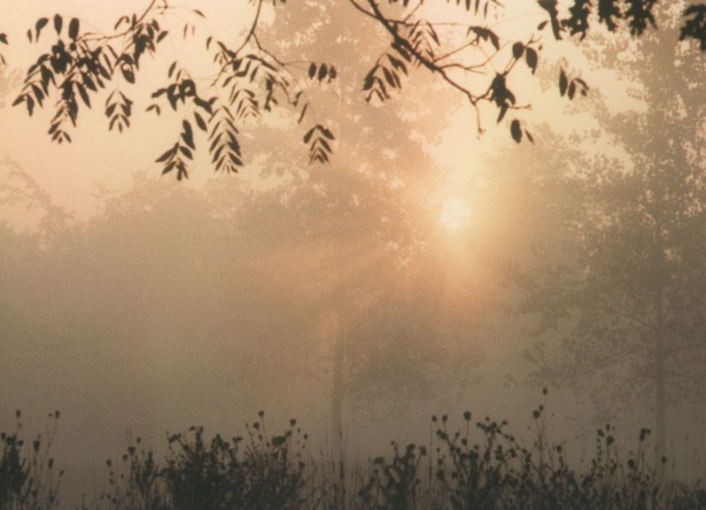
Is Prayer relevant in the 21st century?
Why do we need to Pray?
Why did Jesus need to Pray?
Notes:
Button 1: read
Much the same reasons as the publican…..
To be justified and acceptable before God
Button 2: Dependant on God just as we are. This is Reflected in the things he sought God in prayer for….
Some 25 prayers recorded…
Gloryfied God / Before walking on water / before choosing his disciples / for his disciples / for those who killed him…..
We must recognise that we are in need, and that God alone can meet our needs.
Accepting that God alone can do what we cannot – forgive our sin (tresspass)
By accepting this we bow down to his greatness and acknowledge his grace and mercy towards us.
This is praise! We praise him and give him the glory to him because we are dependant on his love towards us – not the other way around!!!
This is not something which modern man is accustomed to……. Humbleness /
>:@~?

Slide 21

Is Prayer relevant in the 21st century?
Are our Prayers answered?
Notes:
Button 1: Let us consider the power of faithful prayer.
There are so many examples of prayers that have been answered in a Dramatic way through out scripture Samson’s prayer to name but one…
Think of David's prayer for his child.
We can be confident the publican was forgiven.
But what about our daily prayers? here in the 21c –
Well-all evidence suggests we have assurance that if adopt the correct approach as we just detailed, we Will be heard, and if in accordance with Gods will - answered.
But are there any limitation?……..
>:@~?

Slide 22

Depends on what we are praying for!
Is Prayer relevant in the 21st century?
Asking God for favours!
Mat 7:7
Ask, and it shall be given you; seek, and ye shall find;….
Notes:
Button 1: Depends on what ask for - this we have clearly seen in our study so far.
Button 2: For many, prayer is asking God for favours, usually when faced with some crisis in their lives that they cannot control.
Button 3: read….This usually given as justification : yes, its true, if as said, approach with right mind…
If right mind then will not seek our own will to be done – accept humbly the answer we are given.
The response can be in a number of ways……
>:@~?

Slide 23
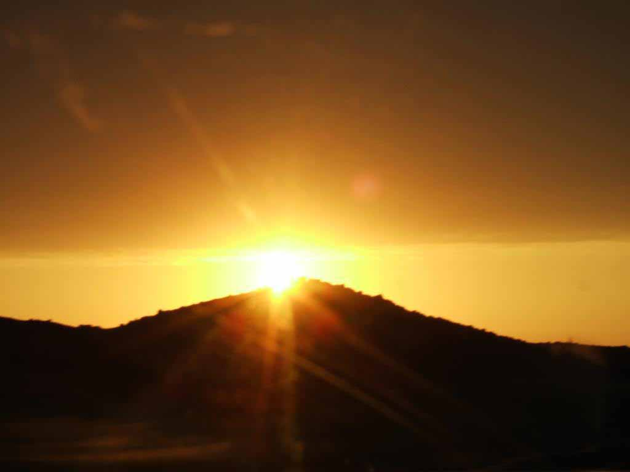
No!
Yes!
Wait!
Notes:
Button 1:
Button 2 :
Button 3:
No prayer disregarded if seeking God’s will in sincerity.
Gods knows what's best for our eternal salvation.
May not appreciate it when suffering, or lost our way.
Or the fact our ‘problems’ just don’t disappear!
but we must learn to trust God.
Lets consider another example of this….
>:@~?

Slide 24
Luke 22:42
Saying, Father, if thou be willing, remove this cup from me: nevertheless not my will, but thine, be done..
43 And there appeared an angel unto him from heaven, strengthening him.
Notes:
Again Jesus situation caused him to pray saying….
Button 1: read
Now although his prayer was not answered in the manner he requested – God did answer in another way…
Button 2: read
Jesus : showed perfect understanding. Accepting gods will for him….
Again shows us how to pray….
And so submitted his will to Gods will, accepted it, just as David did.
James give us some invaluable advise…..
~@:>

Slide 25
James 5:16, "Therefore, confess your faults one to another, and pray for one another, that ye may be healed.
The effectual fervent prayer of a righteous man availeth much."….
Notes:
Button 1: read…
Button 2: read…..or The prayer of a righteous person is powerful and effective. (NIV)
our prayers if aligned with Gods will, will be effective.
both David and Jesus in our examples showed great understanding.
Look at vs to confirm for us …..
?~@:>

Slide 26
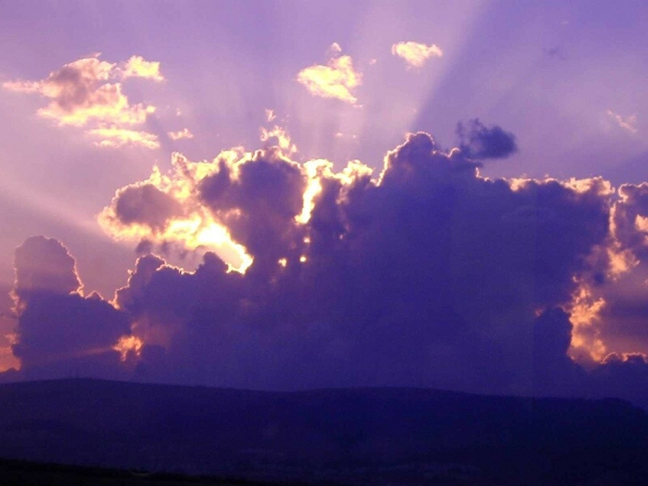
And this is the confidence that we have in him, that, if we ask any thing according to his will, he heareth us: (1John 5:15)
Notes:
Button 1:
and again…
?~@:>

Slide 27
And whatsoever we ask, we receive of him, because we keep his commandments, and do those things that are pleasing in his sight. 23 And this is his commandment, That we should believe on the name of his Son Jesus Christ, and love one another, as he gave us commandment. (1John 3:22, 23)
Notes:
Button 1:
and again…..
?~@:>

Slide 28
If ye abide in me, and my words abide in you, ye shall ask what ye will, and it shall be done unto you. (John 15:7)
Notes:
Button 1:
and again…..
?~@:>

Slide 29
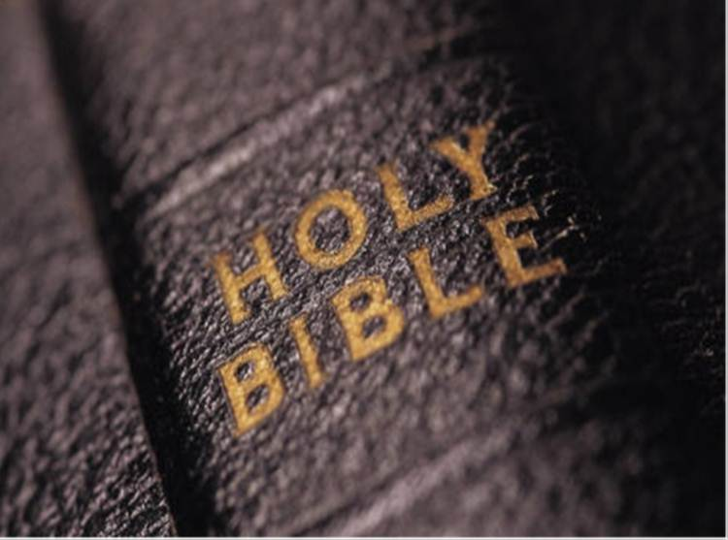
  13 And whatsoever ye shall ask in my name, that will I do, that the Father may be glorified in the Son. 14 If ye shall ask any thing in my name, I will do it. (John 14:13, 14)
Notes:
Button 1:
So what kind of things should Believer pray for……
here are some examples
?~@:>

Slide 30
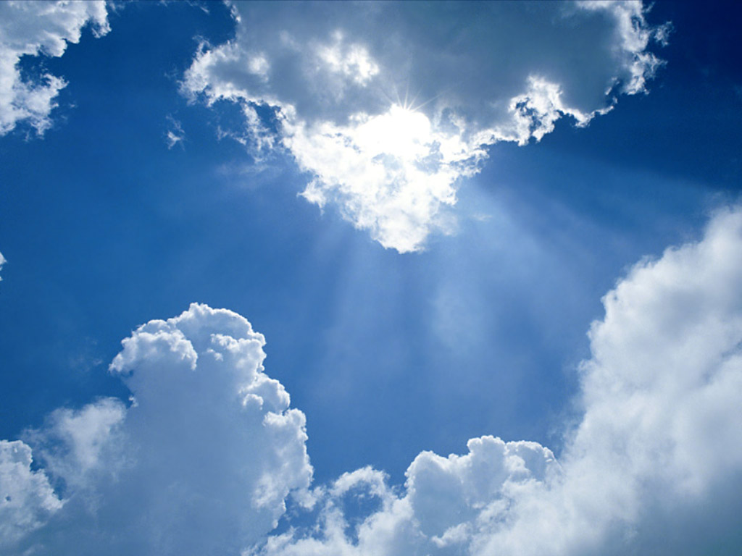
Forgiveness
Divine Care
Strength
Wisdom in Spiritual things
Others
Sickness/Health
Peace (Israel, Jerusalem, the earth
Guidance/Help
Thanksgiving (Food, Shelter, Health – Blessings of Life
To find the “Truth”
of God’s word
Notes:
Button 1: so perhaps the sort of things a True follower of God Might pray for….
?~@:>

Slide 31
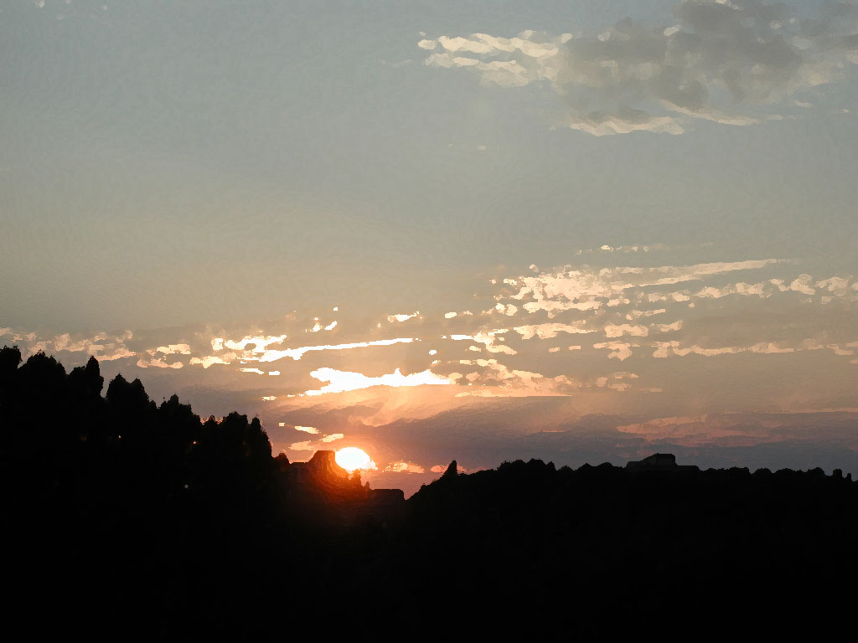
Personal
Circumstance
Notes:
Button 1:
We may be tempted to ask for a outcome to situation, that to put it bluntly, may be selfish
fame, money, popularity….
We tend to view things from a personal perspective. What we think is best..
Hard to view the big picture – esp when confronted with personal tragedy or dilemma.
But often many years later we can look back and feel that things turned out for the best.
even if we never understand why things happened we have the assurance that …
?~@:>

Slide 32
Rom 8:28
And we know that all things work together for good to them that love God,
Notes:
Button 1:
The apostle James warns against asking for petty and selfish things –
~@:>

Slide 33
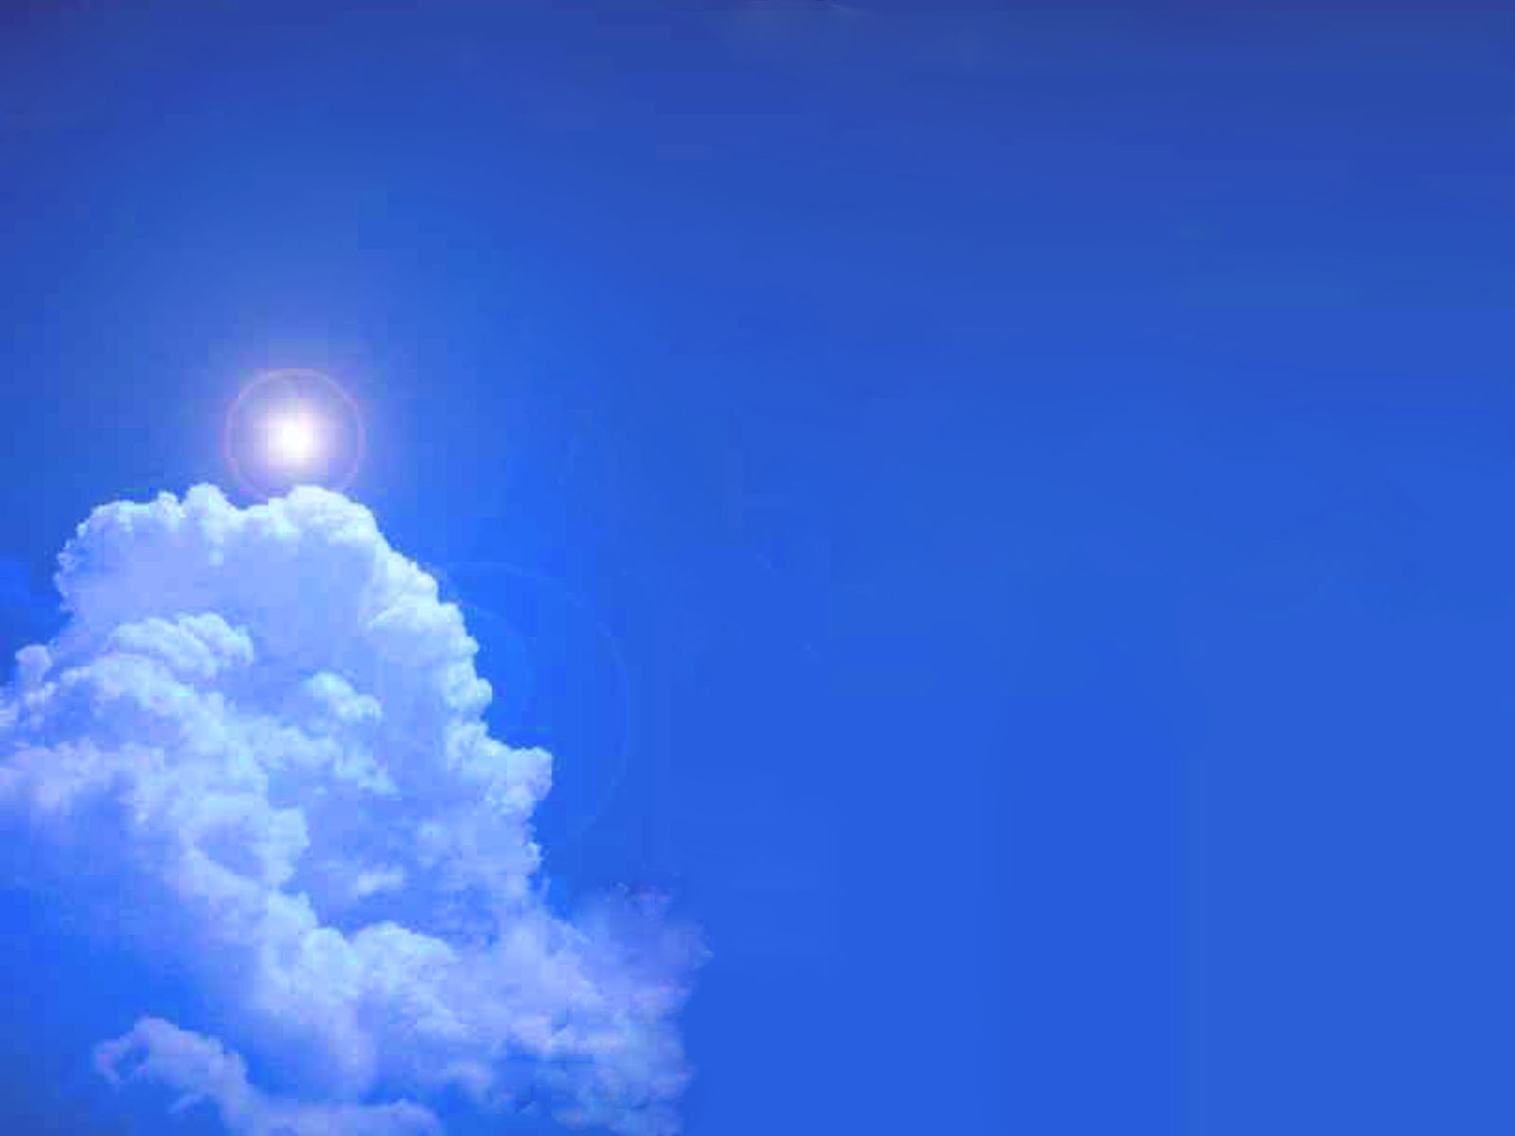
James 4:3
Ye ask, and receive not, because ye ask amiss, that ye may consume it upon your lusts.
Notes:
Button 1:
So yet again we see that a persons mind must be in tune as far as is humanly possibly with God’s.
If they are then we will seek those things which will need to develop spiritually and not materially.
Think of King Solomon. He was told to ask for anything, he asked for wisdom to rule Gods people –
Showed a mind intent on seeking Gods will.
This then, was a selfless prayer!
Praying for others, I suggest, demonstrates a perfect understanding of Gods Love.
Gods has put in place a wonderful medium for us that we show empathy for our fellow man.
~@:>

Slide 34
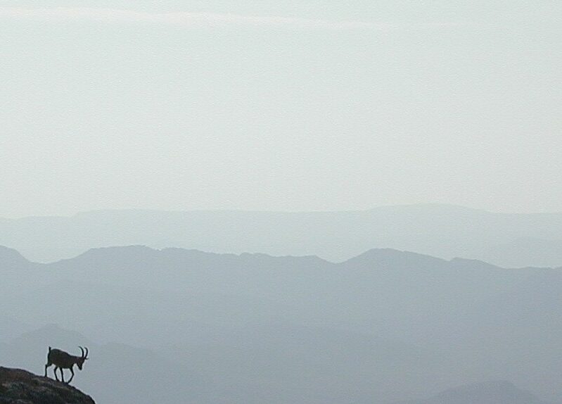
Mark 12:30
love the LORD thy God
Mark 12:31
Thou shalt love thy neighbour as thyself.
Notes:
We have already seen that to make our prayers effective we need to think in harmony with the mind of God.
We are reminded that ………
Button 1:
Read…. if we Love the …… heart, soul, mind, strength,
Button 2:
and, read…thou shalt…….
Then our Prayer will be acceptable, heard and acted upon.
Because we are seeking Gods will and not our own.
But we are still sin?
How can God consider our prayers when we are still sinful?
~@:>

Slide 35
Forgive us our sins.
Believe
Be Baptized.
Notes:
Button 1:
Forgive our sins…refer back to Lords prayer….Important: without this no relationship with God.
Button 2:
He that believeth
Button 3:
and is baptized shall be saved; Mark 16:16
Then we become….as Ephesians 2:19 says…
“Now therefore ye are no more strangers and foreigners, but fellow citizens with the saints, and of the household of God”
We become B&S of Jesus, Sons and daughters of God.
Our hope and ambitions will take on a new direction
That of pleasing God and not ourselves…..
~@:>

Slide 36
Is Prayer Relevant in the 21 Century?
Notes:
Button 1: Read..
May I respectfully suggest, answer is YES : More than ever!
God is soon going to replace the Earthly kingdoms of men with the Earthly kingdom of God with Jesus at its head.
Let us give the last word to the inspired scriptures…………..
~@:>

Slide 37
Last word!
1 Thessalonians 5
17 Pray without ceasing.
18 In every thing give thanks: for this is the will of God in Christ Jesus concerning you.

Slide 38
He prayed upon the mountain, He prayed for you and me,
He prayed in humble dwellings, He prayed beside the sea.
He prayed in early morning, Prayed with all His might,
He prayed at noonday and at dusk, He prayed all thro’ the night.
He prayed for those who scorned Him, For those who killed Him, too,
He prayed, “Father forgive them: They know not what they do.”
He prayed when He was lonely, He prayed when He was sad,
He prayed when He was weary, He prayed when He was glad.
He prayed for those in sorrow, He prayed for those in sin,
He prayed for those in trouble, That they might come to Him

Slide 39
Is Prayer relevent in the 21st century?
He prayed upon the mountain,
He prayed for you and me,
He prayed in humble dwellings,
He prayed beside the sea.
He prayed in early morning,
Prayed with all His might,
He prayed at noonday and at dusk,
He prayed all thro’ the night.
He prayed for those who scorned Him,
For those who killed Him, too,
He prayed, “Father forgive them:
They know not what they do.”
He prayed when He was lonely,
He prayed when He was sad,
He prayed when He was weary,
He prayed when He was glad.
He prayed for those in sorrow,
He prayed for those in sin,
He prayed for those in trouble
That they might come to Him

Slide 40
2 Sam 12:14-23
David's sin and his acceptance of Gods punishment….
Notes:
Button 1: Read 2 sam 12:14-23
Example of right mind…
Great lesson for all of us.
He was told the child would die…..but still besought God for the child….
– how do we explain this….
Lets consider another example….
?~@:>

Slide 41
Acts 12:5
Peter therefore was kept in prison: but prayer was made without ceasing of the church unto God for him.
Notes:
Button 1: Read….
On this occasion, because the will of Peter’s friends was in tune with Gods.
their prayers were answered. And peter was restored to them by a miracle – direct intervention by God.
Peters friends could not be sure what Gods intention for peter were.
interesting – the were astonished!....
But they would have accepted Gods will, what ever the outcome.
~@:>

Slide 42
Pray for recovery.
Pray for Peaceful death.
Both can’t be perfomed!
Notes:
Sadly, there may be occasions when we have to consider this all too common reality.
someone we know and Love dearly, has been diagnosed with terminal illness….
What does the concerned pray for?
Button 1:
Button 2:
Button 3: both perfectly acceptable prayers, both can’t be answered!
We tend to view things from a personal perspective. What we think is best..
Hard to view the big picture – when confronted with personal tragedy or dilemma.
But often many years later we can look back and feel that things turned out for the best.
even if we never understand why things happened we have the assurance that …
?~@:>

