Slide 1
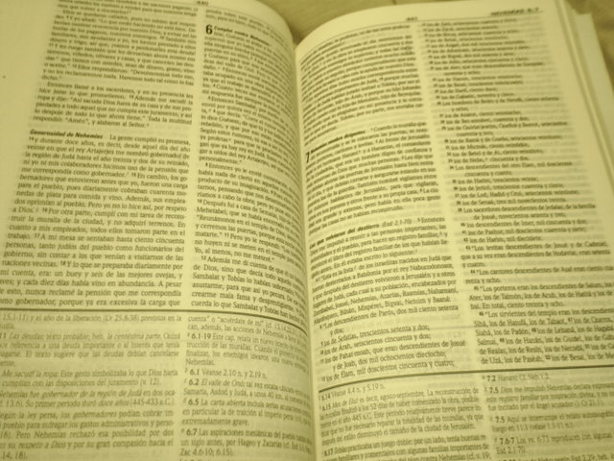
On Earth As It Is In Heaven
The Kingdom of God
²³And Jesus went about all Galilee, teaching in their synagogues, and preaching the gospel of the kingdom [Matt4: 23]
³⁵And Jesus went about all the cities and villages, teaching in their synagogues, and preaching the gospel of the kingdom. [Matt 9 : 35]
¹⁴Now after that John was put in prison, Jesus came into Galilee, preaching the gospel of the kingdom of God. [Mark 1:14]

Slide 2
On Earth As It Is In Heaven
The Kingdom of God
⁴³And he said unto them, I must preach the kingdom of God to other cities also: for therefore am I sent……[luke 4:43]
And it came to pass afterward, that he went throughout every city and village, preaching and shewing the glad tidings of the kingdom of God
[luke8:1]
Then he called his twelve disciples together, and gave them power and authority over all devils, and to cure diseases. ²And he sent them to preach the kingdom of God. [luke 9:1,2]

Slide 3
On Earth As It Is In Heaven
The Kingdom of God
¹⁰And the apostles, when they were returned, told him all that they had done. And he took them, and went aside privately into a desert place belonging to the city called Bethsaida. ¹¹And the people, when they knew it, followed him: and he received them, and spake unto them of the kingdom of God
[luke 9:10,11]

Slide 4
On Earth As It Is In Heaven
The Kingdom of God post Christ
¹²But when they believed Philip preaching the things concerning the kingdom of God, and the name of Jesus Christ, they were baptized, both men and women
[Acts 8 vs 12]
⁸And he went into the synagogue, and spake boldly for the space of three months, disputing and persuading the things concerning the kingdom of God……………….
[Acts19 vs 8]

Slide 5
On Earth As It Is In Heaven
The Kingdom of God post Christ
²³And when they had appointed him a day, there came many to him into his lodging; to whom he expounded and testified the kingdom of God, persuading them concerning Jesus, both out of the law of Moses, and out of the prophets, from morning till evening…
[Acts28 vs 23]
²⁵And now, behold, I know that ye all, among whom I have gone preaching the kingdom of God………….
[Acts20 vs25]

Slide 6
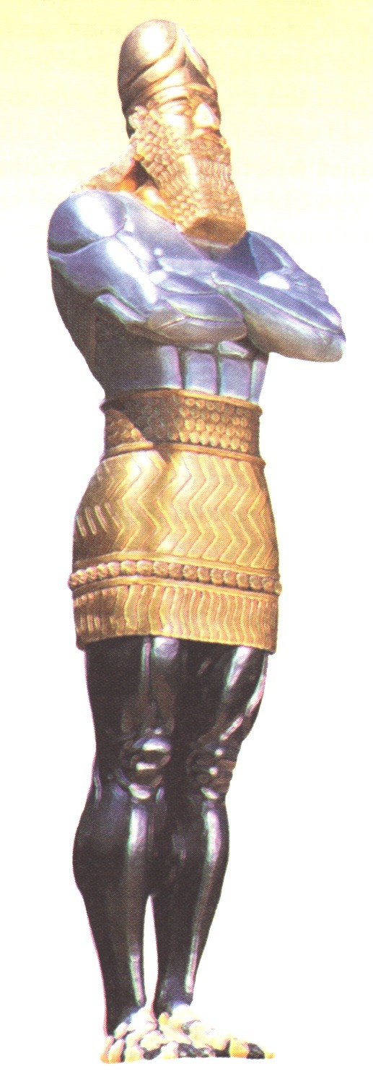
THE IMAGE OF DANIEL CHAPTER 2
HEAD OF FINE GOLD
^{37-8 Thou}, O king, art a king of kings:—Thou art this head of gold.
(Babylonian empire, BC 612-542)
^{BREAST AND ARMS OF SILVER}
³⁹ After thee shall arise another kingdom inferior to thee…
(Medo-Persian empire, BC 542-334)
^{BELLY AND THIGHS OF BRASS}
³⁹ ...and another third kingdom of brass, which shall bear rule over all the earth.
(Graeco-Macedonian empire, BC 344-146)
^{LEGS OF IRON}
⁴⁰ And the fourth kingdom shall be strong as iron; forasmuch as iron breaketh in pieces and subdueth all things: and as iron that breaketh all these, shall it break in pieces and bruise.
(Roman empire, divided into two ‘legs’, the Eastern and Western divisions, BC 146-493, Holy Roman Empire AD 800-1806)
^{FEET…PART IRON / PART CLAY}
⁴¹ As you saw the feet and toes partly of potter’s clay and partly of iron, it shall be a divided kingdom; but some of the strength of iron shall be in it, as you saw the iron mixed with the clay.
(Roman Empire dissolved, the one remaining feature being the Roman Catholic Church, which endures to this day.)

Slide 7
On Earth As It Is In Heaven
The Kingdom of God On Earth
Zechariah 14 : 8
⁸ ¶ And it shall be in that day, that living waters shall go out from Jerusalem; half of them toward the former sea, and half of them toward the hinder sea: in summer and in winter shall it be.
⁹ And the LORD shall be king over all the earth: in that day shall there be one LORD, and his name one.
¹⁰ All the land shall be turned as a plain from Geba to Rimmon south of Jerusalem: and it shall be lifted up, and inhabited in her place, from Benjamin’s gate unto the place of the first gate, unto the corner gate, and from the tower of Hananeel unto the king’s winepresses.
¹¹ And men shall dwell in it, and there shall be no more utter destruction; but Jerusalem shall be safely inhabited

Slide 8
On Earth As It Is In Heaven
The Kingdom of God On Earth
Isaiah 2 : 2
And it shall come to pass in the last days, that the mountain of the LORD’S house shall be established in the top of the mountains, and shall be exalted above the hills; and all nations shall flow unto it.
³ And many people shall go and say, Come ye, and let us go up to the mountain of the LORD, to the house of the God of Jacob; and he will teach us of his ways, and we will walk in his paths: for out of Zion shall go forth the law, and the word of the LORD from Jerusalem.
⁴ And he shall judge among the nations, and shall rebuke many people: and they shall beat their swords into plowshares, and their spears into pruninghooks: nation shall not lift up sword against nation, neither shall they learn war any more.

Slide 9
On Earth As It Is In Heaven
The Kingdom of God On Earth
Psalm 72 : 16
¹⁶ There shall be an handful of corn in the earth upon the top of the mountains; the fruit thereof shall shake like Lebanon: and they of the city shall flourish like grass of the earth.
¹⁷ His name shall endure for ever: his name shall be continued as long as the sun: and men shall be blessed in him: all nations shall call him blessed.
¹⁸ ¶ Blessed be the LORD God, the God of Israel, who only doeth wondrous things.
¹⁹ And blessed be his glorious name for ever: and let the whole earth be filled with his glory; Amen, and Amen.

Slide 10
On Earth As It Is In Heaven
The Kingdom of God On Earth
Amos 9 : 13
¹³ Behold, the days come, saith the LORD, that the plowman shall overtake the reaper, and the treader of grapes him that soweth seed; and the mountains shall drop sweet wine, and all the hills shall melt.
¹⁴ And I will bring again the captivity of my people of Israel, and they shall build the waste cities, and inhabit them; and they shall plant vineyards, and drink the wine thereof; they shall also make gardens, and eat the fruit of them.
¹⁵ And I will plant them upon their land, and they shall no more be pulled up out of their land which I have given them, saith the LORD thy God.

Slide 11
On Earth As It Is In Heaven
The Kingdom of God On Earth
Isaiah 65 : 21-25
²¹ And they shall build houses, and inhabit them; and they shall plant vineyards, and eat the fruit of them.
²² They shall not build, and another inhabit; they shall not plant, and another eat: for as the days of a tree are the days of my people, and mine elect shall long enjoy the work of their hands.

Slide 12
On Earth As It Is In Heaven
The Kingdom of God On Earth
Isaiah 65 : 21-25
²³ They shall not labour in vain, nor bring forth for trouble; for they are the seed of the blessed of the LORD, and their offspring with them.
²⁴ And it shall come to pass, that before they call, I will answer; and while they are yet speaking, I will hear.
²⁵ The wolf and the lamb shall feed together, and the lion shall eat straw like the bullock: and dust shall be the serpent’s meat. They shall not hurt nor destroy in all my holy mountain, saith the LORD.

Slide 13
On Earth As It Is In Heaven
The Kingdom of God On Earth
Isaiah 35 : 5
⁵ ¶ Then the eyes of the blind shall be opened, and the ears of the deaf shall be unstopped.
⁶ Then shall the lame man leap as an hart, and the tongue of the dumb sing: for in the wilderness shall waters break out, and streams in the desert.
⁷ And the parched ground shall become a pool, and the thirsty land springs of water: in the habitation of dragons, where each lay, shall be grass with reeds and rushes.

Slide 14
On Earth As It Is In Heaven
The Kingdom of God On Earth
⁸ And an highway shall be there, and a way, and it shall be called The way of holiness; the unclean shall not pass over it; but it shall be for those: the wayfaring men, though fools, shall not err therein.
⁹ No lion shall be there, nor any ravenous beast shall go up thereon, it shall not be found there; but the redeemed shall walk there:
¹⁰ And the ransomed of the LORD shall return, and come to Zion with songs and everlasting joy upon their heads: they shall obtain joy and gladness, and sorrow and sighing shall flee away.

Slide 15
On Earth As It Is In Heaven
The Kingdom of God On Earth
Numbers 14 : 21
But as truly as I live,
‘all the earth’ shall be
filled with the glory of
the LORD.

Slide 16
On Earth As It Is In Heaven
The Kingdom of God On Earth
Matthew|6:9
“After this manner therefore pray ye:”
Our Father which art in heaven,
Hallowed be thy name.
Thy kingdom come. Thy will be done in earth, as [it is] in heaven.
Give us this day our daily bread.
And forgive us our debts, as we forgive our debtors.
And lead us not into temptation,
but deliver us from evil:
For thine is the kingdom,
and the power, and the glory, for ever.
Amen.

