Slide 1
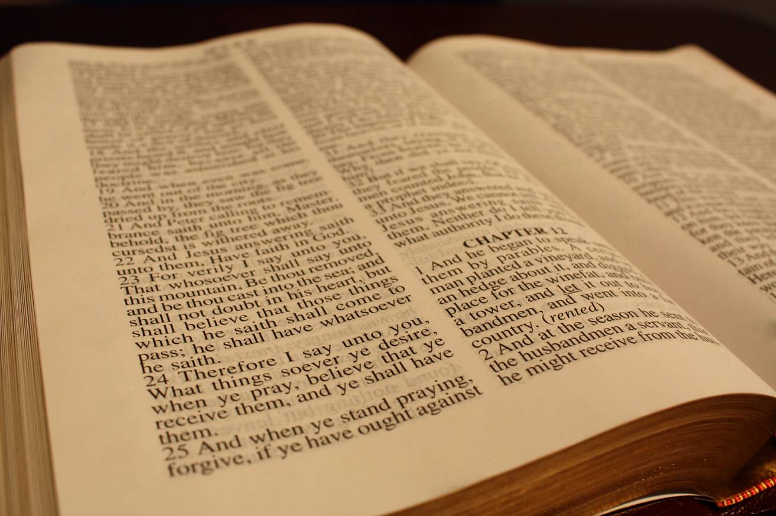
Joseph:
The Glory of the Messiah Foreshadowed

Slide 2
“In studying the events of Joseph's life, therefore, we are studying a case in which God was at work beyond all question;
and from which, therefore, we Shall be able to learn instruction with regard to the experiences of our own lives, if our lives, like his, are framed in the fear of God and Committed to his keeping in prayer and well-doing; for his case, like all the others, was "written for our learning".

Slide 3
Key events that we can identify that gave Joseph glory…..
The coat of many colours
(Separation)
Overseeing of his masters house
(Leadership-Chosen one)
The deliverance from the prison
(The grave-Resurection)
Promotion to oversee saving of gentiles and Jews
(king-ship)
Reunion with his Brethren
(Eating of bread)

Slide 4
Both Joseph and Christ obeyed their father voice to
‘go to thy brethren’
Joseph told in v(Gen37:13 & 14)
Christ, too, was sent to the shepherds and sheep of Israel, which accounts for the special effort he made to appeal to the Jewish religious leaders.

Slide 5
In Genesis 37:3 :
" Now Israel loved Joseph more than all his children… ”
“That at the name of Jesus every knee should bow, of things in heaven, and things in earth, and things under the earth; (Philippians 2:10)
.

Slide 6
Gen – 41:14 :
‘they brought him hastily out of the dungeon’ …
With little imagination we see the foreshadowing and speed of Christ’s resurrection in this event –
The change of clothing = the change of his nature. Zech 3:3-4 .

Slide 7
In Gen 41:40
‘Thou shalt be over my house, and according unto thy word shall all my people be ruled: only in the throne will I be greater than thou.’
Just as Egypt would have been obedient to Joseph’s word as a matter of life or death so to do Christ’s words need to be heard and obeyed in the same way if we are to obtain salvation...

Slide 8
Vs 41. “I have set thee over all the land of Egypt”
This reminds us of MT 28:18 Christ acknowledged all power in heaven and earth was given to him –
Vs18: And Jesus came and spake unto them, saying, All power is given unto me in heaven and in earth.
Yet another striking example foreshadowing of the glory that Jesus was attain..

Slide 9
(1 Tim.6:19)
‘Laying up in store for themselves a good foundation against the time to come, that they may lay hold on eternal life.’
:….We are told to lay up in store a ‘good foundation’
AGAINTS THE TIME TO COME!
.

Slide 10
Gen 37:24
And they took him, and cast him into a pit: and the pit was empty, there was no water in it.
Vs :25
“AND THEY SAT DOWN TO EAT BREAD”
.

Slide 11
The Gentile Bride
Gen 41:45 :
‘Pharaoh gave Joseph the name Zaphenath-Paneah and gave him Asenath daughter of Potiphera, priest of On, to be his wife.’
Upon his exaltation to the right hand of Pharaoh, Joseph was given a gentile bride for his wife.
This is a picture of the Lord Jesus who, upon His exaltation, took a bride for Himself
(the Ecclesia) from among the Gentile nations.

Slide 12
Joseph was looked for at the pit and was no longer there.
Genesis 37:29
‘and Reuben returned unto the pit; and, behold, Joseph was not in the pit; and he rent his clothes.’
Jesus was likewise sought after at the pit or grave and was no longer there.
John 20:2
‘Then she runneth and cometh to Simon Peter, and to the other disciple, whom Jesus loved and saith unto them, They have taken away the Lord out of the sepulchre, and we know not where they have laid him..’

Slide 13
Joseph was 30 years old when he came to greatness and received power to rule.
Genesis 41:46
‘And Joseph was thirty years old when he stood before Pharaoh king of Egypt. And Joseph went out from the presence of Pharaoh, and went throughout all the land of Egypt.’
Jesus was 30 years old when he began his ministry on earth. He was baptized and received the power of the Holy Spirit.
Luke 3:23
‘And Jesus himself began to be about thirty years of age, being (as was supposed) the son of Joseph, which was the son of Heli..’

Slide 14
There is nothing bad (sinful) mentioned about Joseph or Jesus in scripture.
Both were loved by their father
Both were later crowned with glory and honour (Gen 41:39-45, Heb 2:9).
Both delivered mankind from death

Slide 15
END.

Slide 16
.

Slide 17
