Slide 1
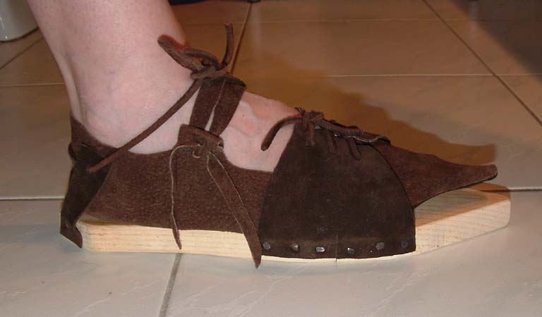
John Son of Thunder Class 2
He that cometh after me is preferred before me
I indeed baptize you with water; but one mightier than I cometh, the latchet of whose shoes I am not worthy to unloose: he shall baptize you with the Holy Ghost and with fire:
Notes:
Luke 1:65-66
65 And fear came on all that dwelt round about them: and all these sayings were noised abroad throughout all the hill country of Judaea.
66 And all they that heard them “laid them up” (to place) in their hearts, saying, What manner of child shall this be! And the hand of the Lord was with him.
Luke 2:51 And he went down with them, and came to Nazareth, and was subject unto them: but his mother “kept” (to watch thoroughly) all these sayings in her heart.

Slide 2
John 1:23 He said, I am the voice of one crying in the wilderness, Make straight the way of the Lord, as said the prophet Esaias.
Make straight =euthuno (yoo-thoo'-no); from euthus; to straighten (level); technically, to steer:
euthus (yoo-thoos'); straight, i.e. (literally) level, or (figuratively) true; adverbially (of time) at once:
John 19:34 ...and forthwith came there out water and blood
Luke 1:17 And he shall go before him in the spirit and power of Elijah, to turn the hearts of the fathers to the children, and the disobedient to the wisdom of the just; to make ready a people prepared for the Lord.
Spirit = pneuma, current of air, breath, fig a spirit
Power = dunamis force, miraculous power
Notes:
The idea of beginnings and endings is a very important theme that Yahweh uses in the scriptures, tree of life at the beginning, tree of life at the end
Joseph first mortal man to handle Jesus, Joseph last mortal to handle Jesus, Jesus beheld Peter, and looked on Peter
We are introduced to a man that was to come in the ways of righteousness and prepare a people, one of those is John the Apostle, or son of thunder
John records for us the witnessing of John the Baptist and the work he was to do, just in his opening words
Euthus John 19:34 But one of the soldiers with a spear pierced his side, and forthwith came there out blood and water.
NT:4151 pneuma (pnyoo'-mah); from NT:4154; a current of air, i.e. breath (blast) or a breeze; by analogy or figuratively, a spirit, i.e. (human) the rational soul, (by implication) vital principle, mental disposition, etc., or (superhuman) an angel, demon, or (divine) God, Christ's spirit, the Holy Spirit:
Power = dunamis (doo'-nam-is); from NT:1410; force (literally or figuratively); specially, miraculous power (usually by implication, a miracle itself):

Slide 3
John Came in the Spirit &
Power of Elijah
1 Kings 17 Elijah appears on the scene prophesying that after 3 years would come dew and rain, “My doctrine shall drop as rain, my speech shall distill as dew”. The word “dabar” dominates the account of Elijah as he burst onto the pages of scripture, while being sent into the wilderness preaching the good news to a widow and her son. Like John, Elijah had a Herodias after him, but this one was going to have her liberality recorded in the cannon of Yahweh’s word, and John the Apostle would warn Thyatira about her.
The prophecy of Elijah came in Mal. “I will send Elijah before the great and dreadful day of Yahweh, to turn the heart of the Father to the children and the children to the fathers, lest I come and smite the earth with a curse.”
Notes:
Elijah was of Gilead heap of testimony
Ps 107:20 He sent his word (debar), and healed (Rapha) them, and delivered them from their destructions.
Isa 11:1-5
1 And there shall come forth a rod out of the stem of Jesse, and a Branch shall grow out of his roots:
2 And the spirit of the Lord shall rest upon him, the spirit of wisdom and understanding, the spirit of counsel and might, the spirit of knowledge and of the fear of the Lord;
3 And shall make him of quick understanding in the fear of the Lord: and he shall not judge after the sight of his eyes, neither reprove after the hearing of his ears:
4 But with righteousness shall he judge the poor, and reprove with equity for the meek of the earth: and he shall smite the earth with the rod of his mouth, and with the breath of his lips shall he slay the wicked.
5 And righteousness shall be the girdle of his loins, and faithfulness the girdle of his reins.

Slide 4
“O generation of vipers”
“Bring forth fruits meet for repentance”
“We have Abraham to our Father”
“God is able of these stones to raise up children unto Abraham”
“Every tree which bringeth not forth good fruit is hewn down”
“He that hath two coats, let him impart to him that hath none”
“Be content with your wages”
“O generation of vipers” Matt 3:7
“Bring forth fruits meet for repentance” Matt 3:8
“We have Abraham to our Father” Matt 3:9
“God is able of these stones to raise up children unto Abraham” Matt 3:8
“Every tree which bringeth not forth good fruit is hewn down” Matt 3:10
“He that hath two coats, let him impart to him that hath none” Luke 3:11
“Be content with your wages” Luke 3:14
The man prophesied of by Isaiah
The messenger sent before the face of Christ
Came for a witness of that Light
He is the “Voice”
Clothed in camel’s hair and leathern girdle
Ate locust and wild honey
Instructed in the wilderness by the Angels
Notes:
We are all fairly aware of the prophecy of Isa about the man to prepare the way Luke 1:15-17
In asking around, there are many that would not attribute this list to John the Baptiser, we could say this is the gospel as taught by this wonderful Brother
The facts as listed in the Bible of this man.
Matt 3:2,7-12; 21:32 Mark 1:7,8 Luke 3:7,11,13,14,16,17
John 1:20-23,26,27, 29-36 Gospel of John the Baptist, and his responsibility
Luke 1:15-17, 76-79; 3:4-6 Prophecy of John

Slide 5
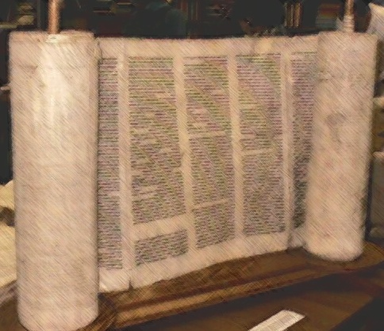
Luke 11:1 And it came to pass, that, as he was praying in a certain place, when he ceased, one of his disciples said unto him, Lord, teach us to pray, as John also taught his disciples.
Luke 11:2-4 Our Father which art in heaven, Hallowed be thy name. Thy kingdom come. Thy will be done, as in heaven, so in earth. Give us day by day our daily bread. And forgive us our sins; for we also forgive every one that is indebted to us. And lead us not into temptation; but deliver us from evil.
Notes:
We look at the Prayer of the Master as the template for all good prayers, yet when the Master was asked it was to be taught as John taught his disciples.
Christ did not correct them, he did not say, “but I say unto you”
John was given a task of preparation and he took it so seriously he died in the fulfilment of it.
These were two minds that walked the same road, Cayla teaching and Daryl saying the same things
Imagine John the B teaching John the A, “Thy kingdom come” wait a minute explain please
Rev 1:1 The Revelation of Jesus Christ, which God gave unto him, to shew unto his servants things which must shortly come to pass; and he sent and signified it by his angel unto his servant John:
We each have a responsibility to the kids, but also to each other.
We have to stand for the truth, a phrase we will find is used alot by John
Roy Styles example and the fruit he bore in kids, grandkids, and Bro & Sis

Slide 6
John 1:28 These things were done in Bethabara beyond Jordan, where John was baptizing.
Bethabara is Bethany = House of Dates
Notes:
We are all fairly aware of the prophecy of Isa about the man to prepare the way Luke 1:15-17

Slide 7
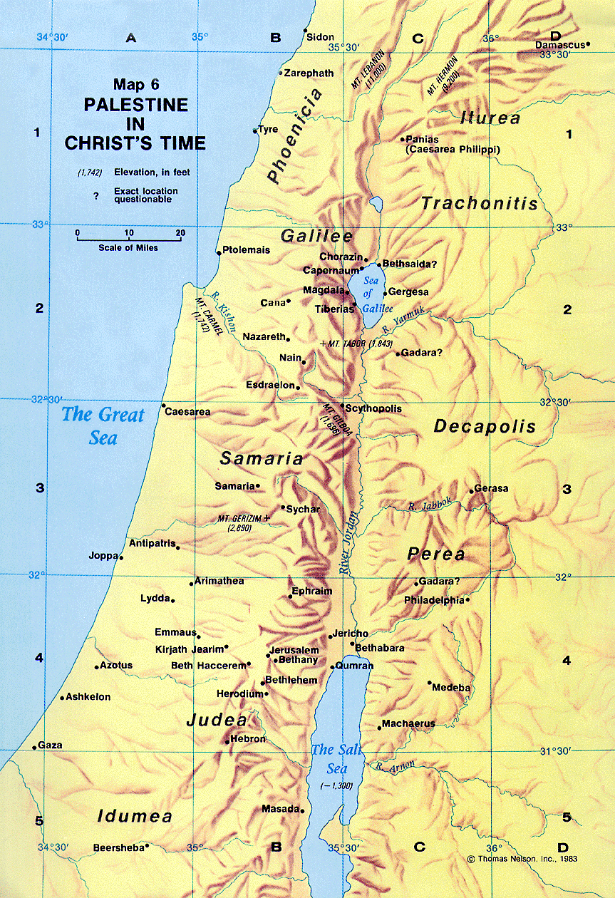
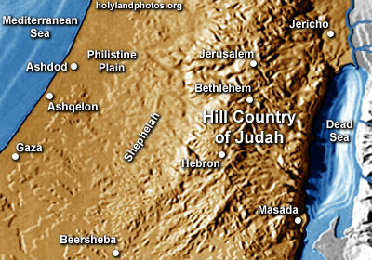
Notes:
John 10:40 And went away again beyond Jordan into the place where John at first baptized; and there he abode.
Matt 3:13 Then cometh Jesus from Galilee to Jordan unto John, to be baptized of him.
Mark 1:9 And it came to pass in those days, that Jesus came from Nazareth of Galilee, and was baptized of John in Jordan.
John 1:28 These things were done in Bethabara beyond Jordan, where John was baptizing.
JOSHUA CROSSED SOMEWHERE IN THIS AREA AND BACKUP UP THE JORDAN TO ADAM, JOHN BEGINS HIS MINISTRY HERE

Slide 8
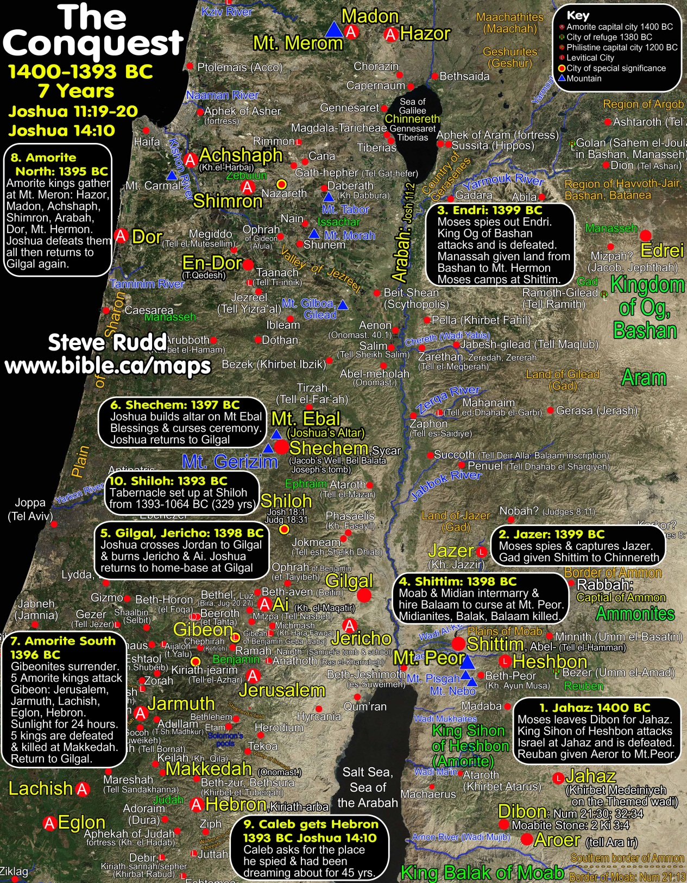

Slide 9
John 1:28 These things were done in Bethabara beyond Jordan, where John was baptizing.
Bethabara is Bethany = House of Dates
John 10:40 And went away again beyond Jordan into the place where John at first baptized; and there he abode.
John 11 The raising of Lazarus (Eliezer =Ail is helper)
Gen 15 Eliezer is introduced as a faithful servant, but the seed would come from Abraham, this was ratified with a vision of God Manifestation, and the land given to Abraham after he would be raised from the dead
John 5:25 ...the dead shall hear the voice of the son of God
Notes:
We are all fairly aware of the prophecy of Isa about the man to prepare the way Luke 1:15-17
All of a sudden we are introduced to three people, seemingly just appear on the scene, people Jesus loved dearly, like John the Apostle,
JOHN IS THE ONLY GOSPEL THAT MENTIONS LAZARUS BY NAME – LUKE MENTIONS THE NAME AS CHRIST TELLS OF THE BEGGAR IN ABRAHAMS BOSOM
Yet it not suddenly, the key is John 1:28 10:40, they were Johns disciples two
John chapter 11 is all about the raising of a man from the house of dates, Jesus blasts the fig tree of Matt 21 since it was like the ecclesia all show and no go, but the raising of a dead man, Elieazar who is first introduced to us in Gen 15 where a covenant was made that Ail’s friend would have a seed like the stairs of heaven, ratified it with a passing between the pieces, and a living promise of the land
It is no accident that John’s work is down in this place, beyond the Jordan, the descender to death, the serpent has no power on those in the “Way of righteousness” Matt 21:32
John 11: 2 tells us It was Mary which anointed the Lord with ointment, and wiped his feet with her hair. John 12
Luke 7:18 the disciples of John come to him, v21 he performs miracles v 22 he talks about it, but throws in something else “to the poor the glad tidings are preached”
V29 the people and the publicans justified God because they were baptised with the baptism of John
V24-35 Christ speaks about John the Baptiser, and goes into a house v37 where a woman comes and anoints the Master wiping his feet with the hairs of her head.
Mary, Martha and Lazarus are all from Bethany, where John’s ministry centered, and they knew about the resurrection in the last day

Slide 10
Matt 21:32 For John came unto you in the way of righteousness, and ye believed him not: but the publicans and the harlots believed him: and ye, when ye had seen it, repented not afterward, that ye might believe him.
Matt 21:32 For John came unto you in the way of righteousness, and ye believed him not: but the publicans and the harlots believed him: and ye, when ye had seen it, repented not afterward, that ye might believe him.
hodos (hod-os'); apparently a primary word; a road; by implication a progress (the route, act or distance); figuratively, a mode or means:
What is the “Way/road/progress of righteousness”?
Rom 9:30 What shall we say then? That the Gentiles, which followed not after righteousness, have attained to righteousness, even the righteousness which is of faith.
Rom 9:31 But Israel, which followed after the law of righteousness, hath not attained to the law of righteousness.
Notes:
In Matt 21: we find the phrase Way of Righteousness
Way is hod-os’ a road progress
What was the “way of righteousness”
Matt 3:15 And Jesus answering said unto him, Suffer it to be so now: for thus it becometh us to fulfil (to make replete, i.e. To cram, level up etc.) all righteousness. Then he suffered him.
In Pauls arguments he speaks of the righteousness that the Gentiles have attained to
Then goes on to speak of the law of righteousness, the only thing that John had to go by, it is important, of paramount importance that we understand we are under the principles of the Law and have a moral obligation to fulfil in practice all of the principles of the Law
-it is this that made Abraham, Noah etc acceptable in the eyes of Yahweh, a living sacrifice

Slide 11
Romans 10:1-3 there are those that have a zeal to righteousness, but not the righteousness of God
Roman 10:4 Christ is the end of the Law of Righteousness”
end = telos (tel'-os); from a primary tello (to set out for a definite point or goal); properly, the point aimed at as a limit
Lev 19:15 “In righteousness shalt thou judge thy neighbor”
Deut 6:24-25 Yahweh’s commandments and statutes become our righteousness
Deut 33:18,19 And out of “his dwelling place” he said, Rejoice, in “your dwelling place”, in thy going out: and “he will bring a reward”, in thy tents. They shall call the people unto the mountain; there they shall offer sacrifices of righteousness: for they shall suck (nurse, give milk) of the abundance of the seas (to roar , a sea) , and of treasures (concealed) hid (cover over) in the sand.
Notes:
Romans 10:4 “end” NT:5056 telos (tel'-os); from a primary tello (to set out for a definite point or goal); properly, the point aimed at as a limit,
Lev 19:15 Ye shall do no unrighteousness in judgment: thou shalt not respect the person of the poor, nor honour the person of the mighty: but in righteousness shalt thou judge thy neighbour.
Deut 6:24-25
24 And the Lord commanded us to do all these statutes, to fear the Lord our God, for our good always, that he might preserve us alive, as it is at this day.
25 And it shall be our righteousness, if we observe to do all these commandments before the Lord our God, as he hath commanded us.
Deut 33:18-19
18 And of Zebulun (habitation or dwelling place) he said, Rejoice, Zebulun, in thy going out; and, Issachar (he will bring a reward), in thy tents.
19 They shall call the people unto the mountain; there they shall offer sacrifices of righteousness: for they shall suck of the abundance of the seas, and of treasures hid in the sand.
Isa 60:16-17
16 Thou shalt also suck the milk (same word as suck of Deut 33:19) of the Gentiles, and shalt suck the breast of kings: and thou shalt know that I the Lord am thy Saviour and thy Redeemer, the mighty One of Jacob.
17 For brass I will bring gold, and for iron I will bring silver, and for wood brass, and for stones iron: I will also make thy officers peace, and thine exactors righteousness.

Slide 12
Romans 10:5 The righteousness of the law? “That a man which doeth those things shall live by them”
Lev 18:5 Ye shall therefore keep my statutes, and my judgments: which if a man do, he shall live in them: I am the Yahweh.
Romans 10:6&8 The righteousness of the Faith? “The word that is nigh thee, in thy mouth, and in thy heart: that is, the word of faith, which we preach”
Romans 10:9 Confess and Believe
Rom 10:10 For with the heart man believeth unto righteousness; and with the mouth confession is made unto salvation.
Yahweh’s Righteousness has never changed, from Gen 1 to Dec 2012.
Notes:
John came teaching in the Way of Righteousness which got mixed up into a zeal of the ecclesia’s own righteousness
When we consider the righteousness of the law in Pauls argument, we see the answer is the same
The righteousness of the Father was professed by many but declared in the Son, in a life of obedience, odedience unto death, even the death of the cross and raised to glory

Slide 13
Isa 40:3-5 The voice of him that crieth in the wilderness, Prepare ye the way of the Lord, make straight in the desert a highway for our God. Every valley shall be exalted, and every mountain and hill shall be made low: and the crooked shall be made straight, and the rough places plain: And the glory of the Lord shall be revealed, and all flesh shall see it together: for the mouth of the Lord hath spoken it.
Notes:
The work of John the Baptist was to prepare the way, to straighten the ways, to show the road to be walked, Gal 3:24 Wherefore the law was our schoolmaster to bring us unto Christ, that we might be justified (same word as rightous) by faith. Bro Roberts says “to prepare the way for Christ”
To declare the righteousness of Yahweh in the baptism of a people, gently bring them to Christ The law was the school master the prophets showed the responsibility of the Master
Luke 1:79 Zacharias said To give light to them that sit in darkness and in the shadow of death, Christ said John 5:35 He was a burning and a shining light: and ye were willing for a season to rejoice in his light.

Slide 14
Luke 1:80 John was tutored in the wilderness by the Angels
John 1:33 “He that sent me….the same said unto me”
John 1:19 The Jews sent Priests and Levites to ask “Who art thou?”
John 1:20 He confessed “I am not the Christ”
John 3:28 He confessed “I am not the Christ”, his disciples were witness
John 1:25 Why baptizest thou then, if thou be not that Christ?
John 1:31 I knew him not, but by the institution of baptism, the Christ will be identified
Matt 3:13-17 John knew this was a God fearing man, John felt he should be baptised by Jesus
Matt 3:15 … it becometh us to fulfill (to cram, level up) all righteousness…
Notes:
God’s timing so perfect John appears to begin the work of preparing hearts when the Angel of Yahweh’s presence Gabriel sends him
Luke 3:1-3
3 Now in the fifteenth year of the reign of Tiberius Caesar, Pontius Pilate being governor of Judaea, and Herod being tetrarch of Galilee, and his brother Philip tetrarch of Ituraea and of the region of Trachonitis, and Lysanias the tetrarch of Abilene,
2 Annas and Caiaphas being the high priests, the word of God came unto John the son of Zacharias in the wilderness.
3 And he came into all the country about Jordan, preaching the baptism of repentance for the remission of sins;
Tiberius Claudius Caesar Augustus, popularly known simply as Tiberius, was the Roman emperor at the time of the crucifixion of Jesus Christ. Tiberius reigned for 23 years, from 14 to 37 A.D. By most accounts, Tiberius was not a sociable man. Tiberius died of natural causes. Suetonius describes the sheer joy expressed by the Romans upon his death. He mentions people dancing in the streets. Upon his death, the Romans felt as though they emerged from a nightmare.
Luke 1:80 And the child grew, and waxed strong in spirit, and was in the deserts till the day of his shewing unto Israel.
John 1:26 John answered them, saying, I baptize with water: but there standeth one among you, whom ye know not;
John 1:29-34
29 The next day John seeth Jesus coming unto him, and saith, Behold the Lamb of God, which taketh away the sin of the world.
30 This is he of whom I said, After me cometh a man which is preferred before me: for he was before me.
31 And I knew him not: but that he should be made manifest to Israel, therefore am I come baptizing with water.
32 And John bare record, saying, I saw the Spirit descending from heaven like a dove, and it abode upon him.
33 And I knew him not: but he that sent me to baptize with water, the same said unto me, Upon whom thou shalt see the Spirit descending, and remaining on him, the same is he which baptizeth with the Holy Ghost.
34 And I saw, and bare record that this is the Son of God.
Matt 3:13-17
13 Then cometh Jesus from Galilee to Jordan unto John, to be baptized of him.
14 But John forbad him, saying, I have need to be baptized of thee, and comest thou to me?
15 And Jesus answering said unto him, Suffer it to be so now: for thus it becometh us to fulfil all righteousness. Then he suffered him.
16 And Jesus, when he was baptized, went up straightway out of the water: and, lo, the heavens were opened unto him, and he saw the Spirit of God descending like a dove, and lighting upon him:
17 And lo a voice from heaven, saying, This is my beloved Son, in whom I am well pleased.

Slide 15
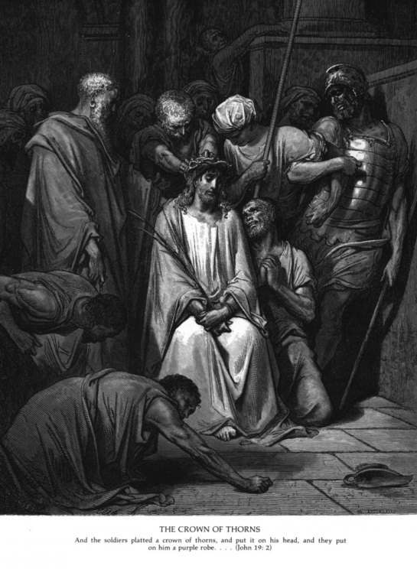
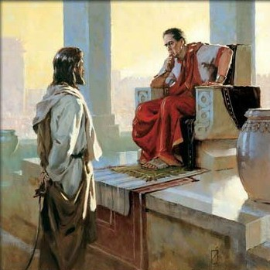
John 18:12,13 The Jews and Priests come to take him
John 18:33 Pilate asks “Who art Thou?”
John 19:5 Jesus came forth wearing the robe and crown and said “Behold the man”
John 20:22 he baptized them with the Holy Spirit “I am the Christ”
Acts 2:3,4 Baptised with “fire” and the Holy Spirit
Notes:
Matt 3:11
11 I indeed baptize you with water unto repentance: but he that cometh after me is mightier than I, whose shoes I am not worthy to bear: he shall baptize you with the Holy Ghost, and with fire:
KJV
Mark 1:8
8 I indeed have baptized you with water: but he shall baptize you with the Holy Ghost.
KJV
Luke 3:16
16 John answered, saying unto them all, I indeed baptize you with water; but one mightier than I cometh, the latchet of whose shoes I am not worthy to unloose: he shall baptize you with the Holy Ghost and with fire
KJV

Slide 16
John’s influence on the Son of Thunder
Matt 3:9 And think not to say within yourselves, We have Abraham to our father: for I say unto you, that God is able of these stones to raise up children unto Abraham.
John 8:39-40, 53-9:1
39 They answered and said unto him, Abraham is our father. Jesus saith unto them, If ye were Abraham's children, ye would do the works of Abraham.
40 But now ye seek to kill me, a man that hath told you the truth, which I have heard of God: this did not Abraham.
Notes:
Acts 3:1-2
1 Now Peter and John went up together into the temple at the hour of prayer, being the ninth hour.
2 And a certain man lame from his mother's womb was carried, whom they laid daily at the gate of the temple which is called Beautiful, to ask alms of them that entered into the temple;
Acts 4:22
22 For the man was above forty years old, on whom this miracle of healing was shewed.

Slide 17
John’s influence on the Son of Thunder
Matt 3:10 And now also the axe is laid unto the root of the trees: therefore every tree which bringeth not forth good fruit is hewn down, and cast into the fire.
John 15:1-2
1 I am the true vine, and my Father is the husbandman.
2 Every branch in me that beareth not fruit he taketh away: and every branch that beareth fruit, he purgeth it, that it may bring forth more fruit.

Slide 18
John’s influence on the Son of Thunder
Matt 3:12 Whose fan is in his hand, and he will throughly purge his floor, and gather his wheat into the garner; but he will burn up the chaff with unquenchable fire.
“he will thoroughly purge” = diakatharizo (dee-ak-ath-ar-id'-zo); from NT:1223 and NT:2511; to cleanse perfectly, i.e. (specially) winnow:
NT:2511 katharizo (kath-ar-id'-zo); from NT:2513; to cleanse (literally or figuratively):
1 John 1:7-9
7 But if we walk in the light, as he is in the light, we have fellowship one with another, and the blood of Jesus Christ his Son cleanseth us from all sin.
8 If we say that we have no sin, we deceive ourselves, and the truth is not in us.
9 If we confess our sins, he is faithful and just to forgive us our sins, and to cleanse us from all unrighteousness.
Notes:
Matt 3: 12Gather = NT:4863 sunago (soon-ag'-o); from NT:4862 and NT:71; to lead together, i.e. collect or convene; specifically, to entertain (hospitably):
John 15:6 If a man abide not in me, he is cast forth as a branch, and is withered; and men gather them, and cast them into the fire, and they are burned.
Rev 16:16 And he gathered them together into a place called in the Hebrew tongue Armageddon

Slide 19
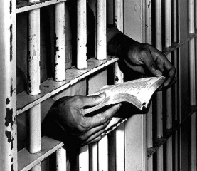
Mark 1:14 Now after that John was put in prison, Jesus came into Galilee, preaching the gospel of the kingdom of God,
Glory
Death
Jesus
Death
30years
30years
John
27 years
6th month
Notes:
And now we come to the end of a man’s ministry, it is suggested that John’s ministry lasted for 3 years
What a trial John would now be under, his ministry seems to have been without persecution for the most part, but now he had to sit in prison awaiting the kingdom of God.
What effect the death of John’s teacher would have on him, as it did Jesus, knowing now it was his turn, the disciples did not know of such things it woukd seem, and did not understand the idea of dying for Christ.

Slide 20
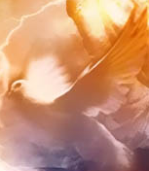
John 1:32 John Bare record
John 1:35-37 John stood with two of his disciples and spoke a word
John 1:23 The Voice of one crying in the wilderness
John 10:2-3 The Porter opens and the sheep hear his voice
John 1:37 “and they followed (to be in the same way with, accompany) Jesus”
John came without pomp and ceremony, there were no miracles, nothing extra special about him, just a firm conviction to fulfill his calling.
The highest rung of Faith is the assurance of things hoped for, the conviction of things unseen, John only spoke a word in the unseen, by it the soil was prepared for the Master Gardener.
Notes:
John 10:2-3
2 But he that entereth in by the door is the shepherd of the sheep.
3 To him the porter (a watcher, R a portal or entrance) openeth; and the sheep hear his voice: and he calleth his own sheep by name, and leadeth them out.
This is the second time he has confessed this is the Lamb of God that taketh away the sin of the World (V29)
V37 “and they followed (to be in the same way with, accompany) Jesus”

