Slide 1
John Boanerges
Class 5
John Boanerges
Class 5
Ex 5:2 The King of Darkness Challenges the source of Light
Voice = qowl (kole); or qol (kole); from an unused root meaning to call aloud; a voice or sound:
Ex 9:23 And Moses stretched forth his rod toward heaven: and the Lord sent thunder and hail, and the fire ran along upon the ground; and the Lord rained hail upon the land of Egypt.
Ex 9:23,28,29,33,34 5 times in the 7th plague Yahweh’s voice thunders on the King of Darkness
Deut 18:16 The ecclesia did not want to hear “the voice”
Deut 18:17-19 A Prophet from among the Brethren will be raised up with “the voice” of Yahweh
Notes:
One of the main themes of John is light and darkness, as the son of Thunder, he would certainly be able to dig into the achieves of his mind and see the consistent theme
One of the other obvious themes John picks up is in the beginning was the word, and the word has been spoken for all that ears to hear, in darkness and light.
Darkness will always challenge the light.
Ex 5:2 And Pharaoh said, Who is the Lord, that I should obey his voice to let Israel go? I know not the Lord, neither will I let Israel go.
OT:6963 qowl (kole); or qol (kole); from an unused root meaning to call aloud; a voice or sound:
Isa 55:10-11
10 For as the rain cometh down, and the snow from heaven, and returneth not thither, but watereth the earth, and maketh it bring forth and bud, that it may give seed to the sower, and bread to the eater:
11 So shall my word be that goeth forth out of my mouth: it shall not return unto me void, but it shall accomplish that which I please, and it shall prosper in the thing whereto I sent it.

Slide 2
John 18:37 The King of Darkness challenges the Source of Light
Every one that is of the truth heareth my voice.
Matt 22:16 - once Mark 5:33, 12:14,32 – three times
Luke 4:25, 20:21, 22:59 – three times
John 1:14 And the Word was made flesh, and dwelt among us, (and we beheld his glory, the glory as of the only begotten of the Father,) full of grace and truth.
John 1:14,17, 3:21, 4:23,24, 5:33, 8:32 x 2,40,44 x 2,45,46, 14:6,17
15:26, 16:7, 13x2, 17:17x2,19, 18:37 x 2,38 = 25 times
}
1 John 1:6,8, 2:4,21 x 2, 3:18,19, 4:6, 5:6
2 John 1x2,2,3,4
3 John 1,3x2,4,8,12
20 times
45 total
Notes:
John 18:37 Pilate therefore said unto him, Art thou a king then? Jesus answered, Thou sayest that I am a king. To this end was I born, and for this cause came I into the world, that I should bear witness unto the truth. Every one that is of the truth heareth my voice.
John is all about truth the word means truth, it is a biblical phrase we need to remind ourselves of, not a man made one
When John came to the light, he was prepared to step into the light

Slide 3
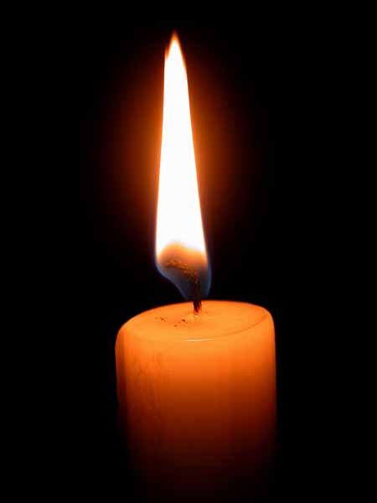
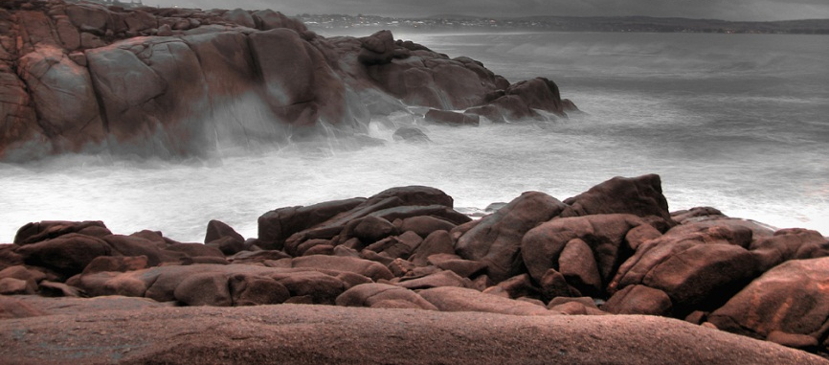
John 1:8 & 9 John the Baptist was not the Light, but witness to the “true” Light
Luke 1:79 To give light to them that sit in darkness and in the shadow of death, to guide our feet into the way of peace.
Gen 1:1-5 “Let there be light”..Elohim divided the light from darkness
1 John 1:5 God is Light
Notes:
John 21:24 This is the disciple which testifieth of these things, and wrote these things: and we know that his testimony is true.
Luke 1:79 To give light to them that sit in darkness and in the shadow of death, to guide our feet into the way of peace.
Gen 1:1-5
1 In the beginning God created the Heaven and the earth.
2 And the earth was without form, and void; and darkness was upon the face of the deep. And the Spirit of God moved upon the face of the waters.
3 And God said, Let there be light: and there was light.
4 And God saw the light, that it was good: and God divided the light from the darkness.
5 And God called the light Day, and the darkness he called Night. And the evening and the morning were the first day.

Slide 4
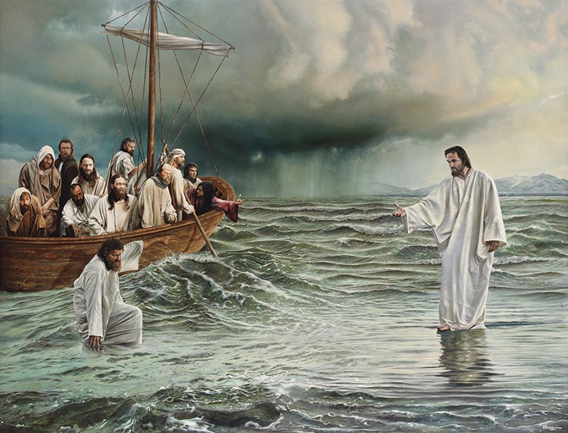
Gen 1:2 And the Spirit of God moved upon the face of the waters.
John 6:19 And the Spirit of God moved upon the Face of the waters
1 John 1:1 That which was from the beginning, which we have heard, which we have seen with our eyes, which we have looked upon, and our hands have handled, of the Word of life;
John 20: 24-29 “Which we have heard, seen, looked upon, our hands have handled,
“My Lord and my God”
John 1:1 In the beginning was the Word, and the Word was with God, and the Word was God.
John reminds us over and over about the “beginning”
John 1:1,2,2:11,6:64, 8:25,44, 15:27, 16:4 ---8 times, a cutting off of the old and a new beginning.
10 times in the Epistles to remind us that we all have a responsibility, from the beginning to cut off the first Adam, allowing the last man to live
Notes:
John 6:19-20
19 So when they had rowed about five and twenty or thirty furlongs, they see Jesus walking on the sea, and drawing nigh unto the ship: and they were afraid.
20 But he saith unto them, It is I; be not afraid.
John is all about the beginning, he will drive our minds back time and again, this is all about the principle of Yahwehs character, and what he expects from us
He is light and in him is no darkness at all, it is about choices in separating from the works of darkness in our personal life, family life, ecclesial life, and the world.
The last place the word is used, is Rev 22:12-13
12 And, behold, I come quickly; and my reward is with me, to give every man according as his work shall be.
13 I am Alpha and Omega, the beginning and the end, the first and the last.

Slide 5
Men Loved Darkness, deeds are evil
Stumble, no light in him
Walketh not knowing where he goes
Abide in darkness
In Yahweh is no Darkness
If we walk in Darkness we lie, do not “the Truth”
Detesting Brothers, we are in darkness
He that doeth truth, his deeds are wrought in God
The light of the world
Not walk in darkness
Light of life
Stumble not
The light is with you, walk in it
Believe in the light
Children of the light
A light into the World
God is Light
Walk in the Light
We have fellowship one with another
Life of Christ cleanseth us from sin
Love Brothers in Christ
Notes:
I wondered about this?
From the beginning we see the word, we know the word, we have handled the word
Then it is as if John threw the spirit, sinks into an exhortation about light and darkness both in his gospel and in his epistle
This is about mending 1 Cor 1:10-11 10 Now I beseech you, brethren, by the name of our Lord Jesus Christ, that ye all speak the same thing, and that there be no divisions among you; but that ye be perfectly joined together in the same mind and in the same judgment. 11 For it hath been declared unto me of you, my brethren, by them which are of the house of Chloe, that there are contentions among you.
But in order that the body be joined together, we have to identify first in our selves the darkenss but we have a responsibility to the ecclesia to do the same.
Let a man examine himself 1 Cor 11:28 But let a man examine himself, and so let him eat of that bread, and drink of that cup.
-Yet John still deals with this idea of loving our Brothers, is’nt it easy for us to judge each other in our understanding of the Love of God
-Ken did an excellent exposition of this a few years ago
-john uses a few words synonymously (NEXT SLIDE)
John 3:19-21
19 And this is the condemnation, that light is come into the world, and men loved darkness rather than light, because their deeds were evil.
20 For every one that doeth evil hateth the light, neither cometh to the light, lest his deeds should be reproved.
21 But he that doeth truth cometh to the light, that his deeds may be made manifest, that they are wrought in God.
John 8:12 Then spake Jesus again unto them, saying, I am the light of the world: he that followeth me shall not walk in darkness, but shall have the light of life.
John 11:9-10
9 Jesus answered, Are there not twelve hours in the day? If any man walk in the day, he stumbleth not, because he seeth the light of this world.
10 But if a man walk in the night, he stumbleth, because there is no light in him.
John 12:35-36
35 Then Jesus said unto them, Yet a little while is the light with you. Walk while ye have the light, lest darkness come upon you: for he that walketh in darkness knoweth not whither he goeth.
36 While ye have light, believe in the light, that ye may be the children of light. These things spake Jesus, and departed, and did hide himself from them.
John 12:44-46
44 Jesus cried and said, He that believeth on me, believeth not on me, but on him that sent me.
45 And he that seeth me seeth him that sent me.
46 I am come a light into the world, that whosoever believeth on me should not abide in darkness.
1 John 1:5-7
5 This then is the message which we have heard of him, and declare unto you, that God is light, and in him is no darkness at all.
6 If we say that we have fellowship with him, and walk in darkness, we lie, and do not the truth:
7 But if we walk in the light, as he is in the light, we have fellowship one with another, and the blood of Jesus Christ his Son cleanseth us from all sin.
1 John 2:8-10
8 Again, a new commandment I write unto you, which thing is true in him and in you: because the darkness is past, and the true light now shineth.
9 He that saith he is in the light, and hateth his brother, is in darkness even until now.
10 He that loveth his brother abideth in the light, and there is none occasion of stumbling in him.

Slide 6
Sin =hamartia (ham-ar-tee'-ah); from hamartano; a sin
hamartano (ham-ar-tan'-o) properly, to miss the mark (and so not share in the prize), i.e. (figuratively) to err, especially (morally) to sin:
Wicked one -poneros (pon-ay-ros'); hurtful, i.e. evil (properly, in effect or influence, figuratively, to bring about ruin; also (passively) ill, i.e. diseased; but especially (morally) deserving reproach
World = kosmos (kos'-mos); orderly arrangement, i.e. decoration; by implication, the world (in a wide or narrow sense, including its inhabitants, literally or figuratively [morally]):
Notes:
These three we can see that John uses to describe us, and also others.
The very first place he uses it is John 1:29 The next day John seeth Jesus coming unto him, and saith, Behold the Lamb of God, which taketh away the sin of the world
What was the sin that the Lord Jesus Christ came to take away from the world, was it transgression, was it the root Sin nature, was it a combination?
-there seems to be something a little more that John is driving at then the satement that John the Bap made.
-the first place we find sin used in the epistle, John seems to bring us closer to the point he is making
-and we have considered already
John 1:8-9
8 He was not that Light, but was sent to bear witness of that Light.
9 That was the true Light, which lighteth every man that cometh into the world.
-the life that the Lord lived, the victory he accomplished nailed both aspects of sin
-when we walk in the light our deeds are know John 3:19,20

Slide 7
1 John 1:8 - 10
8 If we say that we have no sin, we deceive ourselves, and the truth is not in us.
9 If we confess our sins, he is faithful and just to forgive us our sins, and to cleanse us from all unrighteousness.
10 If we say that we have not sinned, we make him a liar, and his word is not in us.
1 John 5:17-19
17 All unrighteousness is sin: and there is a sin not unto death.
18 We know that whosoever is born of God sinneth not; but he that is begotten of God keepeth himself, and that wicked one toucheth him not.
19 And we know that we are of God, and the whole world lieth in wickedness.
1 John 2:15,16 Love not the World, if we love the world we have not the Love of the Father, but the Lust of flesh, the lust of the eyes and the Pride of life.
V19 “they went out from us”
Notes:
-but there is one who says he has no sin, he is a deceiver = NT:4105 planao (plan-ah'-o); to (properly, cause to) roam (from safety, truth, or virtue):
-in our confession (1 John 1:9) our sins, our missing the mark, our recognition that the heart of man is only evil continually, then and only then can and will we be cleansed from all unrighteousness
Unrightousness =NT:93 adikia (ad-ee-kee'-ah); (legal) injustice (properly, the quality, by implication, the act); morally, wrongfulness (of character, life or act):
Liar = NT:5583 pseustes (psyoos-tace'); from NT:5574; a falsifier:
NT:5574 pseudomai (psyoo'-dom-ahee); middle voice of an apparently primary verb; to utter an untruth or attempt to deceive by falsehood:

Slide 8
1 John 3:12 Not as Cain, who was of that wicked one, and slew his brother. And wherefore slew he him? Because his own works were evil, and his brother's righteous.
John 13:11&18 “For he knew…He that eateth bread with me, lifteth up his heel against me”
John 13:21 Jesus was troubled (stir or agitate, (roll water)) one of you will walk in darkness, one of you is deceived….one of you is a liar
John 13:23-26 John is eye witness to the one of darkness
John 13:30 He then having received the sop went immediately out: and it was night.
1 John 2:19 “They went out from us, but they were not of us”
John 18:2,5 “the betrayer” paradidomi to surrender, i.e yield up
John 19:11 “he that delivered me hath the greater sin”
Notes:
John say it first hand, it was he that Jesus told, it was an understanding that came later, but when it came, it came with a brutal force.
This was a brother in arms, a brother that had been given the Holy spirit, healed, preached, worked
This was a tare sown among the wheat
Can we imagine the thoughts in Johns head, this was the one.
How sad it is that there are those today who are not really in the light, are we?
-what is the treasure of our heart, that of the super abundance of it we can speak?
-have there been brothers or sisters that a have done something, are they dead and we still have a issue with them?
-John goes to great lengths to deal with the feelings we have for others.
NT:3860paradidomi (par-ad-id'-o-mee); to surrender, i.e yield up, intrust, transmit:
John 6:64 But there are some of you that believe not. For Jesus knew from the beginning who they were that believed not, and who should betray him.
19:11 Jesus answered, Thou couldest have no power at all against me, except it were given thee from above: therefore he that delivered me unto thee hath the greater sin.

Slide 9
1 John 3:12 Not as Cain, who was of that wicked one, and slew his brother. And wherefore slew he him? Because his own works were evil, and his brother's righteous.
John 6:64 For Jesus knew from the beginning who should betray him.
John 8:44 he was a murder and liar from the beginning
In the beginning light was separated from darkness
separated from darkness
Gen 3:14 the serpent beguiled (nasha to lead astray)
Gen 3:15 a hostility was put in place between light and darkness, the truth and the world 2 Cor 6: 14-17 come out from among them, be separate
Gen 4:2 the ecclesia worked, worshiped, preached together
Gen 4:8 he that eateth bread lifted his heel against me.
Gen 4:14 “They went out from us, but they were not of us”
Notes:
John 8:44 Ye are of your father the devil, and the lusts of your father ye will do. He was a murderer from the beginning, and abode not in the truth, because there is no truth in him. When he speaketh a lie, he speaketh of his own: for he is a liar, and the father of it.
John 8:55 Yet ye have not known him; but I know him: and if I should say, I know him not, I shall be a liar like unto you: but I know him, and keep his saying.

Slide 10
1 John 4:20-21
20 If a man say, I love God, and hateth his brother, he is a liar: for he that loveth not his brother whom he hath seen, how can he love God whom he hath not seen?
21 And this commandment have we from him, That he who loveth God love his brother also.
1 John 3:11 For this is the message that ye heard from the beginning, that we should love one another.

Slide 11
1 John 3:18 We MUST do more than lip service.
Mal 2:17 ye have wearied Yahweh with your words
Ezek 33:30-32 with the mouth they speak “Love” but walk after covetousness
Ergon (ergon) =to work, toil as an effort or occupation, by implication, an act
Ephesus
Rev 2:2,5 “Works”
Rev 2:6 “deeds”
Smyrna
Rev 2:9 “works
Pergamos
Rev 2:13 “works”
Thyatira
Rev 2:2x 19,23,26 “Works”
Rev 2:22 “deeds”
Sardis
Rev 3:1,2 “works
Philadelphia
Rev 3:8 “works”
Laodicean
Rev 3:15 “Works”
1 John 2:8-11 The Darkness is past..the command has no optional clause
LOVE YOUR BROTHER AND ABIDE IN THE LIGHT
1 John 3:14-15 we have past from death to life, by following the command …as opposed to murderers
Notes:
Deeds of 1 John 3:18 NT:2041ergon (er'-gon); from a primary (but obsolete) ergo (to work); toil (as an effort or occupation); by implication, an act:
John 3:19-21
19 And this is the condemnation, that light is come into the world, and men loved darkness rather than light, because their deeds (2041) were evil.
20 For every one that doeth evil hateth the light, neither cometh to the light, lest his deeds (2041) should be reproved.
21 But he that doeth truth cometh to the light, that his deeds (2041) may be made manifest, that they are wrought in God.
John 7:7 The world cannot hate you; but me it hateth, because I testify of it, that the works (2041) thereof are evil.
John 8:41 Ye do the deeds (2041) of your father. Then said they to him, We be not born of fornication; we have one Father, even God.
Last place it is used
Rev 22:12 And, behold, I come quickly; and my reward is with me, to give every man according as his work (2041 shall be.
1 John 2:8-11 the Darkness is past, Paul gives the same message but we do not have time to look at all passages, we do know that the rightous those that manifest the fathers charactor are very aware of the differnace, the line and where they stand
Eph 5:8 For ye were sometimes darkness, but now are ye light in the Lord: walk as children of light
Eph 5:13-14
13 But all things that are reproved are made manifest by the light: for whatsoever doth make manifest is light.
14 Wherefore he saith, Awake thou that sleepest, and arise from the dead, and Christ shall give thee light.

Slide 12
God Manifestation
Abode = meno (men'-o);to stay (in a given place, state, relation or expectancy):
Abode = 1st place it is used John 1:32 Last place John 21:22,23
Abode = use 5 times in the first chapter v32 abode, 33 remaining, 38 dwellest thou, 39 dwelt and abode
1 John 4 12 “God dwelleth in us”, v13 “we dwell in him, v15 God dwelleth in us.
John 14:23-24 God’s love is conditional on keeping the words of our Master’s words, then and only then will the Father stay or dwell with us
John 15 “Abide in me, and I in you, the branch must abide in the vine, and the Father is glorified that ye bear much fruit, if ye keep my commandments, ye shall abide in my love.
Abide, abideth, and remain used 12 times in the discourse by the Lord in the context of John 15
Notes:
(WE LOOKED AT ABODE IN CLASS 3)
When we do more than lip service, when we are fulfilling this divine obligation then we are a vessel that the Father will want to be with via his angels
The Fathers Love is only extended to those that are God manifestation, he leaves the door open to all mankind as long as they are on this side of the grass to come to him
1 John 4:11-15
11 Beloved, if God so loved us, we ought also to love one another.
12 No man hath seen God at any time. If we love one another, God dwelleth in us, and his love is perfected in us.
13 Hereby know we that we dwell in him, and he in us, because he hath given us of his Spirit.
14 And we have seen and do testify that the Father sent the Son to be the Saviour of the world.
15 Whosoever shall confess that Jesus is the Son of God, God dwelleth in him, and he in God.
The influence that the Lord had on John was profound as he “called these things to remembrance”
John 14:23-24
23 Jesus answered and said unto him, If a man love me, he will keep my words: and my Father will love him, and we will come unto him, and make our abode with him.
24 He that loveth me not keepeth not my sayings: and the word which ye hear is not mine, but the Father's which sent me.
Perhaps the one of the greatest influences (if we could find one) was the words that stir even us as 2012 draws to a close
Does the word of God as manifest in his son impact us like it did John?, are we zealous for the truth as Bro Thomas and Roberts were, not tolerating in an age of tolerance, or have we become weary?
Are we embracing the covenant made to Eve, Abram, and David, that the Father by his righteousness would be manifest in a multitude of Mighty ones who reflect his character?
-are we ready to witness the greatest event the world has ever seen? Are ready to witness the second advent of the Lord Jesus Christ?
-Are we ready for Yahweh himself to accept the Kingdom from his son, that he may be all and in all
Rev 21:3 And I heard a great voice out of heaven saying, Behold, the tabernacle of God is with men, and he will dwell with them, and they shall be his people, and God himself shall be with them, and be their God.

Slide 13
Ps 24:1-6
1 The earth is the Lord's, and the fulness thereof; the world, and they that dwell therein.
2 For he hath founded it upon the seas, and established it upon the floods.
3 Who shall ascend into the hill of the Lord? or who shall stand in his holy place?
4 He that hath clean hands, and a pure heart; who hath not lifted up his soul unto vanity, nor sworn deceitfully.
5 He shall receive the blessing from the Lord, and righteousness from the God of his salvation.
6 This is the generation of them that seek him, that seek thy face, O Jacob. Selah.
Ps 24:1-6
1 The earth is the Lord's, and the fulness thereof; the world, and they that dwell therein.
2 For he hath founded it upon the seas, and established it upon the floods.
3 Who shall ascend into the hill of the Lord? or who shall stand in his holy place?
4 He that hath clean hands, and a pure heart; who hath not lifted up his soul unto vanity, nor sworn deceitfully.
5 He shall receive the blessing from the Lord, and righteousness from the God of his salvation.
6 This is the generation of them that seek him, that seek thy face, O Jacob. Selah.
Ps 24:1-6
1 The earth is the Lord's, and the fulness thereof; the world, and they that dwell therein.
2 For he hath founded it upon the seas, and established it upon the floods.
3 Who shall ascend into the hill of the Lord? or who shall stand in his holy place?
4 He that hath clean hands, and a pure heart; who hath not lifted up his soul unto vanity, nor sworn deceitfully.
5 He shall receive the blessing from the Lord, and righteousness from the God of his salvation.
6 This is the generation of them that seek him, that seek thy face, O Jacob. Selah.

