Slide 1
Class 6
Increase our Faith
Taking ownership of the Word of Yahweh
Ps 30:2 Yahweh my Elohim, I cried unto thee, and thou hast healed me.
Notes:
Luke 17:5 And the apostles said unto the Lord, Increase our faith.
The request of the Apostles as they followed the Master was a genuine yearning to learn more
We get caught up in their lack of understanding, they believed him, “Thou art the Christ the son of the Living God”
John 16:27 For the Father himself loveth you, because ye have loved me, and have believed that I came out from God.
John is the eagle spirit, he captures the spirit of the Lord in acts, preaching and prayer

Slide 2
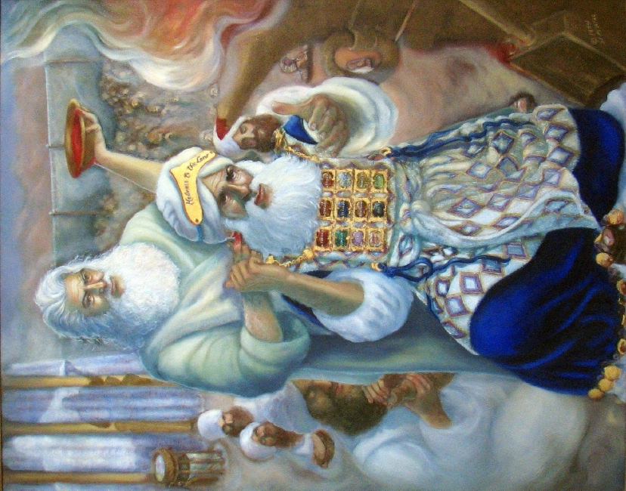
1 John 5:6 This is he that came by water and blood, even Jesus Christ; not by water only, but by water and blood. And it is the Spirit that beareth witness, because the Spirit is truth.
Lev 8:6 Priests are washed with Water
Lev 8:23 Ram of consecration’s blood is used in hearing, handling and walking
John 13:5 Christ washed the priests in training with water
John 10:11 He poured out his life in hearing, handling, and walking
John 19:34 forthwith there came out
water and blood
Notes:
John captures through the Spirit the essence, the principle of the Life of the King
He has thought on the things he saw, clean animal
He puts it all together for us, from the shadow institution
1 John 2:27 But the anointing which ye have received of him abideth in you, and ye need not that any man teach you: but as the same anointing teacheth you of all things, and is truth, and is no lie, and even as it hath taught you, ye shall abide in him.
John’s first hand witnessing of the end of the Lords life is stirring
John 18:10 Then Simon (hear intelligently) Peter having a sword drew it, and smote the high priest's servant, and cut off his right ear. The servant's name was Malchus (OT melek king, to riegn).

Slide 3
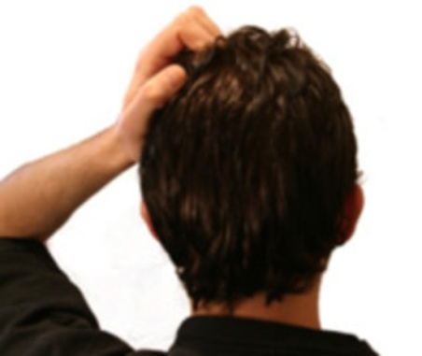
Mark 9:1 That there be some of them that stand here, which shall not taste of death, till they have seen the kingdom of God come with power.
V 9 “No man” = NT:3367 medeis (may-dice'); not even one (man, woman, thing):
V 9 “Till the Son of Man were risen from the dead”
V 10 “questioned one with another” =NT:4802 suzeteo (sood-zay-teh'-o); to investigate jointly, i.e. discuss, controvert, cavil:
John 12:16 When Jesus was glorified then remembered (to remember, to recall to mind)
John 19: 35 he that saw bare record....
John 20:31 these are written....
John 21:24 this is the disciple which testifieth...
1 John 1:2 ...bear witness and shew unto you...
3 John 12 ...we bear record and ye know that our record is true.
Notes:
We look then to a life changing incident in John’s life
Mark 9:9 And as they came down from the mountain, he charged them that they should tell no man what things they had seen, till the Son of man were risen from the dead.
Mark 9:10 And they kept that saying with themselves, questioning one with another what the rising from the dead should mean.
Can you imagine the discussion, the time John spent at the beginning with Andrew and Jesus,
Yet the record of John is silent about the transfiguration, at least the Gospel is silent about it
John 12:16 These things understood not his disciples at the first: but when Jesus was glorified, then remembered they that these things were written of him, and that they had done these things unto him.
John 20:9 For as yet they knew not the scripture, that he must rise again from the dead.
Luke 24:12 Then arose Peter, and ran unto the sepulchre; and stooping down, he beheld the linen clothes laid by themselves, and departed, wondering in himself at that which was come to pass.
John 20:2-9
2 Then she runneth, and cometh to Simon Peter, and to the other disciple, whom Jesus loved, and saith unto them, They have taken away the Lord out of the sepulchre, and we know not where they have laid him.
3 Peter therefore went forth, and that other disciple, and came to the sepulchre.
4 So they ran both together: and the other disciple did outrun Peter, and came first to the sepulchre.
5 And he stooping down, and looking in, saw the linen clothes lying; yet went he not in.
6 Then cometh Simon Peter following him, and went into the sepulchre, and seeth the linen clothes lie,
7 And the napkin, that was about his head, not lying with the linen clothes, but wrapped together in a place by itself.
8 Then went in also that other disciple, which came first to the sepulchre, and he saw, and believed.
9 For as yet they knew not the scripture, that he must rise again from the dead.
Dan 12:8 And I heard, but I understood not: then said I, O my Lord, what shall be the end of these things?
John validates his witnessing and his involvement and understanding in John 19:35,20:31,21:24

Slide 4
We have to take ownership of the Word of Yahweh, it cannot be a distant book of words, it has to be our life, our ear has to be anointed with the oil/word, motivating us to put our open hand to the task of working in the vineyard, while walking beside our Lord and Master, the King of Kings and Lord of Lords .
1 John 1 “we have heard from the beginning”, “we have seen”, “we have seen and heard”, “these things write we unto you”, “we have fellowship”, “we walk in the light”, etc
1 John 2:1 “my little children, these things write “I” unto you
1 John 2:13 “”I” write unto you Fathers”
1 John 2:13 “”I” write unto you young men”

Slide 5
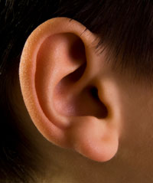
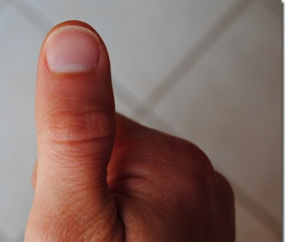

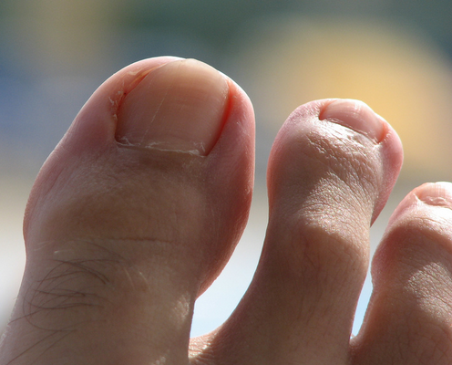

Slide 6
Little Children
2:1 sin not
2:12 your sin is forgiven
2:13 you have known the Father
2:18 there are antichrists, it is the last time
2:28 abide in him
3:7 no man deceive you
3:18 love in deed and truth
4:4 you have overcome the antichrist
5:21 keep yourselves from idols
Young Men
2:13 you have overcome the wicked one
2:14 you are strong, the word of God abides in you, you have over come the wicked one
Fathers
2:13 you have known him from the beginning
2:14 you have known him from the beginning
Notes:
John exhorts with authority, he was in the shadow of the Lord as his Gospel is written giving the Glory to the Son of man
When the Son ascended and sat down as High Priest anointed and consecrated, John accepted his responsibility to teach, exhort and admonish....do we?

Slide 7
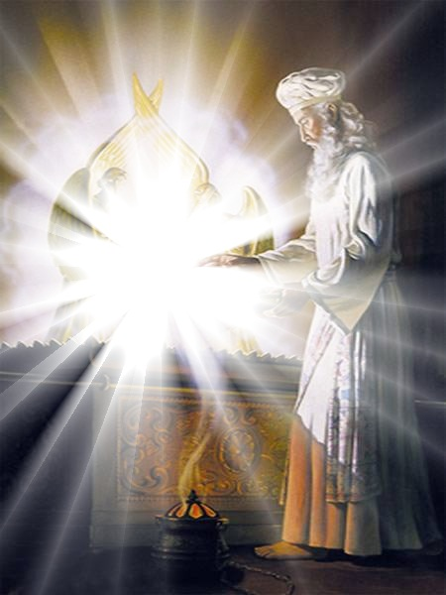
1 John 4:12 God dwelleth in us, v13 we dwell in him v16 dwellth in God and God in him
Lev 26:11-13 I will set my tabernacle among you, I will walk among you and will be your God and ye shall be my people
Lev 26:13 I am Yahweh Elohim that brought you forth out of darkness
Lev 26:13 I am Yahweh Elohim that brought you forth out of darkness
Deut 23:14 Yahweh Elohim walks in the midst of the ecclesia, therefore it must be Holy
2 Cor 6:14-16 Yahweh Elohim walks in the midst of the ecclesia, therefore it must be Holy
Notes:
Lev 26:11-13
11 And I will set my tabernacle among you: and my soul shall not abhor you.
12 And I will walk among you, and will be your God, and ye shall be my people.
13 I am the Lord your God, which brought you forth out of the land of Egypt, that ye should not be their bondmen; and I have broken the bands of your yoke, and made you go upright.

Slide 8
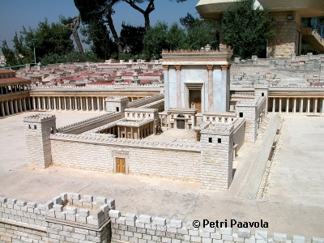
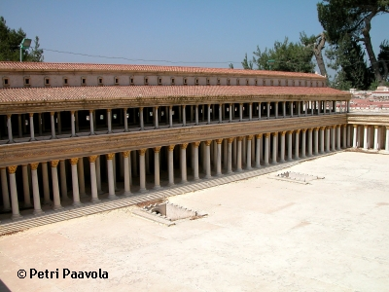
Acts 3:1-11 Healing of the man in the Beautiful gate
Isa 35:6 Then shall the lame man leap as an hart, and the tongue of the dumb sing: for in the wilderness shall waters break out, and streams in the desert.
Beautiful gate
Solomon’s Porch
Acts 4:1-7 Peter and John are taken prisoner
Acts 4:13 the boldness (outspokenness, frankness) of Peter and John
Notes:
Acts 3:11 the lame man held Peter and John
Gal 2:9 And when James, Cephas, and John, who seemed to be pillars, perceived the grace that was given unto me, they gave to me and Barnabas the right hands of fellowship; that we should go unto the heathen, and they unto the circumcision.
Acts miracle of healing
Rev

Slide 9
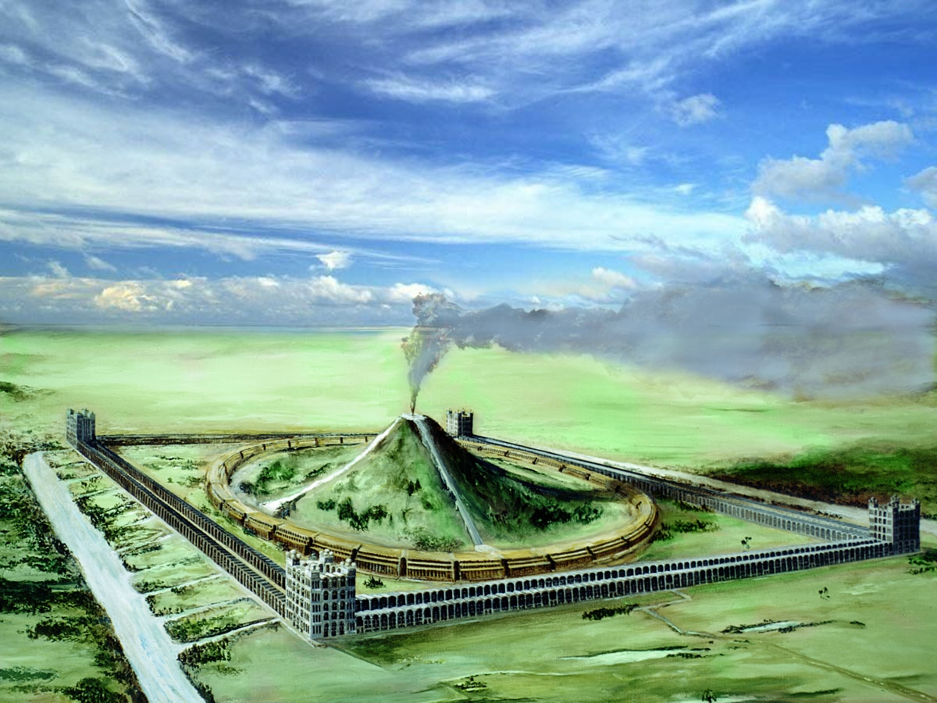
I tell you of a truth, there be some standing here, which shall not taste of death, till they see the kingdom of God.
John 21:22 Jesus saith unto him, If I will that he tarry till I come, what is that to thee? follow thou me.
Notes:
Luke 9:23-27
23 And he said to them all, If any man will come after me, let him deny (NT:720 arneomai (ar-neh'-om-ahee); to contradict, i.e. disavow, reject) himself, and take up his cross daily, and follow (NT:190 akoloutheo (ak-ol-oo-theh'-o); (a road); properly, to be in the same way with, i.e. to accompany (specially, as a disciple)) me.
24 For whosoever will save his life shall lose it: but whosoever will lose (NT:622 apollumi (ap-ol'-loo-mee); to destroy fully) his life for my sake, the same shall save it.
25 For what is a man advantaged, if he gain the whole world, and lose himself, or be cast away?
26 For whosoever shall be ashamed of me and of my words, of him shall the Son of man be ashamed, when he shall come in his own glory, and in his Father's, and of the holy angels.
27 But I tell you of a truth, there be some standing here, which shall not taste of death, till they see the kingdom of God.
Mark 13:2-4
2 And Jesus answering said unto him, Seest thou these great buildings? there shall not be left one stone upon another, that shall not be thrown down.
3 And as he sat upon the mount of Olives over against the temple, Peter and James and John and Andrew asked him privately,
4 Tell us, when shall these things be? and what shall be the sign when all these things shall be fulfilled?
John 21:21-23
21 Peter seeing him saith to Jesus, Lord, and what shall this man do?
22 Jesus saith unto him, If I will that he tarry till I come, what is that to thee? follow thou me.
23 Then went this saying abroad among the brethren, that that disciple should not die: yet Jesus said not unto him, He shall not die; but, If I will that he tarry till I come, what is that to thee?

Slide 10
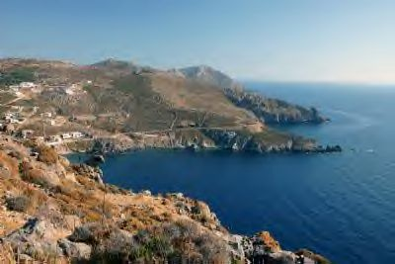
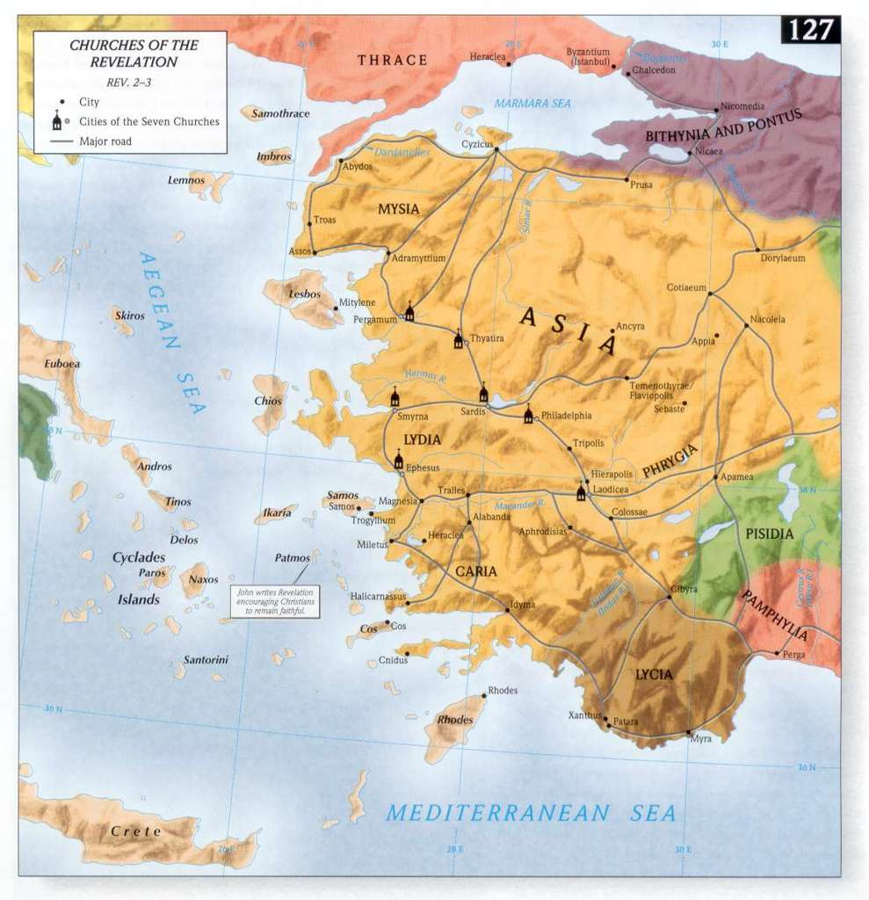

Slide 11
Rev 1: 5 we are washed in the Lifes/blood of the Great High priest, to become kings and priests
Rev 1:7 and they which pierced him (Zech 12:10)
John 18:2,12,13,14
Judas = (OT) Judah - Praise
Annas = (OT) Hananiah – “Yah has favoured” first Rome appointed High Priest of Iduaea
Caiaphas = Aramaic “the dell” appointed by Rome as the High Priest
Rev 1:9 “I John”....for the word of God and the testimony of Jesus Christ
Notes:
Annas [also Ananus^{[1]} or Ananias^{[2]}], son of Seth (23/22 BC–death date unknown, probably around 40CE), was appointed by the Roman legate Quirinius as the first High Priest of the newly formed Roman province of Iudaea in 6 AD; just after the Romans had deposed Archelaus, Ethnarch of Judaea, thereby putting Judaea directly under Roman rule.
Joseph, son of Caiaphas, Hebrew יוסף בַּר קַיָּפָא or Yosef Bar Kayafa, commonly known simply as Caiaphas (Greek: Καϊάφας) in the New Testament, was the Roman-appointed Jewish high priest who is said to have organized the plot to kill Jesus. Caiaphas is also said to have been involved in the Sanhedrin trial of Jesus.^{[1]}
John comes from an old testement name much like Annas the high priest Yehowchanan (yeh-ho-khaw-nawn'); Yahweh-favored;
Jer 28:12-17
12 Then the word of the Lord came unto Jeremiah the prophet, after that Hananiah the prophet had broken the yoke from off the neck of the prophet Jeremiah, saying,
13 Go and tell Hananiah, saying, Thus saith the Lord; Thou hast broken the yokes of wood; but thou shalt make for them yokes of iron.
14 For thus saith the Lord of hosts, the God of Israel; I have put a yoke of iron upon the neck of all these nations, that they may serve Nebuchadnezzar king of Babylon; and they shall serve him: and I have given him the beasts of the field also.
15 Then said the prophet Jeremiah unto Hananiah the prophet, Hear now, Hananiah; The Lord hath not sent thee; but thou makest this people to trust in a lie.
16 Therefore thus saith the Lord; Behold, I will cast thee from off the face of the earth: this year thou shalt die, because thou hast taught rebellion against the Lord.
17 So Hananiah the prophet died the same year in the seventh month.
Rev1:9 The son of Thunder, the outspokeness of John has landed him in exile

Slide 12
Matt 6:9-13 9 After this manner therefore pray ye: Our Father which art in heaven, Hallowed be thy name. 10 Thy kingdom come. Thy will be done in earth, as it is in heaven. 11 Give us this day our daily bread.
12 And forgive us our debts, as we forgive our debtors.13 And lead us not into temptation, but deliver us from evil: For thine is the kingdom, and the power, and the glory, for ever. Amen.
Rev 1:10 I was in the Spirit on the Lord’s day
Rev 1: 17 “I fell at his feet as dead, he laid his right hand upon me...”Fear not”
Matt 25:33-34
33 And he shall set the sheep on his right hand, but the goats on the left.
34 Then shall the King say unto them on his right hand, Come, ye blessed of my Father, inherit the kingdom prepared for you from the foundation of the world:
Notes:
Luke’s record says teach us to pray like John the Baptist
There are those that will not experience death until they see “the day”
Matt 20:21 And he said unto her, What wilt thou? She saith unto him, Grant that these my two sons may sit, the one on thy right hand, and the other on the left, in thy kingdom.
Matt 20:23 And he saith unto them, Ye shall drink indeed of my cup, and be baptized with the baptism that I am baptized with: but to sit on my right hand, and on my left, is not mine to give, but it shall be given to them for whom it is prepared of my Father.
Matt 25:40 And the King shall answer and say unto them, Verily I say unto you, Inasmuch as ye have done it unto one of the least of these my brethren, ye have done it unto me.

Slide 13
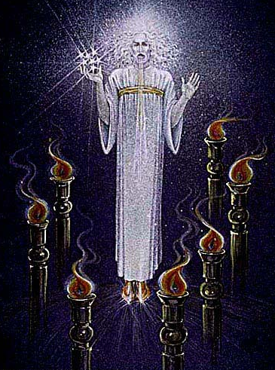
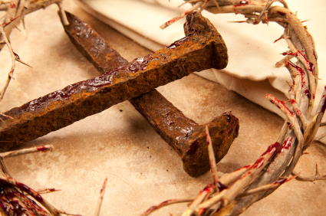
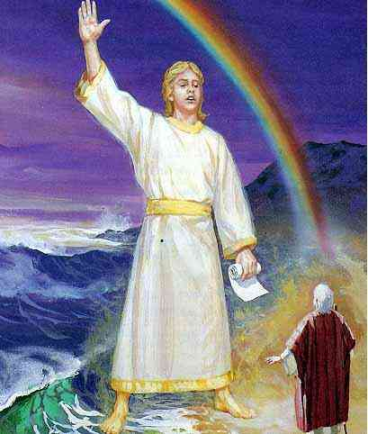
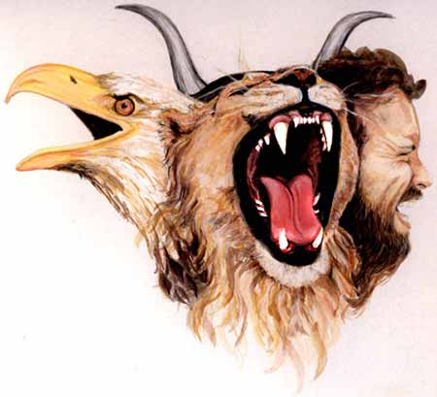
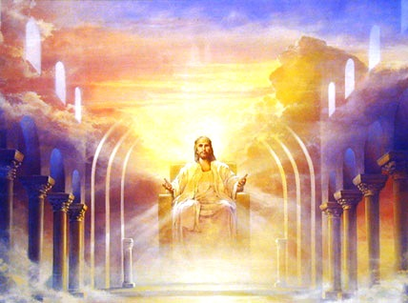
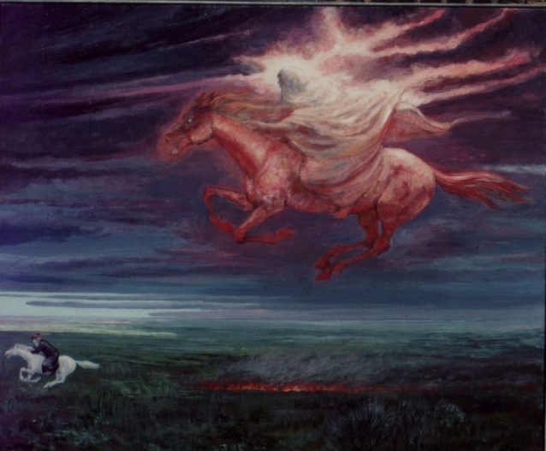
Notes:
We must remember that imprinted on the mind of our Brother is the nails, the crown, the stake, the weeping aunty Mary that had been pierced also
-John is about to be exposed to things that would astound and mystify him

Slide 14
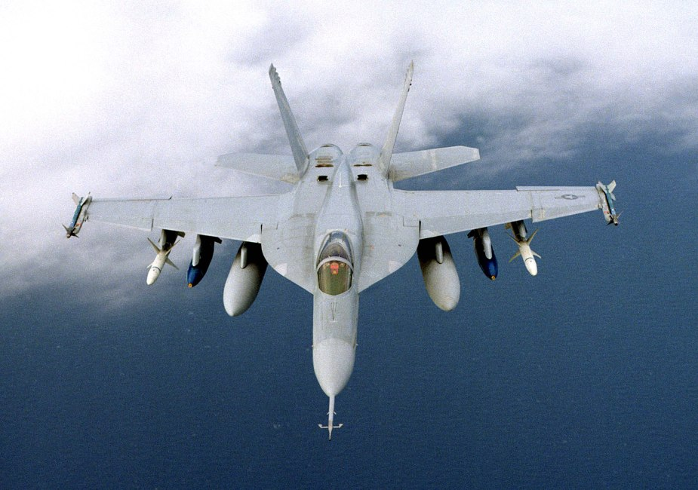
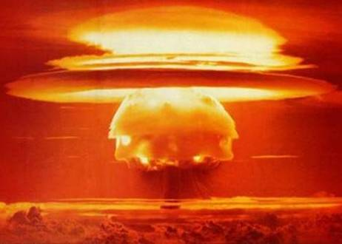
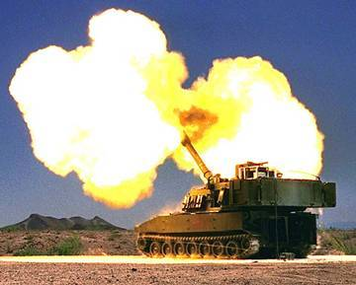
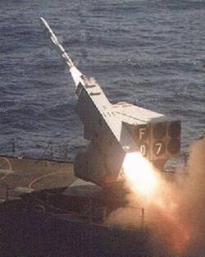
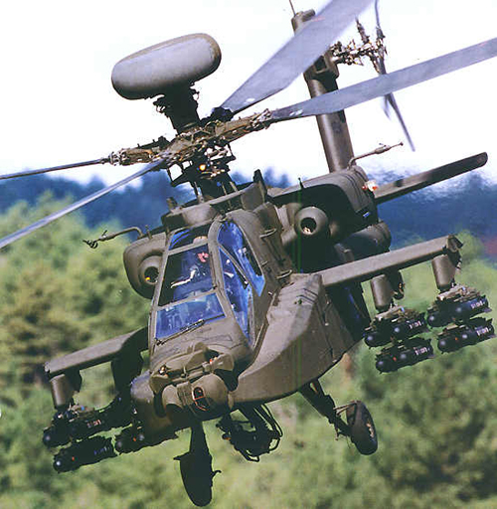
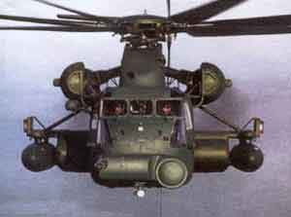
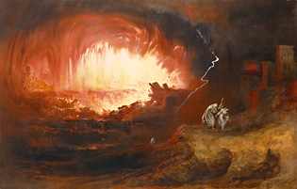
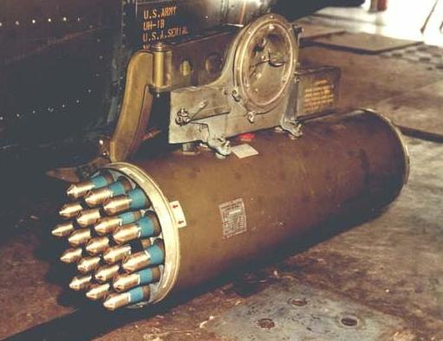
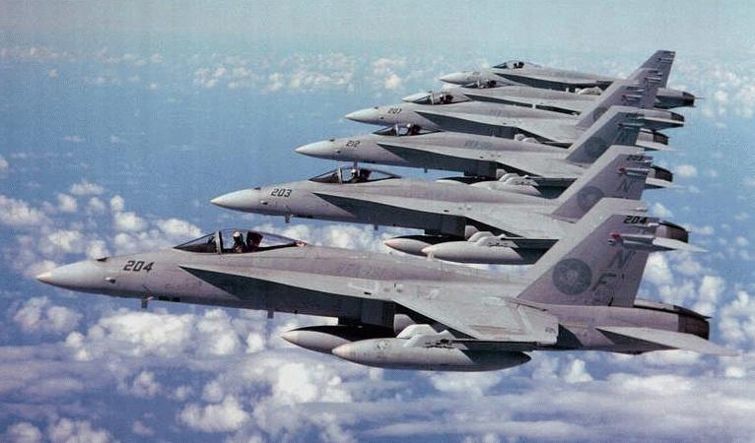

Slide 15
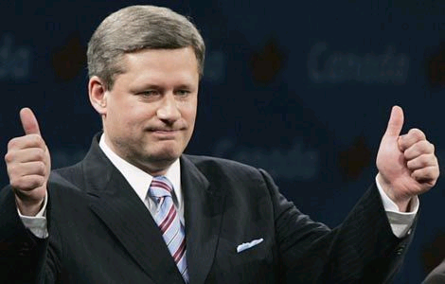
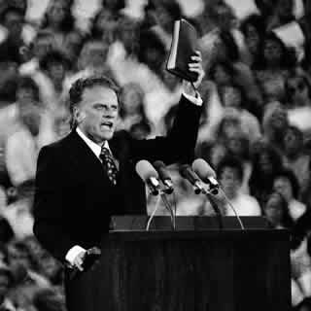
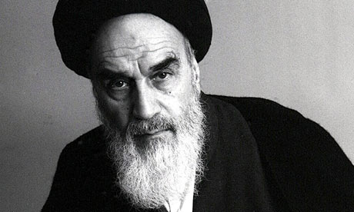
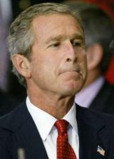
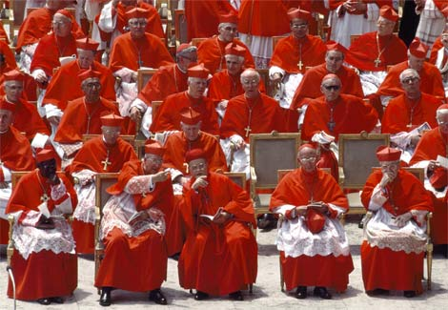

Slide 16
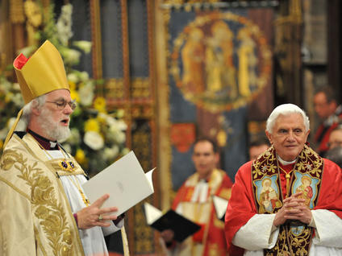
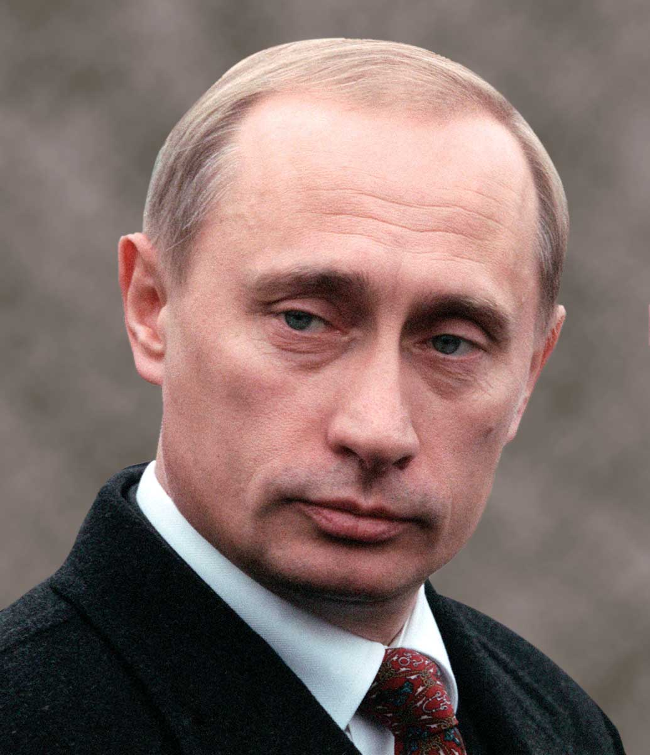
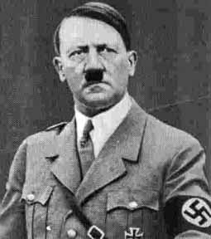
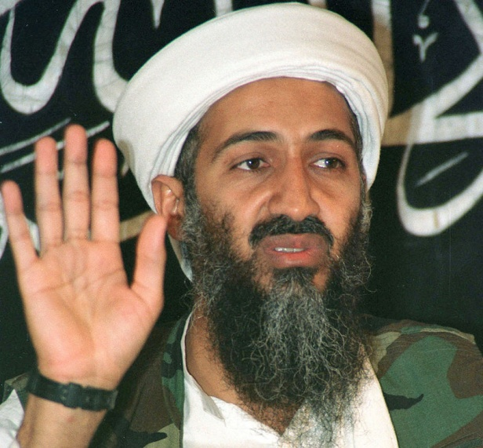
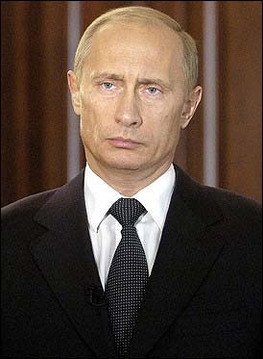
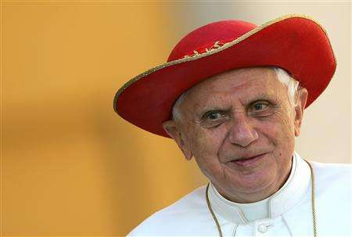

Slide 17
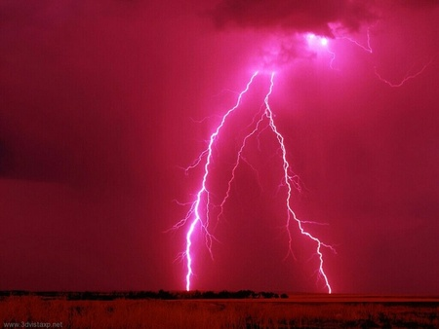
Rev 4:5 And out of the throne proceeded lightnings and thunderings
Rev 6:1 And I saw when the Lamb opened one of the seals, and I heard, as it were the noise of thunder, one of the four beasts saying, Come and see.
Rev 8:5 And the angel took the censer, ... and there were voices, and thunderings, and lightnings, and an earthquake.
Rev 10:3 And cried with a loud voice, as when a lion roareth: and when he had cried, seven thunders uttered their voices. V4 the seven thunders x2
Rev 11:19 And the temple of God was opened in heaven, and there was seen in his temple the ark of his testament: and there were lightnings, and voices, and thunderings, and an earthquake, and great hail.
Rev 14:2 And I heard a voice from heaven, as the voice of many waters, and as the voice of a great thunder: and I heard the voice of harpers harping with their harps:
Rev 16:18 And there were voices, and thunders, and lightnings; and there was a great earthquake, such as was not since men were upon the earth, so mighty an earthquake, and so great.
Notes:
His involvement
Rev 5:4 “I wept much”
Only John records “The Lamb of God” used 27 times in the Apocalypse
John 1:29 The next day John seeth Jesus coming unto him, and saith, Behold the Lamb of God, which taketh away the sin of the world.
Rev 5:6 a Lamb as it had been slain – engrained in his mind the king hanging on a tree, like we cannot imagine
Rev 5:10 ...made us kings and priests...
Rev 6:9 I saw under the alter the souls of them that were slain for the word of God...
Rev 10:1-7 7 thunders, v9 give me the little book...v10 I ate it
Rev 14:1 Holiness to Yahweh in thier Foreheads (Priests) v12 here is the patience of the Saints...and keep the commandments...rest from their labors
Then there is a great voice of much people in heaven
Rev 19:2 true and righteous are his judgements...avenged the blood of his servants at her hand
Overcome with the whole thing
Rev 19:10 “I fell at his feet... I am thy fellow servant and of thy brethren”
Matt 24:30-31
30 And then shall appear the sign of the Son of man in heaven: and then shall all the tribes of the earth mourn, and they shall see the Son of man coming in the clouds of heaven with power and great glory.
31 And he shall send his angels with a great sound of a trumpet, and they shall gather together his elect from the four winds, from one end of heaven to the other.
Rev 19:11-16 the King of Kings and Lord of Lords coming with the clouds of heaven
Rev 20:4 the souls of them that were beheaded....John the Baptist???
Rev 21:3 he shall dwell with them and they shall be his people and God himself shall be with them and be their God.
Rev 22:16 I Jesus have sent mine Angel....
Rev 22:17 Come Come Come v22 even so come Lord Jesus. Amen

Slide 18
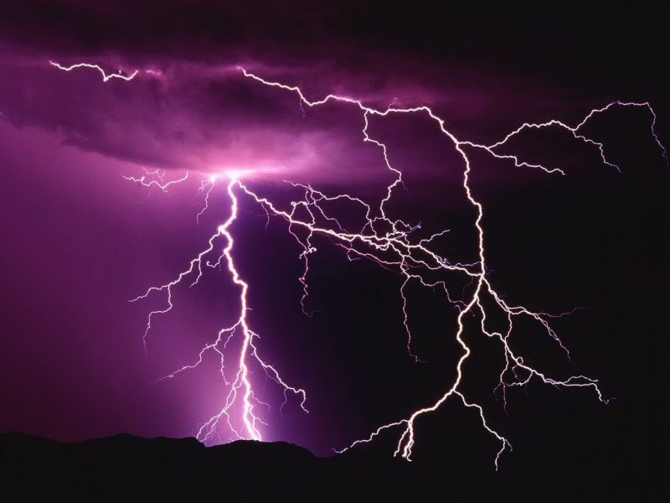
Luke 17:24 For as the lightning, that lighteneth out of the one part under heaven, shineth unto the other part under heaven; so shall also the Son of man be in his day.

Slide 19
Rev 19:5-8
And a voice came out of the throne, saying, Praise our God, all ye his servants, and ye that fear him, both small and great. And I heard as it were the voice of a great multitude, and as the voice of many waters, and as the voice of mighty thunderings, saying, Alleluia: for the Lord God omnipotent reigneth. Let us be glad and rejoice, and give honour to him: for the marriage of the Lamb is come, and his wife hath made herself ready. And to her was granted that she should be arrayed in fine linen, clean and white: for the fine linen is the righteousness of saints.

Slide 20
Blessed be the Lord God of Israel; for he hath visited and redeemed his people,
And hath raised up an horn of salvation for us in the house of his servant David;
As he spake by the mouth of his holy prophets, which have been since the world began:
That we should be saved from our enemies, and from the hand of all that hate us;
To perform the mercy promised to our fathers, and to remember his holy covenant;
The oath which he sware to our father Abraham,
That he would grant unto us, that we being delivered out of the hand of our enemies might serve him without fear,
In holiness and righteousness before him, all the days of our life.

