Slide 1
“Gibeah of Saul”
Study 2
“Saul of Gibeah”

Slide 2
Gibeah in Scripture
Gibeah simply means "hill".
The name is used 48 times in the O.T. - 1st occ. Josh. 15:57 is of a town in southern Judah (not Benjamin).
Occurs 24 times in Judges 19 and 20.
Mentioned 12 times in the life of Saul.
The Gibeah of 2 Sam. 6:3-4 is a hill near Kirjath-jearim, not Gibeah of Saul.
Home of one of David's mighty men - 2 Sam. 23:29; 1 Chron. 11:31.
Think Gibeah. Think covenants, vows and oaths!

Slide 3
Gibeah
"Gibeah of Saul" occurs 4 times in O.T. - 1 Sam. 11:4; 15:34; 2 Sam. 21:6; Isa. 10:29.
"Gibeah of Benjamin" occurs 5 times - Judges 20:10; 1 Sam. 13:2,15,16; 14:16.
"Gibeah of the children of Benjamin" - 2 Sam. 23:29.
Gibeah is in many ways a microcosm of Israel

Slide 4
Rejection of aged leaders
The attitude of Israel towards Samuel after his many years of faithful leadership was a reflection of their fleshly reasoning. When demanding an earthly king, they dismissed Samuel, and his importance to the nation, with a few cold, callous words: “Behold, thou art old...” (1 Sam. 8:5). Their respect for his age and wisdom, his devotion to the cause of Yahweh and the people, had disappeared from their minds with contemptuous disdain. Did it matter that he was old? Did that mean that his influence should be removed? Was he being cast aside because he had proven unworthy?
HPM Logos Vol. 55 pg. 48

Slide 5
The origins of Saul of Gibeah
1 Sam. 9:1 – “Now there was a man of Benjamin, whose name was Kish, the son of Abiel, the son of Zeror, the son of Bechorath, the son of Aphiah, a Benjamite, a mighty man of power.”
V. 1 - "man" - ish - great man.
"Benjamin" - "son of the right hand".
"Kish" - "bent" (BDB); "hard; difficult; straw; for age" (Hitchcock); "a bow" (Strong).

Slide 6
The origins of Saul of Gibeah
V.1 - "Abiel" - "El (God) is (my) father". Abiel here is Jehiel of 1 Chron. 9:35 - the founder of Gibeon. (Barnes thinks Gibeon and Gibeah are one and the same.)
"Zeror" - "a parcel (as packed up)".
"Bechorath" - "first-born".
"Aphiah" - "I will make to breathe".
"mighty man" - gibbor - powerful warrior.
V.2 - "Saul" - "desired" (BDB); "asked" (Strong); "asked for" (Easton) – v.20.
Possesses all the credentials for a king from a human perspective

Slide 7
Saul of Gibeah
Was his ancestral mother one of the 400 virgins of Jabesh-gilead?
There is a 2 in 3 chance that is so!
Implicit proof lies in Saul's first decisive act as king of Israel - 1 Sam. 11:1-7.
Why did Saul hew a yoke of oxen into 12 pieces and send them to each tribe?
Consider too the numbers - 400 and then 200 - David pursued by Saul first had 400 men, and then 200 more = 600.

Slide 8
All Israel called
1 Sam. 11:1-7
All Israel called to save the town of Jabesh-gilead from Nahash the Ammonite.
Saul divided two yoke of oxen into 12 pieces and sent them to each tribe with an ultimatum. Where did he get that from - not being a Bible student?
Jabesh-gilead
Gibeah

Slide 9
Our first sight of Saul
1 Sam. 9:3-14
V.3 - "asses" - athon - she asses. Represents the multitude of Israel.
"were lost" - abad - stray, be lost; perish, destroyed. The ISA translates - "and they-are-being-lost".
V.4 - "Ephraim" - "double fruit".
"Shalisha" - "third"; "trebled".
"Shalim" - "foxes".
V.5 - "Zuph" - "honeycomb". Near Ramah - Samuel's home.

Slide 10
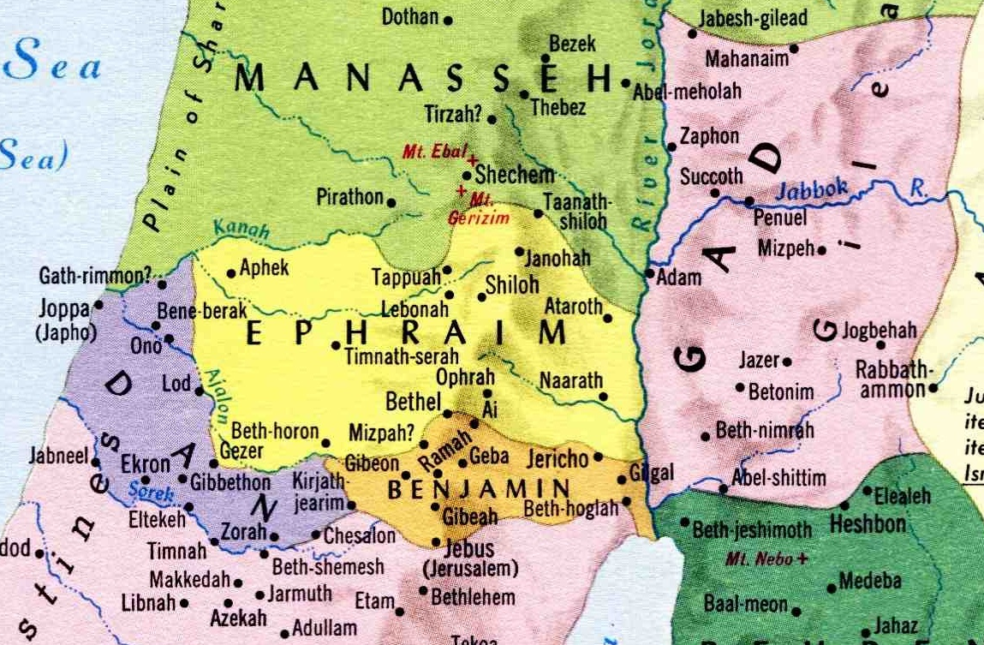
Saul's vain search for the asses
Like all men Saul was just “passing through” – he did not find the lost asses (symbol for the multitude of Israel) nor was he to succeed as king because of half measures and broken promises. His failure is a cameo of far too many who came after him!
...

Slide 11
Our first sight of Saul
1 Sam. 9:5-14
V.5 - "take thought" - da'ag - become anxious.
V.6 - "honourable" - kabed - heavy, weighty; hence honourable.
"way" - derek - a road (as trodden); figuratively a course of life or mode of action – V.8.
"we should go" - halak - walk.
V.7 – “what shall we bring” – Judaistic spirit.

Slide 12
Our first sight of Saul
1 Sam. 9:7-14
V.7 - "the bread (food) is spent in our vessels" - Cp. principle Matt. 25:1-13.
"present" - teshurah (only occ.) - gift.
V.8 - "fourth part of a shekel of silver" - Silver is the symbol for redemption. Under the Law every Israelite had to pay a "half shekel of the sanctuary" at census - Ex. 30:13-15.
V.10 - "Well said" - Saul agrees with the proposal to offer 'half price'.

Slide 13
Our first sight of Saul
1 Sam. 9:13-14
V.13 - "for the people will not eat until he come" - This was an object lesson for Saul. He was to continue to do things in half measures - see his first failure - 1 Sam. 13:8-10.
Samuel arrived (V.14) to bless the sacrifice – Saul saw it with his own eyes! Would Samuel fail to keep his promise to Saul? – 1 Sam. 10:8.

Slide 14
1st encounter - Samuel and Saul
1 Sam. 9:15 - "in his ear" - So it must be with leaders in Israel - Isa. 50:4-5.
V.16 - "anoint" - mashach (the root of mashiyach - "Messiah") - to smear, anoint with oil (the Word).
"captain" - nagiyd - leader, ruler, captain, prince. Title of Christ - Isa. 55:4.
"save" - yasha (part of the name Joshua) - to save, deliver.
"Philistines" - "rollers in the dust" = the flesh (uncircumcised).

Slide 15
The Divine plan for Saul
V.17 - "reign" - atsar - to inclose, restrain. ISA has "he shall steer". Roth. - "Here, is one shall control my people."
V.18 - "Then Saul drew near to Samuel" - But did not recognise him! A telling fact.
V.20 - "three days" - Saul failed to find ('save') the asses - contrast Israel's true 'captain' - Luke 13:32-33.
"desire" - chemdah - delight; that which is desirable. "one coveted" (ISA). See use of Christ - Haggai 2:7.

Slide 16
The desire of Israel prepared
V.24 - "shoulder" - shoq - leg, thigh. Used of the right shoulder - the priest's portion of the offerings.
V.25 - "communed" - dabar (the Word).
"the top of the house" - The place of prayer and meditation.
V.26 - “arose early" - 'Resurrection' to a newness of life.
"spring" - alah - to ascend. 1st occ. Gen. 2:6.
"both of them" - Key to Saul's success.

Slide 17
The final key for success
V.27 - "stand thou still" - amad - to stand. There are times when faced with bearing great responsibilities there is a need to stand still and learn - Deut. 5:31.
"that I may shew thee the word (dabar) of God" - Roth. - "that I may let thee hear the word of God."
He who could not find his father's lost asses was unlikely to find and successfully lead "the lost sheep of the house of Israel"

Slide 18
The failure of Saul's leadership
Saul was a failure as a leader in Israel. Spiritually uneducated and inept, he proved inadequate for any purpose, save his own. Like so many who had gone before him during those dark centuries of Israel’s struggle for survival, his downfall was inevitable because he “transgressed…against the Word of Yahweh” (1 Chron. 10:13).
HPM Logos Vol. 55 pg. 48

Slide 19
Next Study
(God willing)
Study 3 – “Seven days shalt thou tarry”

Slide 20
…
...

