Slide 1
“Gibeah of Saul”
Study 2
“We have no king”

Slide 2
Saul lost his kingdom and eternal life for breaking covenants
But what about us?
Baptism is a vow of commitment and service to God and of espousal to Christ – 2 Cor. 11:2; Rom. 7:1-4

Slide 3
Israel’s record of failure
Ezek. 16:59 – “For thus saith the Lord GOD; I will even deal with thee as thou hast done, which hast despised the oath in breaking the covenant.”
Ezek. 17:15 – “…shall he break the covenant, and be delivered?”
Jer. 11:10 – “…the house of Israel and the house of Judah have broken my covenant which I made with their fathers.”

Slide 4
God’s character
Dan. 9:4 – “O Lord, the great and dreadful God, keeping the covenant and mercy to them that love him, and to them that keep his commandments.”
Neh. 9:32 – “Now therefore, our God, the great, the mighty, and the terrible God, who keepest covenant and mercy…”
Ps. 89:34 – “My covenant will I not break, nor alter the thing that is gone out of my lips.”

Slide 5
The hill of God and vows
“Gibeah” - gibah – Strong’s number 1390 – signifies “hill”.
1st occ. Gen.49:26 – “the everlasting hills” – context Joseph as type of Christ – the first Nazarite – making of vows!
Next occ. Ex. 17:9-10 – Context Yahweh’s vow to destroy Amalek = serpent.
Ps. 65:12 – “the little hills (gibah) rejoice” – Context V.1 – “unto thee shall the vow be performed”.

Slide 6
Gibeah in Hosea
Hos. 5:8 - Mentioned as a station of the invader of the Land who has already swallowed up Israel and is now in Benjamin on his way to Judah.
Hos. 9:9 - The corruption of ancient Gibeah cause of Divine judgement.
Hos. 10:9 - The lesson of Gibeah of old not heeded.

Slide 7
Covenant in Hosea
Hos. 2:18 - Israel brought into the bonds of the covenant via the Second Exodus.
Hos. 6:7 - Treacherous attitude to covenant-keeping source of Yahweh's anger.
Hos. 8:1 - Call for judgement based on transgression of the covenant.
Hos. 10:4 - Swearing falsely in making a covenant reason for judgement.
Hos. 12:1 - Israel's covenant with Assyria.

Slide 8
Dethroning Yahweh in the Heart
It is not difficult for the people of God to dethrone Him in their hearts. It requires only a relatively simple transition. Let leaders fail to lead, as Yahweh would have them do; let people become disinterested in sound knowledge, contenting their consciences with “a form of Godliness” untroubled by the demands of true worship; ……….
HPM Logos Vol. 55 pg. 48

Slide 9
Dethroning Yahweh in the Heart
…let self-interest replace love of God; let expediency of the moment displace obedience to God’s Word — let these weaknesses develop within a community of professing believers, and their hold upon Yahweh’s Truth will become loosened and lost despite any protestations they may make to the contrary.
HPM Logos Vol. 55 pg. 48

Slide 10
Gibeah and Christ
Hos. 10:8 is cited by Christ on the way to Golgotha - Luke 23:30.
Hos. 10:9 – “O Israel, thou hast sinned from the days of Gibeah…”
The context of Hos. 10 is apposite:
  V. 3 - "We have no king…" - Cp. John 19:15 – “The chief priests answered, We have no king but Caesar.”
  V. 8 - "thorn and thistle" - Cp. John 19:2,5 – “…the soldiers platted a crown of thorns...”

Slide 11
The ultimate repudiation
John 19:15
“We have no king but Caesar.”
These words, uttered by the chief priests, are very significant. These chief representatives of the theocratic government of Israel thus formally and expressly renounce it, and declare their allegiance to a temporal and pagan power. This utterance is “the formal abdication of the Messianic hope.”
Vincent’s Word Studies

Slide 12
Gibeah and Christ
Hos. 9:9 – “They have deeply corrupted themselves as in the days of Gibeah.”
Hos. 9:10 – Israel likened to the fruit of the vine and fig tree. Cp. Luke 13:6-7 – “a fig tree planted in his vineyard.”
Hos. 9:12,14,16 – “Though they bring up their children, yet will I bereave them.” Cp. Christ’s warning - Luke 23:28-29 – “...weep for yourselves and your children.... Blessed are the barren, and the wombs that never bare...”

Slide 13
Gibeah and Christ
Hos. 9:16 – “...their root is dried up, they shall bear no fruit...” Cp. Luke 23:31 – “For if they do these things in a green tree, what shall be done in the dry?”
The Future - Hos. 14:6-8 – “Ephraim shall say, What have I to do any more with idols? I have heard him, and observed him: I am like a green fir tree.” The day of Israel’s redemption will come.

Slide 14
Israel of the future
Jer. 50:5 – “They shall ask the way to Zion with their faces thitherward, saying, Come, and let us join ourselves to the LORD in a perpetual covenant that shall not be forgotten.”
Ezek. 20:37 – “And I will cause you to pass under the rod, and I will bring you into the bond of the covenant.”

Slide 15
Marriage vows - Hymn 429
1. Maker of all things, we earnestly pray:
Please bless these, Thy children, who promise today
To spend life together and faithful remain
Until death shall part them, or Christ comes again.
5. As we now witness the vows they both make,
We pray for Thy care on the road that they take;
So grant them Thy blessing, O Lord God above,
And bind them together in faith, hope and love.
Will Yahweh treat broken marriage vows differently to Saul’s broken vows?

Slide 16
Psalm 15 - A Psalm of David
LORD, who shall abide in thy tabernacle? who shall dwell in thy holy hill?
He that walketh uprightly, and worketh righteousness, and speaketh the truth in his heart.
He that backbiteth not with his tongue, nor doeth evil to his neighbour, nor taketh up a reproach against his neighbour.
In whose eyes a vile person is contemned; but he honoureth them that fear the LORD. He that sweareth to his own hurt, and changeth not.
He that putteth not out his money to usury, nor taketh reward against the innocent. He that doeth these things shall never be moved.

Slide 17
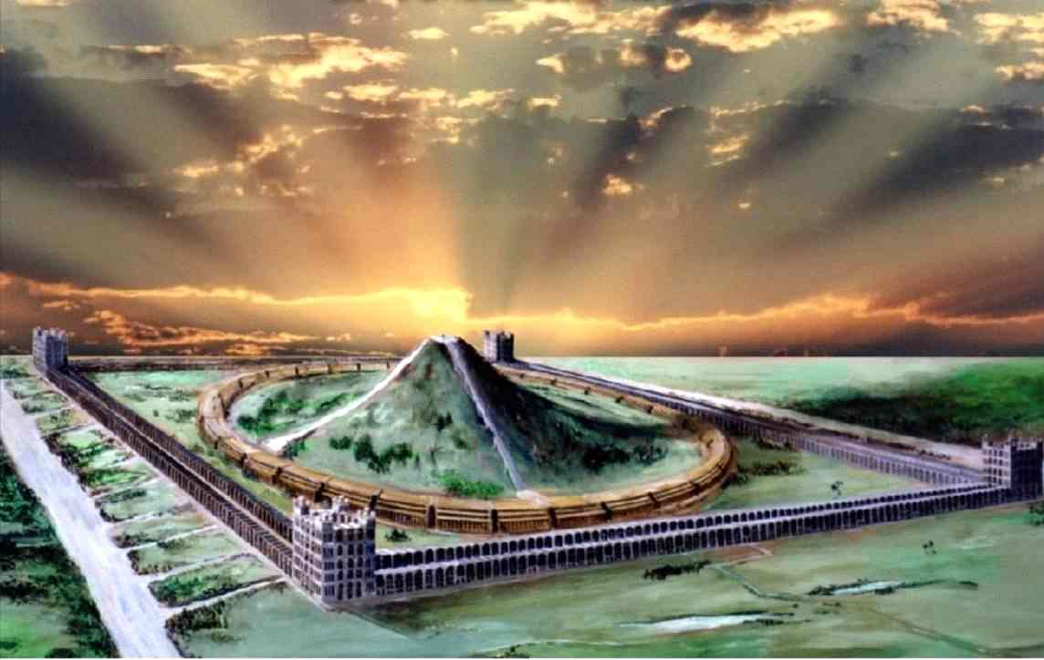
“Who shall dwell in thy holy hill?”
…
He that sweareth to his own hurt, and changeth not.

Slide 18
Gibeah of Saul
Keep covenant
Fulfil unto Yahweh your vows
Let your Yea be Yea! And your Nay be Nay!

